Slide 1

Quality control in agricultural labs
Kristin Hicks
NCDA Agronomic division

Slide 2
Quality control overview
QA QC Introduction
Acceptance Criteria
Common Statistical Tests
Calibration
Continuing Calibration and Independent Calibration
Blanks: Calibration and Method Blank
Duplicates
Spiked Blanks
Matrix Spikes

Slide 3
Challenges
Agricultural labs analyze a wide range of matrices…
  Soil, plant tissue, water/nutrient solutions, manure/compost, soilless media
Using a wide range of tests/methods…
  ICP-OES, N, NO2, NO3, PO4, WEP, solids, bulk density, NH4, Cl, EC, pH, OM, C, alkalinity, CCE
Across many independent labs…
Without clear, uniform guidelines

Slide 4
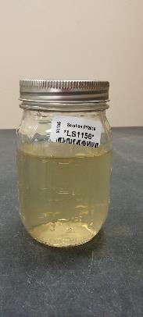

Factors that affect Data quality
Outside the lab
  Representative sample collection
  Sample “holding” time
  Sample transfer conditions
Inside the lab
  Education/training of staff
  Sample storage & processing
  Sample analysis (equipment, QC)
  Results and reporting
Notes:
Education of clients
Storage is less important for soil but very important for other matrices

Slide 5

Quality Assurance vs. Quality Control
Quality assurance: Overall management program that ensures that the final results reported are correct
  Pre-analysis: sample receiving, storage and handling, labeling, proficiency testing, training, SOPs
  Analysis: quality control testing
  Post-analysis: record keeping, reporting, interpretation, documentation
Notes:
Quality assurance is concerned with the big picture, that the right method is performed on the right sample and given the right interpretation and delivered to the right person.
Today, we are focused on quality control
Proficiency testing is a challenge to the QA and QC programs

Slide 6
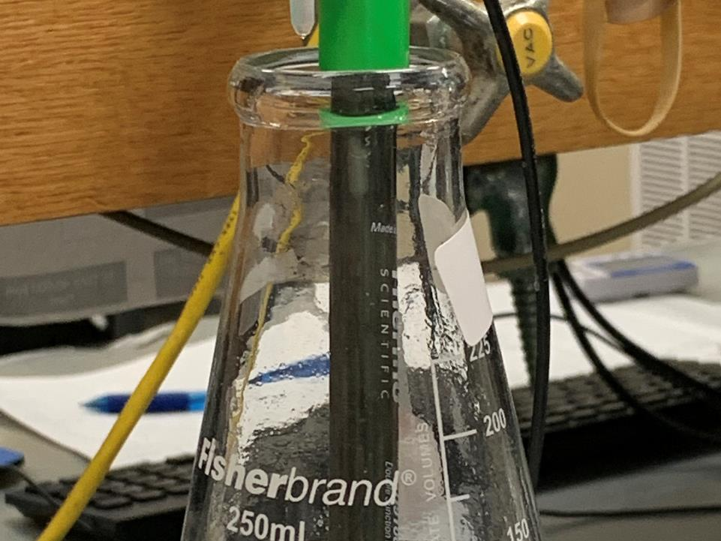
What is quality control?
The checks that must be included during each test to verify that the test is performing properly
The statistical approaches and acceptance criteria used to evaluate the performance of the analytical process

Slide 7
Types of analytical error
Random
Systematic
Difficult to predict or prevent with QC
Ex: pipetting errors (e.g. double), data input (e.g. decimal place), labeling, equipment malfunction
Solution: training
Remains constant under repeated measurements, preventable
Ex: Reagent contamination or recipe error, equipment misfunction
Solution: QC checks for accuracy and precision

Slide 8
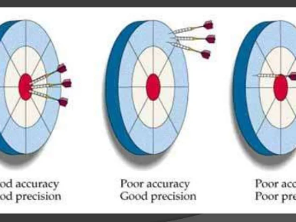
Accuracy vs. precision
Accuracy: How well a measured value agrees with a known value
Precision: How well a series of measurements agree with each other

Slide 9
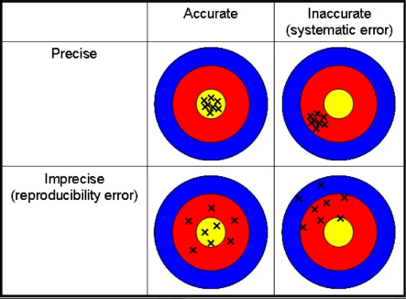
Imprecise or inaccurate?
Imprecision: large scatter around the mean, usually caused by errors in technique (e.g. poor homogenization, weighing, digestion, extraction)
Inaccuracy: seen as a trend or shift; usually caused by a change in the testing procedure (e.g. new reagent, recipe error, contamination)

Slide 10
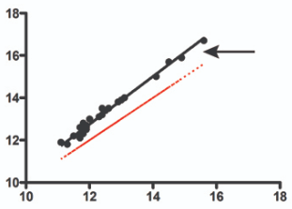
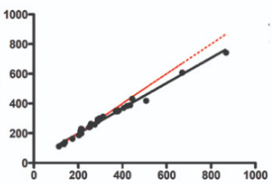
Accuracy and Bias
Accuracy
Ex: Positive Constant Bias
Difference between the true and measured value is known as the BIAS and can be:
  Constant bias: Consistently positive or negative. Can be ascertained from the regression curve.
  Random bias: Sometimes positive or negative
  Proportional bias: Bias is proportional (negative or positive) to the concentration of the analyte. Can also be ascertained from the regression curve
QCs that measure Accuracy are:
  Calibration, CCV, ICV, Spiked Blanks, Matrix Spike, Reference material
Ex: Negative Proportional Bias

Slide 11
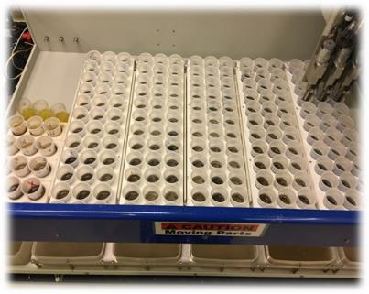
Precision
Precision
Precision is a measure of agreement among replicate measurements of the same sample under the same conditions (i.e., reproducibility, repeatability).
Within batch precision: Determined by measuring the same sample more than once in the same batch
Between batch precision: Determined by measuring the same sample on different days or with different instruments or different operators. Usually less precise than within run precision.
QCs that measure precision: duplicates

Slide 12
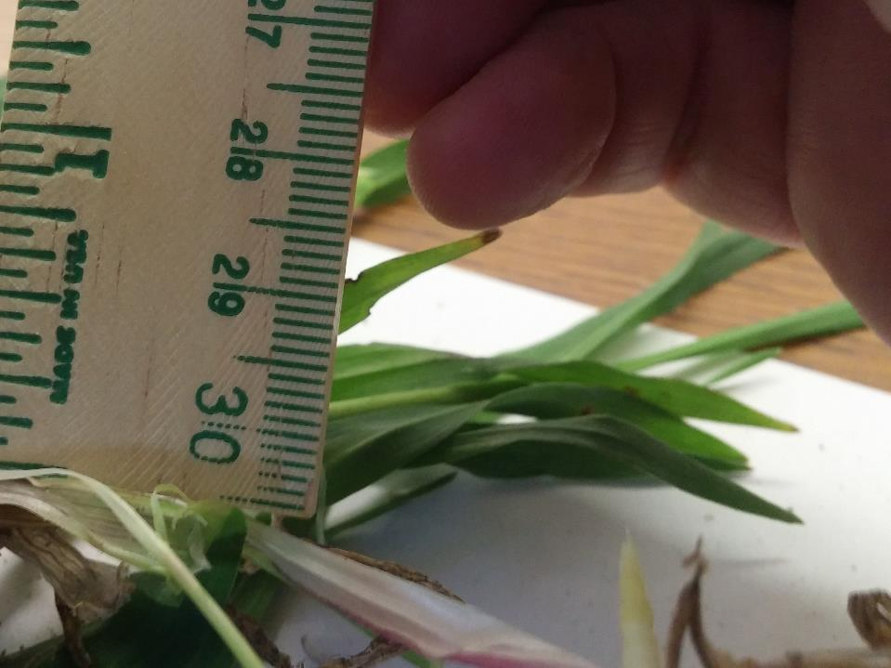
Acceptance criteria
Second part of QC checks is establishing what is an acceptable result.
What constitutes reasonable accuracy and precision is challenging to define.
  A confidence measure for some analytes may be ±15%, while for others, ±30% may be reasonable.
  Rely on regulatory methods, scientific literature, historical lab performance and analyst experience.
  DOCUMENT

Slide 13
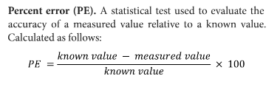
statistical tests
Accuracy
Percent error (PE). A statistical test used to evaluate the accuracy of a measured value relative to a known value.
Used in CCV, ICV, RM

Slide 14
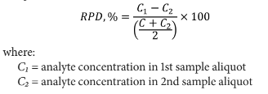
statistical tests
Precision
Relative percent difference (RPD). Used to calculate the precision or random error between duplicate measurements.
Defined as the absolute difference between two values divided by their mean, expressed as a percent
Duplicates

Slide 15
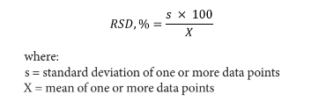
statistical tests
Precision
Relative standard deviation (RSD). The ratio of the standard deviation to the mean, expressed as a percent. It provides a normalized expression of precision between multiple measurements
Used to develop acceptance criteria for internal reference or in evaluating acceptance for analytes at low concentrations.
Also known as the Coefficient of Variation (CV).

Slide 16
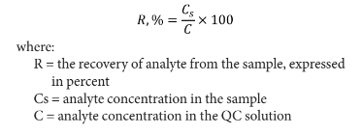
statistical tests
Accuracy
Recovery, %: A statistical test used to measure accuracy
Spiked blanks, matrix spikes

Slide 17
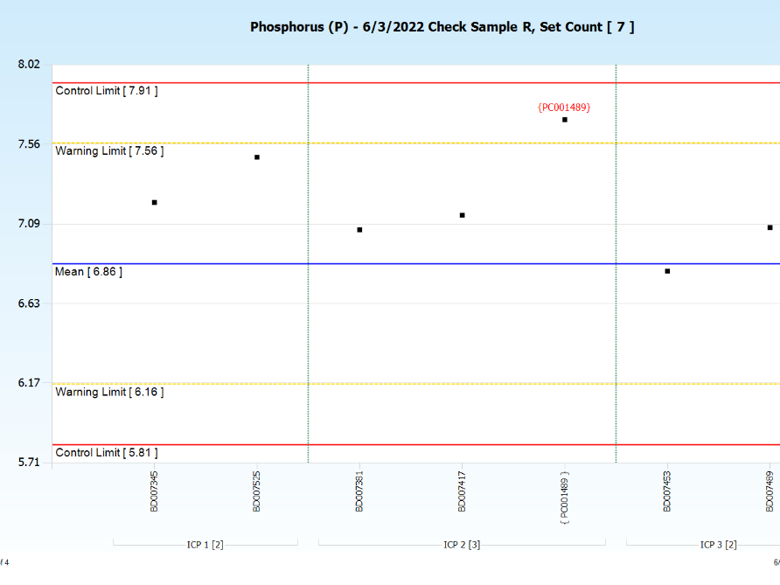
Control Charts
A graph of the quality control test data with warning and control limits.
Shows bias, trends and predicts future precision.
Use statistical test (std dev) to visually track outliers.

Slide 18
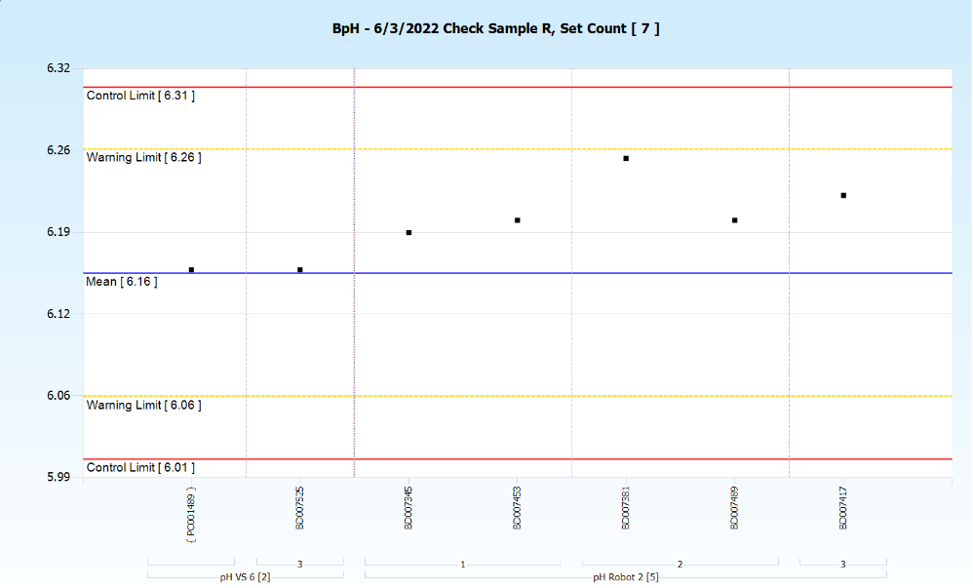

Slide 19
QUALITY CONTROL COMPONENTS

Slide 20
calibration
Accuracy
Essential first step in all analyses
Some methods don’t require daily calibration but most do. Instruments sensitive to drift or require high sensitivity should be calibrated daily. Otherwise, validate calibration with standards.
For linear regression, r² ≠ r. For most methods, the correlation coefficient r should be > 0.995 or r^{2 >}0.990.

Slide 21
Calibration
Accuracy
A high correlation can be obtained with significant scatter– check visually for imprecision.
Do not drop standards to achieve high correlation
Number of standards to use varies but for most instruments should be at least 5. Use more when using higher order non-linear regression.

Slide 22
Calibration
Accuracy
Deviation from linearity is usually related to concentration at both the lower and the upper end.
If you identify non-linearity, reduce the calibration range
All unknown measurements should fall within the range of the calibration standards

Slide 23
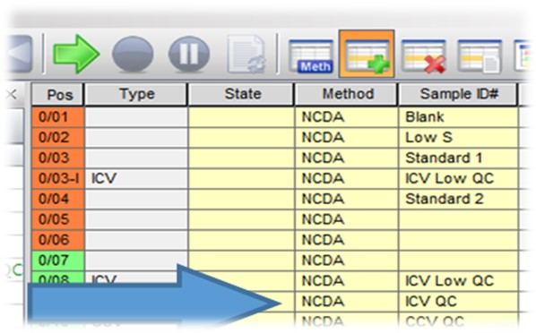
Ccv and icv
Accuracy
Continuing Calibration Verification (CCV) is a calibration standard or reference material used in the initial calibration. Analyzed to validate the ongoing calibration during the run. Also known as the calibration verification solution or instrument performance check.
Independent Calibration Verification (ICV) is used to detect contamination or other errors that affect the accuracy of the calibration standards. The ICV is prepared from a source other than the one from which the calibration standards are prepared. Also known as an initial calibration verification solution.
Most methods should include both and two concentration points better than one.
Acceptance criteria: PE ~<10%

Slide 24
Reference material
Accuracy
Critical QC component of every method
Used as an independent measure of accuracy, frequently called “check” samples, should be included with each batch (or more).
A Certified, Standard or Internal material with a matrix similar to that of materials tested.
Reference material is sufficiently homogeneous and stable with respect to one or more specified properties, which has been established to be fit for its intended use in a measurement process (ISO Guide 30:2015).

Slide 25
Reference material
Accuracy
Certified or standard RM are accompanied by a certificate, one or more of whose property values are accurately determined by a selected laboratory which provides the value of the specified property, and its associated uncertainty. Results should be within specified uncertainty limits.
Can be used for calibration (in some methods), CCV and ICV. Examples: Acetanilide (10.36% N), glutamic acid (9.52% N) and EDTA (9.59% N) Domestic Sludge, (4.78% N). Plant CRMs, e.g. wheat flour, spinach. Reagent grade calcium carbonate (for CCE). $$$ so.
Internal RM often prepared by labs for soil and plant (less so manure, water). The RM should be sufficiently stable and homogeneous for the properties concerned. How to determine? Suitable for use as CCV but not calibration or ICV.

Slide 26
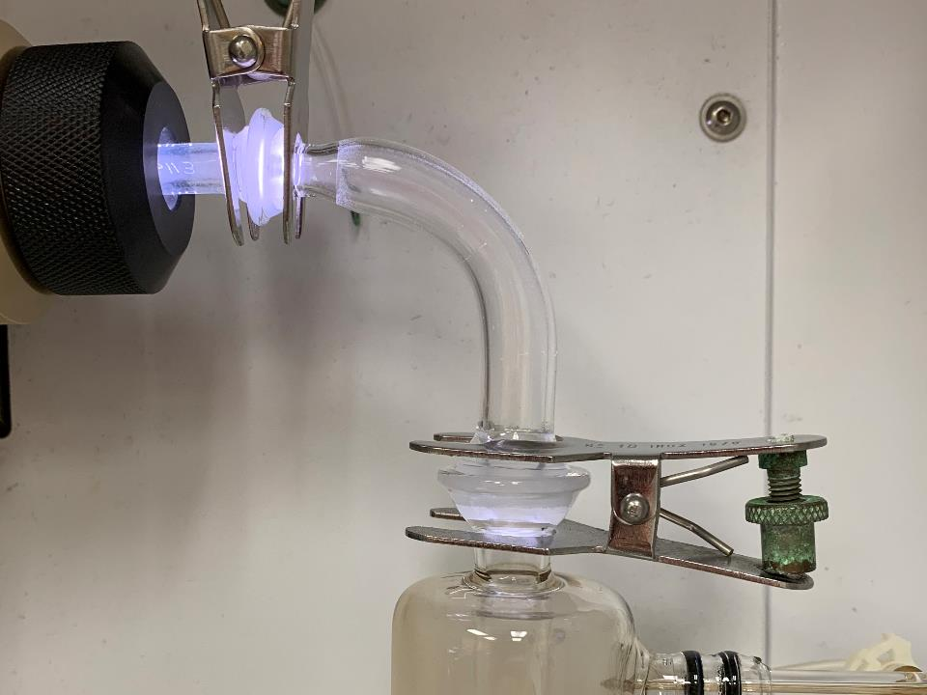
Calibration & Method Blanks
Calibration and method blanks are analyzed to determine background contribution to the measured value and to ensure that the reported values are “true”.
Calibration blank (CB). A zero standard consisting of a volume of reagent water used for initial and continuing calibration of the analytical process. CB should be matrix matched to calibration stds, e.g., for ICP-OES analysis, the CB contains 2-5% nitric acid in reagent water, and for spectrophotometric analysis of NO3-N and NH4-N the CB is matrix matched to the KCl extraction solution.
Concentrations of detected analytes should be below the MDL for each analyte.
Accuracy

Slide 27
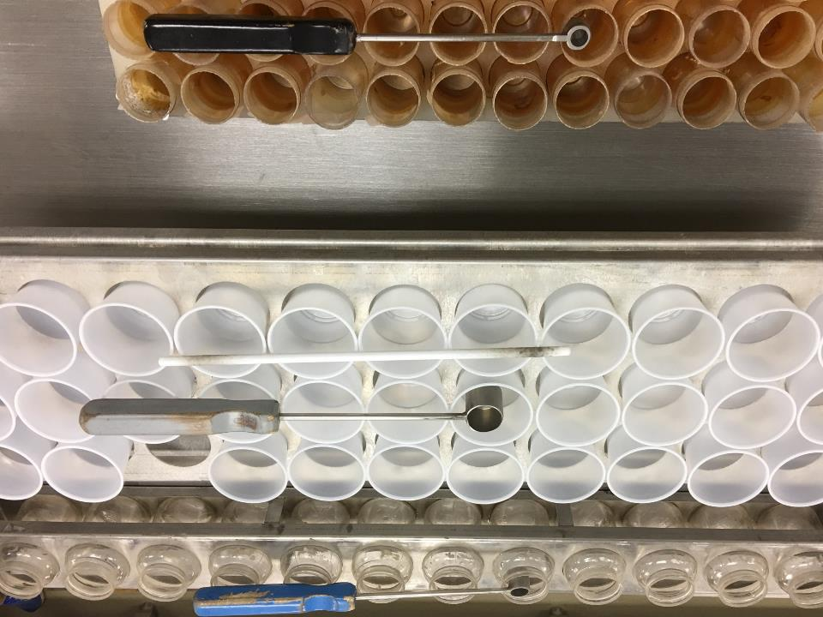
Calibration & method blanks
Method blank (MB). A laboratory sample with a matrix similar to the associated samples (e.g., reagent water, boiling chips, glass beads), and known to be free of the analyte of interest and that is taken through all preparation, digestion and analytical steps in the method. The method blank is used to determine if analytical contamination or other interferences are present in the laboratory environment, reagents, or apparatus.
Concentrations of detected analytes must be below the LOQ or documented historical acceptance limits.

Slide 28
duplicates
Precision
Second aliquot or sub-sample of an unknown sample brought through the entire sample preparation and analytical process and used to evaluate method precision.
Randomly select samples to duplicate, ~every 10 or 20, depending on matrix
Measured concentrations of the analyte of interest are compared between the two samples, and the method precision is determined by calculating the relative percent difference (RPD).

Slide 29
Precision is [C] Dependent
Precision
Difficult to meet acceptance criteria at low [C]

Slide 30
Duplicates: acceptance criteria
Precision
May need to use separate control limits for different concentration ranges
Or analyze matrix spike duplicates if most sample target analyte concentrations fall below reporting level
Or use a statistic other than RPD, e.g. RSD

Slide 31
Spiked blank
Accuracy
Blank sample (e.g. reagent water) that is spiked with known concentrations of analytes of interest. Analyte recoveries are used to assess analytical accuracy
Used to ensure that the laboratory analysis remains in control while samples are analyzed and separates laboratory performance from method performance on the sample matrix.

Slide 32
Spiked blank
Accuracy
Generally, second source standards are used for spiking and sample is carried through the entire procedure, including any digestions, extraction, or filtration.
Also called a laboratory-fortified blank (LFB), a laboratory control sample (LCS)
% Recovery, should be higher than matrix spike criteria, ~ 90-100%

Slide 33
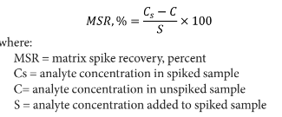
Matrix Spike
Precision
Accuracy
Used to evaluate matrix interference either as spike or spiked duplicate
A representative duplicate subsample is spiked with a known quantity of the analyte(s) and processed and analyzed along with the un-spiked sample.
One should be included with each analytical batch of client samples (~5%).
Also known as laboratory fortified matrix (LFM).
Acceptance calculated as % Recovery: ~ 85-115%; 80-120% depending on analyte

Slide 34
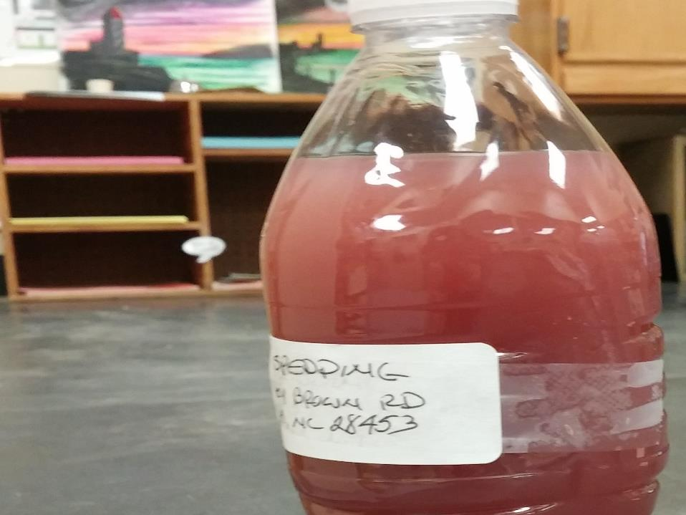
Matrix Spikes: tips
Can dilute spike with sample to a known volume or spike on the sample. Be sure to account for dilution and to homogenize well
In general, spike 1 to 10 times the expected level in the sample or 5 to 50 times MDL if not known
  If unspiked sample result is in the top 40% of the calibration range, the sample should be diluted and the spike prepared using diluted sample
  Recovery of the spiked samples must be bracketed by the calibration range
Limit volume to <10% of sample volume
Compare results to spiked blank results

Slide 35
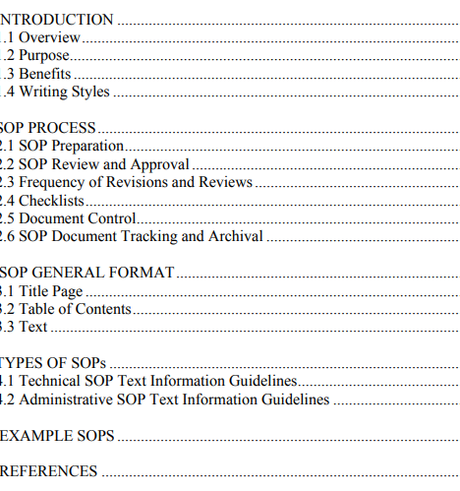
Standard operating procedures
EPA has guidance on SOP formatting and content
https://www.epa.gov/sites/default/files/2015-06/documents/g6-final.pdf
Monitor for drift!

Slide 36
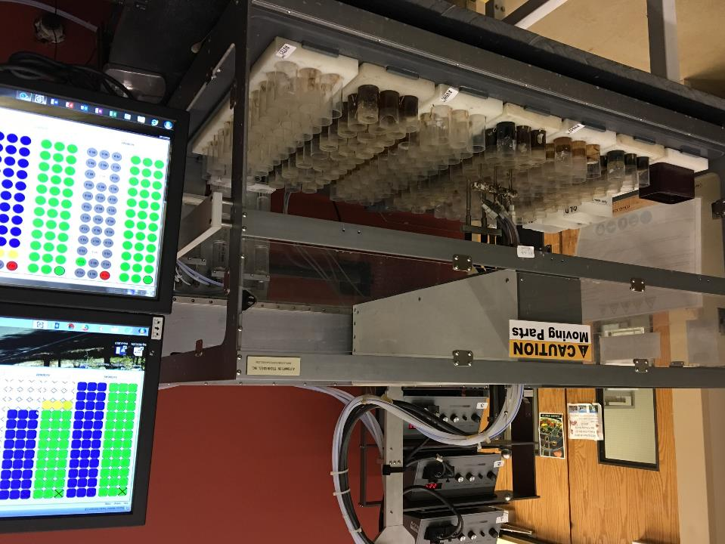
Thank you

