Slide 1
Nitrogen in Poultry Litter and Livestock Manure by Preparation method
Brenda R. Cleveland
Plant/Waste/Solution/Media Section
NCDA&CS Agronomic Division

Slide 2
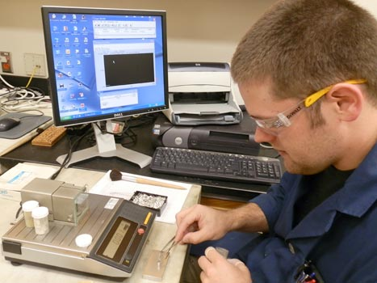
NCDA&CS Waste Analysis
SOP
  >10–15% solids are homogenized
  Dried at 80°C
  Ground (1-mm sieve)
  Nitrogen is determined by O₂ combustion (10–15 mg)

Slide 3
INMC Question
North Carolina Interagency Nutrient Management Committee
  Used five years of NCDA&CS waste analysis to update NRCS Nutrient Management tables
  Requested characterization of NH₄-N lost when drying solid, semi-solid and slurry manure

Slide 4
Objective
Determine impact of sample preparation method on nitrogen concentration (combustion nitrogen and ammonium-nitrogen) for poultry litter and livestock manure

Slide 5
Experimental Design
8 × 5 factorial
  8 animal manure and litter types
  5 sample preparation treatments
Randomized (subsample collection and analysis)
Five replications

Slide 6
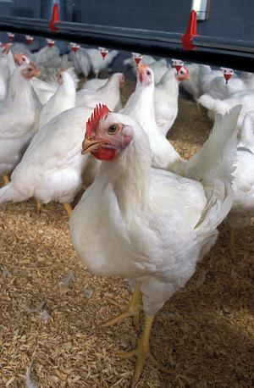
Animal Manure Types
Poultry house litter
  Roaster
  Broiler
  Pullet
  Turkey
  Layer
Animal-scraped manure
  Beef
  Dairy
  Horse

Slide 7
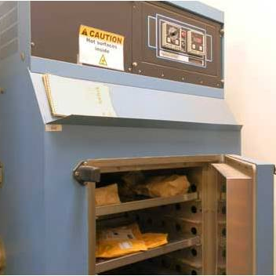
Sample Preparation Treatments
No drying + no acid (as-is)
  N analyzed at Penn State
Drying at 60°C + no acid
Drying at 60°C + acetic acid
Drying at 80°C + no acid (NCDA current method)
Drying at 80°C + acetic acid

Slide 8
Measured Variables/Methodology
Percent dry matter
Nitrogen
  oxygen combustion gas chromatography
      dried/ground sample or fresh sample
Ammonium nitrogen (NH₄-N)
  KCl extraction
      auto-flow spectrophotometric analyzer

Slide 9
Litter Collection
Collected 8/8/11 (transferred to AC room) or 8/9/11 (put on ice within 4 hr)
  Pullet – 1 house (3 bags)
  Layer – 1 house (3 bags)
  Roaster – 5 houses (5 bags)
  Turkey – 3 houses (5 bags)
  Broiler – 5 houses (5 bags)
For each type, litter was combined and homogenized
Stored at 0°C

Slide 10
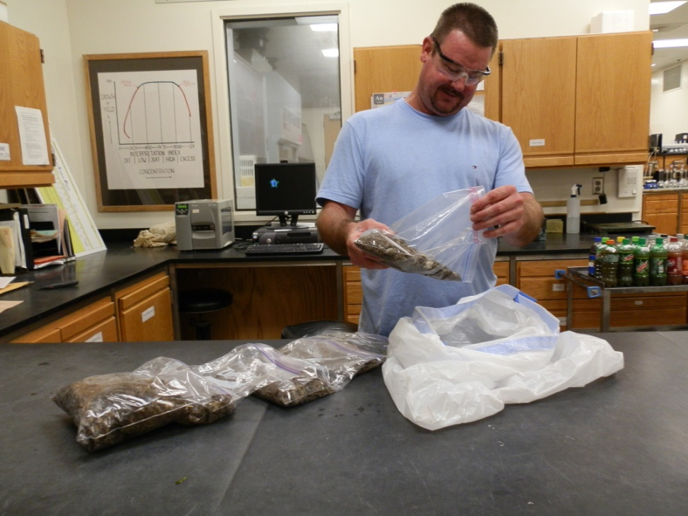
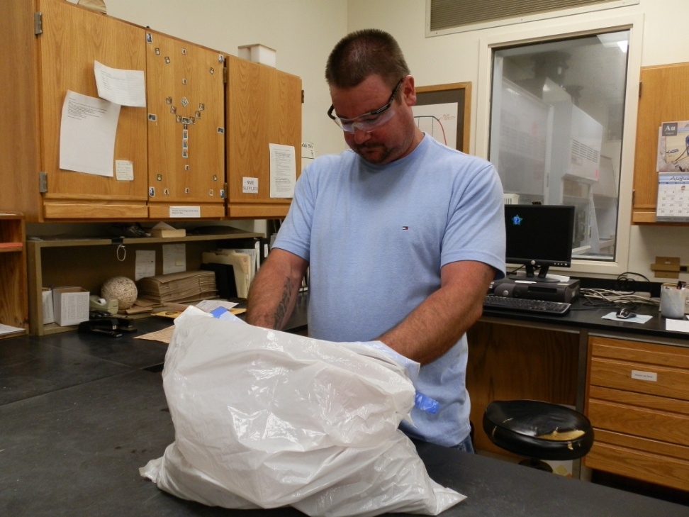
Combine & Homogenize Litter

Slide 11
Manure Collection
Collected 8/10/11 and 8/11/11
Put on ice immediately
  Horse – 4 farms
  Beef – 5 farms
  Dairy – 5 farms
For each type, manure was combined and homogenized
Stored at 0°C

Slide 12
Acetic Acid
Poultry litter
  Added to saturate
Surface-scraped manure
  Added to pH~5

Slide 13
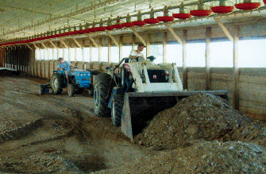
Nitrogen and %Moisture Results
Poultry Litter (as received)

Slide 14
% Moisture

Slide 15
Combustion Nitrogen (mg kg⁻¹) by Poultry Type

Slide 16
Combustion Nitrogen (mg kg⁻¹) by Rep and Type
REP
Layer
Broiler

Slide 17
Combustion Nitrogen (mg kg⁻¹) by Rep and Type
Roaster
Turkey

Slide 18
Combustion Nitrogen (mg kg⁻¹) by Rep and Type
Pullet

Slide 19
No statistical difference
 | Average nitrogen concentration (mg∙kg⁻¹) as received basis ^{z}
 | -----------------Poultry Type-----------------
Preparation Method | Layer | Pullet | Broiler | Roaster | Turkey
As-Is | 16,800 | 28,700 | 31,100 | 34,700 | 40,000
60°C / No Acid | 21,500 | 31,600 | 31,000 | 36,400 | 42,800
60°C / Acid | 15,200 | 31,100 | 33,000 | 34,200 | 39,000
80°C / No Acid | 17,000 | 32,000 | 32,300 | 35,900 | 38,700
80°C / Acid | 16,400 | 27,500 | 28,700 | 35,700 | 35,600
^{z} Means based on 5 observations

Slide 20
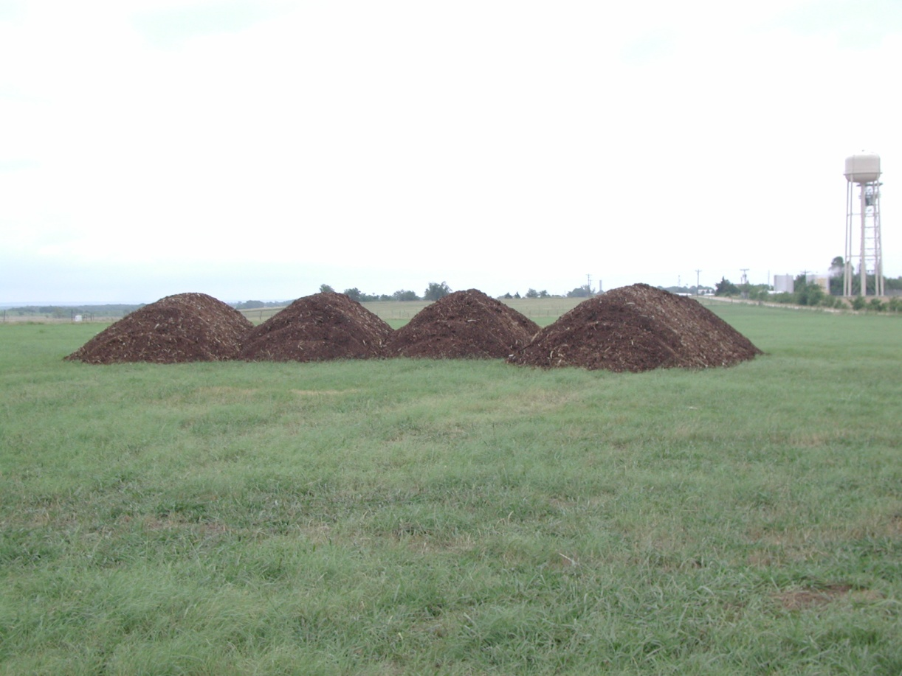
NH₄-N Results
Poultry Litter

Slide 21
Ammonium Nitrogen (mg kg⁻¹) by Poultry Type

Slide 22
NH₄-N (mg kg⁻¹) by Rep and Type
Layer
Broiler

Slide 23
NH₄-N (mg kg⁻¹) by Rep and Type
Roaster
Turkey

Slide 24
NH₄-N (mg kg⁻¹) by Rep and Type
Pullet

Slide 25
Statistics
Treatments resulted in statistical difference for turkey litter only
 | Average NH₄-N (mg∙kg⁻¹) as received basis ^{z}
 | -----------------Poultry Type-----------------
Preparation Method | Layer | Pullet | Broiler | Roaster | Turkey
As-Is | 2703 | 3367 | 3907 | 4952 | 6767a
60°C / No Acid | 2242 | 2832 | 3451 | 5307 | 6198a
60°C / Acid | 2034 | 3170 | 4068 | 5962 | 6515a
80°C / No Acid | 1624 | 2747 | 3068 | 4512 | 4943b
80°C / Acid | 1748 | 3278 | 3256 | 4791 | 4290b
^{z}Means based on 5 observations

Slide 26
Ammonium Nitrogen (ppm) As-Is by Poultry Type
4–10 lb NH₄-N per ton (no drying/no acid)
Layer | 4.0
Pullet | 5.7
Broiler | 6.1
Roaster | 7.3
Turkey | 10.3

Slide 27
Summary
N and NH₄-N in Poultry Litter
  Drying at 60°C or 80°C resulted in highest average N
  N is highly variable from sample to sample within a poultry litter type
  No drying/no acid (as-is) resulted in highest NH₄-N
  Acetic acid tended to stabilize NH₄-N at 60°C except in layer litter
  4–10 lb NH₄-N per ton litter

Slide 28
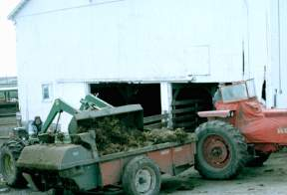
Nitrogen and %Moisture Results
Surface -scraped Manure

Slide 29
Surface-scraped Manure
% Moisture

Slide 30
Combustion Nitrogen (mg kg⁻¹)

Slide 31
Statistical Difference
 | Average nitrogen concentration (mg∙kg⁻¹) as received basis ^{z}
 | -----------------Manure Type-----------------
Preparation Method | Dairy | Beef | Horse
As-Is (no drying/no acid) | 5,956 a | 7,452 | 6,568 b
60°C / No Acid | 4,722 b | 7,407 | 7,934 a
60°C / Acid | 4,111 c | 7,402 | 8,291 a
80°C / No Acid | 4,465 bc | 7,056 | 8,093 a
80°C / Acid | 4,170 bc | 6,841 | 8,397 a
^{z} Means based on 5 observations

Slide 32
Summary
N Surfaced-scraped Manure
Beef and dairy
  No drying & no acid resulted in highest N
  Adding acetic acid then drying resulted in a lower N
Horse
  Adding acetic acid then drying at 80°C resulted in highest N
  No drying & no acid resulted in lowest N
NH₄-N analysis in process

Slide 33
Thank you to the following who contributed greatly to this work
Michelle McGinnis, Agronomist
Ying Kritalugs, Chemist Tech
Donta Baker, Chemist Tech
Kyle Crump, Chemist Tech
Jan Queen, Chemist I

