Slide 1

Recommended Sufficiency Ranges for Cannabis sativa in North Carolina
Kristin Hicks
Section Chief, Plant Analysis Lab
NCDA&CS Agronomic Division
Notes:
In 2018, NC and many other states established industrial hemp pilot programs. Since that time, I have been working on establishing plant tissue ranges for hemp for NC and we have recently adopted a set of ranges for NC. What I’d like to do today is present these adopted ranges and the process that I used to arrive at them. I’d also really like to make this a broader discussion of how to use survey data to approximate sufficiency ranges, because that has been a real challenge for me. There is a wealth of knowledge and experience in this group that we can all benefit from so please feel free to stop me and chime in with questions and comments as we go.

Slide 2
Interpretation Approaches Used in Plant Analysis
Critical values-- the concentration at which there is a 5–10% yield reduction.
Sufficiency ranges—Based on 100% yield. Includes zone of hidden hunger. Includes a concentration upper end (poorly defined).
DRIS ratios--Places emphasis on the relationship among essential elements rather than absolute concentrations, e.g. N:S 10-15; N:K 1.2–2.2; Fe:Mn >1
NCDA uses a combination of these approaches with sufficiency range model the most predominant
Notes:
I’m going to start with some basic background in how plant tissue results have been interpreted. There are three major approaches to interpreting plant analysis results. The critical value approach was developed early on and is defined as the concentration where a 5-10% reduction in yield occurs. Some publications put it at 5 and others at 10% so that is why it’s presented as a range. I don’t know the history of this approach but I suspect it evolved out of a similar approach used in soil test interpretation. Critical values play an important role in establishing lower limits of sufficiency ranges. It is best suited to diagnose severe deficiencies and has little application in identifying hidden hunger.. Because of the amount of work involved, critical concentrations are rarely determined; consequently ranges of sufficiency are most commonly used in assessment of plant nutrition
Sufficiency range interpretation offers significant advantages over the use of critical values. First, hidden hunger in the transitional zone can be identified since the beginning of the sufficiency range is clearly above the critical value. Sufficiency ranges also have upper limits, which provide some indication of the concentration at which the element may be in excess
Lastly, the DRIS Diagnosis and Recommendation Integrated system- approach focuses on nutrient ratios rather than fixed target concentrations and these ratios are generally used as secondary and supportive evaluations

Slide 3
Sufficiency Range Interpretation Model
Sufficiency Values—concentration of an essential plant nutrient that has been established by research for a specified plant part and stage of plant growth where
  optimum plant growth and/or product yield is obtained (lower end of range)
  toxicity/nutrient antagonism or other negative effect on growth is documented (upper end of range)
  More often done in sand culture than field
  Mostly on NPK than on secondary or micronutrients
Notes:
A sufficiency study is generally considered the gold standard for plant tissue interpretation. To establish sufficiency, the crop must be supplied with the nutrient of interest at a range of concentrations, yield or growth measured and crop response curve established using tissue concentrations from the same plant part and at the same growth stage. You are then able to set the low end of sufficiency where 100% yield is obtained and ideally, the high end of the range where effects of excess nutrients is documented.
These studies are more often done in the GH than in the field because it’s much easier to control the nutrient levels and availability although they are not often done even in the GH anymore.
When you see sufficiency ranges documented in the literature or handbooks, it’s important to remember that these studies are more often than not, just on NPK, occasionally secondary and less often micronutrients.

Slide 4
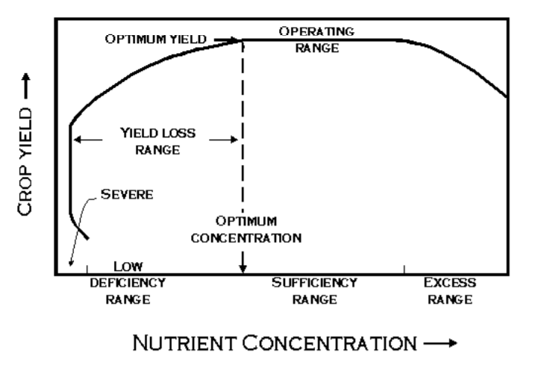
Critical Value
Schematic of yield and nutrient concentration (Chapman 1967)
Notes:
A number of researchers have offered schematics showing the generalized relationship between maximum yield and concentrations of essential elements (Ulrich and Hills 1967; Brow 1970; Dow and Roberts 1982). This is the schematic developed by Chapman which serves as the basis of the NCDA interpretation approach. Chapman (1967) added interpretation ranges to these relationships

Slide 5
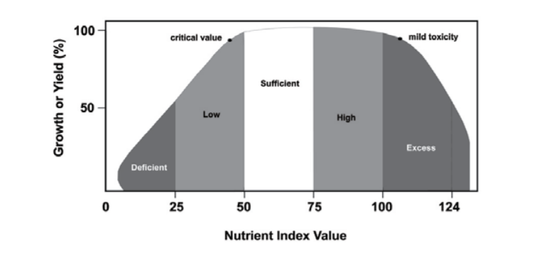
NCDA Interpretation Model
Schematic of yield or growth in response to increasing nutrient concentration and interpretation.
Notes:
NCDA expanded this relationship to include excess and toxic levels of nutrients along with an interpretation index.
In this model, each nutrient concentration has a calculated numerical index and a nutrient status category of Deficient, Low, Sufficient, High or Excessive. Many labs follow this interpretation model although many do not report the numerical index as we do. The challenge in developing an interpretation for each nutrient is that it involves much more than establishing sufficiency. We much also determine where the transition occurs from low to deficient and from high to excess.

Slide 6
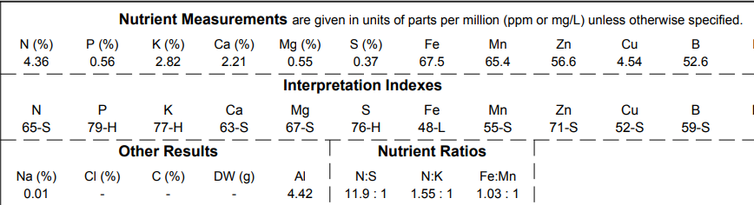
Example NCDA Hemp Report
NCDA reports concentrations (top) and alpha-numeric interpretation (bottom)

Slide 7
Sufficiency v Survey
Survey Values—nutrient element concentrations that have not been clearly identified as being either at deficient or toxic levels covering a broad range of growing conditions. Based on a particular plant part and stage of plant growth from plants showing an acceptable visual appearance and or a desired economical yield. Translation: If the plant has access to all it needs, it will take up all it needs.
  May be used to approximate sufficient levels
  Typically very small data sets
  Statistical approach to extrapolating to sufficiency ranges is VERY poorly defined
Notes:
In the absence of funding for sufficiency studies, we have come to rely heavily on survey data for plant tissue interpretations. Survey Values provide a workable alternative for those crop/plants currently without Sufficiency Range data. Most ranges used in the southeast are not true sufficiency ranges. In most cases research was not conducted for the sole purpose of identifying critical limits or sufficiency ranges. These values were extrapolated from research in which the primary purpose was to develop response curves for specific fertilizer application, soil test calibration or variety trials.
The idea behind using survey data is that if you are growing a plant under non-limiting fertility conditions and you sample the same plant part at the same growth stage, then the concentration of nutrient in the leaf tissue should be sufficient. I have not yet found anything in the literature that validates or has even tested this hypothesis but it is a common assumption in plant analysis.
An additional challenge is that the literature does not offer guidelines as to how to apply survey data. Some papers report a min/max, some a mean with confidence interval, but how these translate to a working sufficiency range is poorly defined.

Slide 8
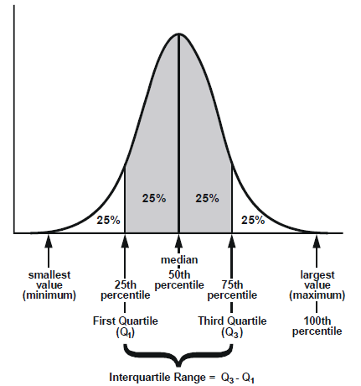
Statistical Approach & Validation
Examined nutrient population distribution of all Cannibas samples submitted to NCDA&CS 2018-2020 from 76 NC counties. Dozens of varieties
  Greenhouse and field
  CBD production only
  n=6119
Calculated 1st and 3rd quartiles to approximate typical concentration range
Compared to published GH survey values (Bryson & Mills 2014; Landis et al 2019; Kalinowski et al. 2020)
Notes:
I started looking at distributions in hemp tissue and in other crops a few years back and I found it has some advantages over the mean and min/max approach. I like that you can see the actual data and see if the data is skewed. Where that’s the case, the median is considered to be a better estimate of the center of the data than the mean and several nutrients tend to present skewed distributions for both hemp and other crops.
My approach was to take all of the samples that had been submitted to NCDA since 2018, regardless of growth stage or whether they were routine or problem samples, greenhouse or field, research or growers. My hypothesis was if I could get to a large enough data set, any effect of outliers would be mitigated and I would be able to see the true center of the nutrient range.
I calculated the 1st and 3rd quartiles, which represents the middle 50% of the distribution, also called the 25th and 75th percentile. And then I compared those to published surveys and my own unpublished in house surveys to see if the Q1 and Q3 could be used to approximate a sufficiency range.

Slide 9
Published Studies
Bryson, G.M.; Mills, H.A.; Sasseville, D.N.; Jones, J.B., Jr.; Barker, A.V. 2014. Plant Analysis Handbook IV: A Guide to Sampling, Preparation, Analysis and Interpretation for Agronomic and Horticultural Crops; Micro-Macro Publishing, Inc.: Athens, GA, USA. GH Survey.
Landis, H. Hicks, K. Cockson, P. Henry, J., Smith, J. and B. Whipker. 2019. Expanding Leaf Tissue Nutrient Survey Ranges for Greenhouse Cannabidiol-Hemp. Chapter 10. In Crop, Forage and Turfgrass Management. Vol. 5, Issue 1. 1-3. GH Survey.
Kalinowski J, Edmisten K, Davis J, McGinnis M, Hicks K, Cockson P, Veazie P, Whipker BE. 2020. Augmenting Nutrient Acquisition Ranges of Greenhouse Grown CBD (Cannabidiol) Hemp (Cannabis sativa) Cultivars. Horticulturae. 6(4):98. GH Survey.
Cockson, P., H. Landis, T. Smith, K. Hicks, B. Whipker. 2019. Characterization of Nutrient Disorders of Cannabis sativa. Appl. Sci. 9(20), 4432. GH Deficiency Study.

Slide 10
Comparison of Published Surveys to Total Population Distribution
Data Source | System | n | N % |  | P % |  | K % |  | Ca % |  | Mg % |  | S %
Bryson & Mills. 2014 | GH | NR | 3.3 | 4.76 | 0.24 | 0.49 | 1.83 | 2.35 | 1.47 | 4.42 | 0.4 | 0.81 | 0.17 | 0.26
Landis et al. 2019 | GH | 24 | 2.65 | 4.47 | 0.31 | 0.44 | 1.54 | 2.98 | 0.53 | 2.14 | 0.25 | 0.46 | 0.19 | 0.29
Kalinowski et al. 2020 | GH | 52 | 3.29 | 4.98 | 0.26 | 0.43 | 2.08 | 3.41 | 1.50 | 5.34 | 0.34 | 0.69 | 0.25 | 0.37
NCDA Q1-Q3 | ALL | 6119 | 3.26 | 5.05 | 0.27 | 0.48 | 1.78 | 2.74 | 1.67 | 2.94 | 0.36 | 0.65 | 0.25 | 0.36
Adopted |  |  | 3.3 | 5.0 | 0.27 | 0.48 | 1.8 | 2.7 | 1.50 | 2.9 | 0.30 | 0.65 | 0.25 | 0.36
Data Source | System | n | Fe ppm |  | Mn ppm |  | Zn ppm |  | Cu ppm |  | B ppm |  | Mo ppm
Bryson & Mills. 2014 | GH | NR | 100 | 150 | 41 | 93 | 24 | 52 | 5 | 7 | 56 | 105 | 0.5 | 1.5
Landis et al. 2019 | GH | 24 | 59 | 132 | 24 | 72 | 23 | 46 | 2 | 11 | 23 | 57
Kalinowski et al. 2020 | GH | 52 | 84 | 169 | 67 | 264 | 26 | 55 | 2 | 7 | 26 | 91
NCDA Q1-Q3 ALL | ALL | 6119 | 91 | 150 | 56 | 158 | 33 | 60 | 5 | 11 | 42 | 91 | 0.38 | 2
Adopted |  |  | 70 | 150 | 40 | 158 | 33 | 60 | 5 | 11 | 30 | 90 | 0.3 | 1.5

Slide 11
NCDA Interpretation Model
Q1
Q3
?
?
Schematic of yield or growth in response to increasing nutrient concentration and interpretation.
Notes:
So coming back

Slide 12
Interpretation Ranges for Low, Deficient, Sufficient and Excessive Nutrient Statuses
Element | Deficient | Low | Sufficient | High | Excessive
N | <1.65 | 1.66 - 3.20 | 3.30 - 5.00 | 5.10 - 6.00 | > 6.00
P | <0.135 | 0.136 - 0.26 | 0.27 - 0.48 | 0.49 - 1.00 | >1.00
K | <0.9 | 1.00 - 1.70 | 1.80- 2.70 | 2.80 - 4.00 | >4.00
Ca | <0.82 | 0.83 - 1.40 | 1.5 - 2.90 | 3.00 - 4.40 | >4.40
Mg | <0.17 | 0.18 - 0.29 | 0.30 - 0.65 | 0.66 - 1.00 | >1.00
S | <0.12 | 0.13 - 0.24 | 0.25 - 0.36 | 0.37 - 0.50 | >0.50
Fe | <34.0 | 35.0 - 69.0 | 70.0 - 150.0 | 151.0 - 300.0 | >300.0
Mn | <19.0 | 20.0 - 39.0 | 40.0 - 158.0 | 159.0 - 300.0 | >300.0
Zn | <15.0 | 16.0 - 32.0 | 33.0 - 60.0 | 61.0 - 200.0 | >200.0
Cu | <2.0 | 3.0 - 4.0 | 5.0 - 11.0 | 12.0 - 30.0 | >30.0
B | <14 | 15.0 - 29.0 | 30.0 - 90.0 | 91.0 - 200.0 | >200.0
Mo | <0.09 | 0.10 - 0.20 | 0.30 - 1.50 | 1.60 - 5.00 | >6.0

Slide 13
% Nitrogen in Cannabis Samples 2018-2020
n = 6119
Sufficiency Range Estimate
3.3-5.0
High
Low
Landis
Kalinowski
Bryson & Mills
Excess
Deficient
NCDA Q1-Q3
Deficiency symptoms at 1.6 %. Cockson et al. (2019)

Slide 14
Distribution of Macronutrients in Early Corn Samples 2013-2017
N
P
K
Ca
Mg
S
n = 2686

Slide 15
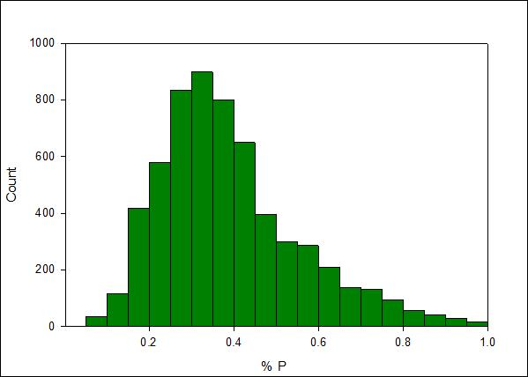
% Phosphorus in Cannabis Samples 2018-2020
Sufficiency Range Estimate
0.27-0.48
n = 6119
Landis
Kalinowski
Bryson & Mills
NCDA Q1-Q3
Deficiency symptoms at 0.09 %. Cockson et al. (2019)

Slide 16
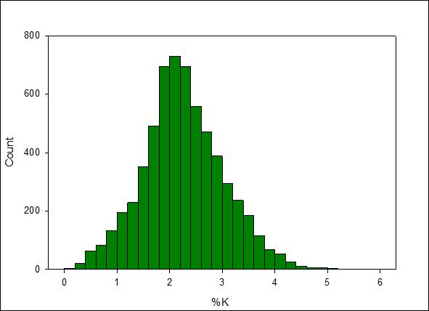
% Potassium in Cannabis Samples 2018-2020
Sufficiency Range Estimate
1.8-2.7
n = 6119
Landis
Kalinowski
B&M
NCDA Q1-Q3
Deficiency symptoms at 0.41 %. Cockson et al. (2019)

Slide 17
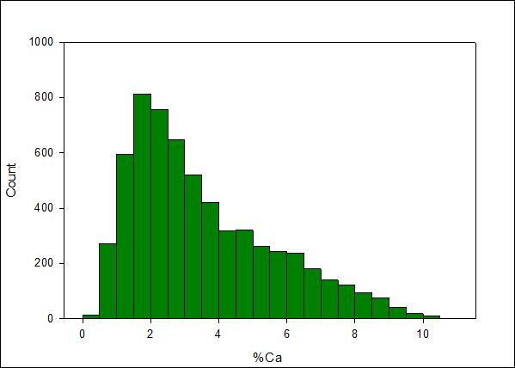
% Calcium in Cannabis Samples 2018-2020
n = 6119
Removed values above 4.0%
Deficiency symptoms at 0.5 %. Cockson et al. (2019)

Slide 18
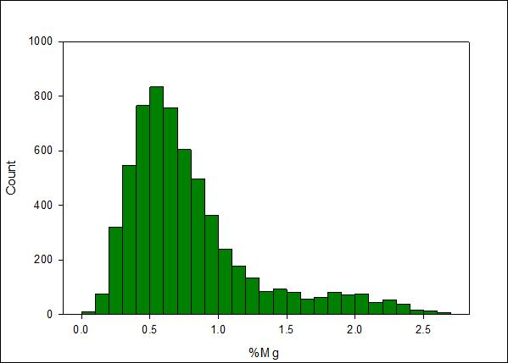
% Magnesium in Cannabis Samples 2018-2020
n = 6119
Removed values above 1.0%
Deficiency symptoms at 0.12 %. Cockson et al. (2019)

Slide 19
Ca% & Mg % in Corn & Soybean 2010-2019/2020
Corn
Soybean
n = 22362
n = 7930
n = 22362
n = 7930
n = 5548

Slide 20
K:Ca and K:Mg Interactions
High Ca uptake associated with low tissue K
High Mg uptake associated with low tissue K
High Ca uptake associated with high Mg uptake (not shown)
K:Ca Ratios in Hemp 2018-2021
K:Mg Ratios in Hemp 2018-2021
n = 6119
n = 6119

Slide 21
Comparison of K:Ca to K:Ca of Corn and Soybean
K:Ca Ratios in Hemp 2018-2021
n = 6119
n = 7930

Slide 22
Comparison of K:Mg to K:Mg of Corn and Soybean
K:Mg Ratios in Hemp 2018-2021
n = 6119
n = 7930
n = 22362

Slide 23
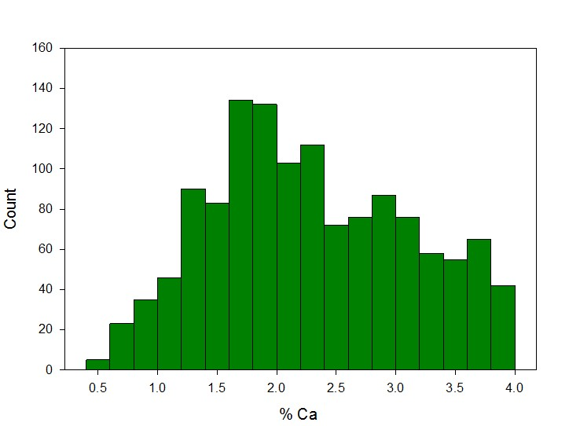
% Calcium in Cannabis Samples 2018-2020
Sufficiency Range Estimate
1.5-2.9
Landis
Kalinowski
Bryson & Mills
NCDA Q1-Q3
Deficiency symptoms at 0.5 %. Cockson et al. (2019)

Slide 24
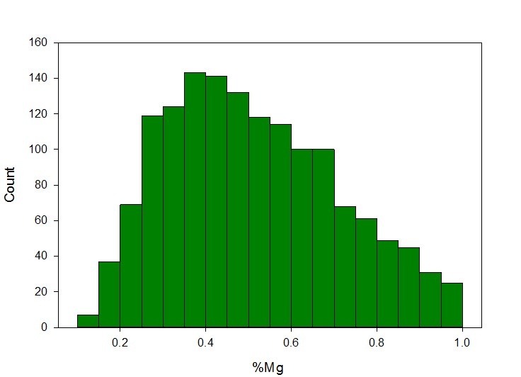
% Magnesium in Cannabis Samples 2018-2020
n =
Sufficiency Range Estimate
0.30-0.65
Landis
Kalinowski
Bryson & Mills
NCDA Q1-Q3
Deficiency symptoms at 0.12 %. Cockson et al. (2019)

Slide 25
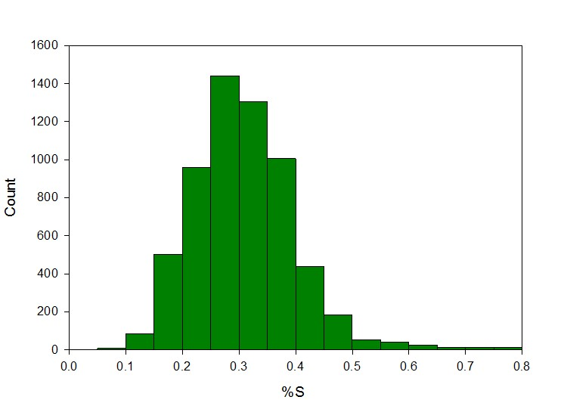
% Sulfur in Cannabis Samples 2018-2020
Sufficiency Range Estimate 0.25-0.36
n = 6119
Landis
Kalinowski
Bryson & Mills
NCDA Q1-Q3
Deficiency symptoms at 0.11 %. Cockson et al. (2019)

Slide 26
Distribution of Micronutrients in Early Corn Samples 2013-2017
Fe
Mn
Zn
Cu
B
n = 2686

Slide 27
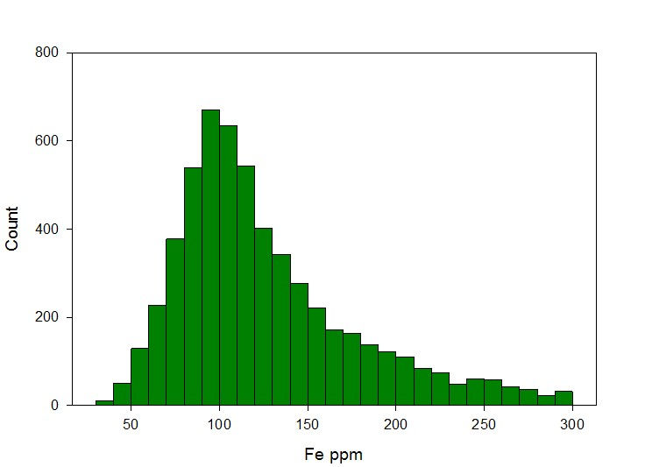
Iron (ppm) in Cannabis Samples 2018-2020
Sufficiency Range Estimate
70-150
n = 5593
Removed values above 300 ppm
Landis
Kalinowski
Bryson & Mills
NCDA Q1-Q3

Slide 28
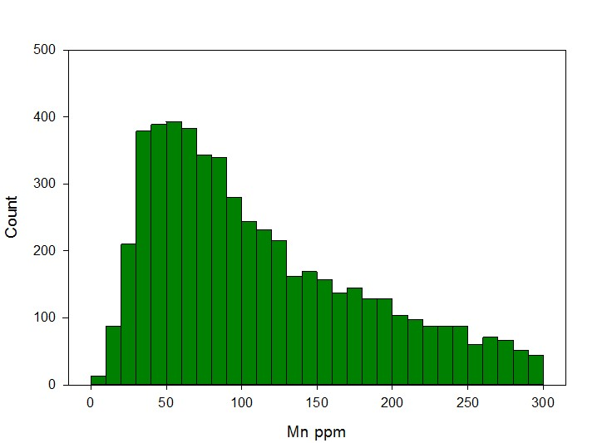
Manganese (ppm) in Cannabis Samples 2018-2020
Sufficiency Range Estimate 40-158
n = 5293
Removed values above 300 ppm
Landis
Kalinowski
Bryson & Mills
NCDA Q1-Q3
Deficiency symptoms at 7.5 ppm Cockson et al. (2019)

Slide 29
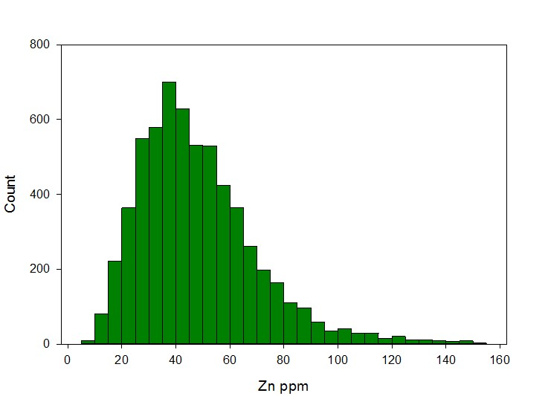
Zinc (ppm) in Cannabis Samples 2018-2020
Sufficiency Range Estimate 33-60
n = 6083
Removed values above 150 ppm
No effect on Q calcs
Landis
Kalinowski
Bryson & Mills
NCDA Q1-Q3
Deficiency symptoms at 11 ppm Cockson et al. (2019)

Slide 30
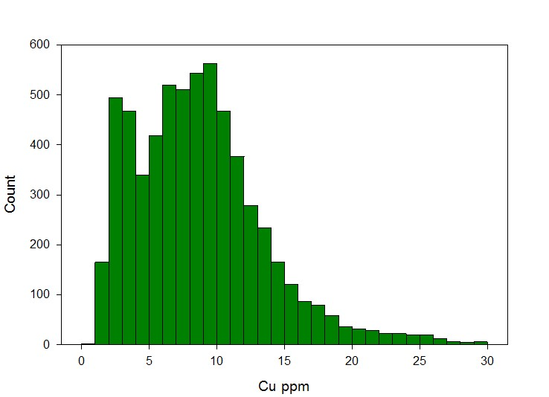
Copper (ppm) in Cannabis Samples 2018-2020
Sufficiency Range Estimate 5.0-11.0
n = 6108
Removed values above 30 ppm
No effect on Q calcs
Landis
Kalinowski
B & M
NCDA Q1-Q3
Deficiency symptoms at 1.4 ppm Cockson et al. (2019)

Slide 31
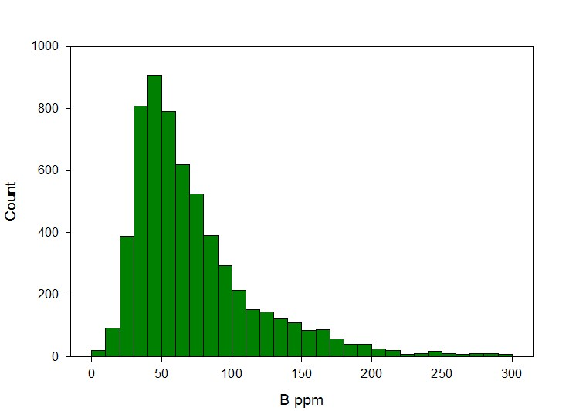
Boron (ppm) in Cannabis Samples 2018-2020
Sufficiency Range Estimate 30-90
n = 6035
Removed values above 300 ppm
No effect on Q calcs
Landis
Kalinowski
B & Mills
NCDA Q1-Q3
Deficiency symptoms at 2.5 ppm Cockson et al. (2019)

Slide 32
Final Thoughts
Working on validation of quartiles approach with different crops
Developing guidelines for how to use tissue surveys to estimate sufficiency levels would be very helpful
How do you set the transitions between interpretation categories?
What statistics are the best fit for data sets of differing sample sizes and variation
  Medians and Quartiles?
  Means and CIs?

Slide 33
Thank You!

