Slide 1
Mineralization of high-N organic fertilizers
SERA-6 2012
L. Sonon, D. Kissel, U. Saha, and SPW Lab Staff
Agricultural and Environmental Services Labs.
University of Georgia
2400 College Station Road
Athens, GA

Slide 2
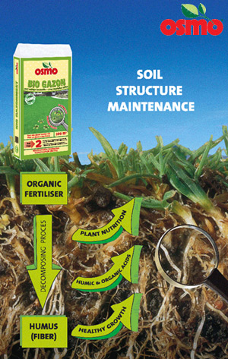
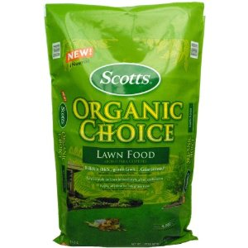
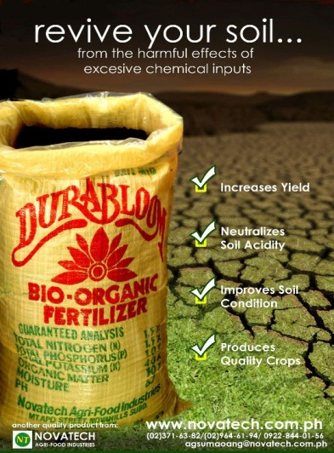
FACTS ABOUT ORGANIC FOOD PRODUCTION
Organic foods – fastest growing sector of agriculture.
Growth in sales ~20% per year.
Increasing acreage converted to organic farming.
http://www.osmo-organics.co.uk/start/fertilizers_bio/en
http://www.ers.usda.gov/media/185272/eib58_1_.pdf
http://www.smilinggardener.com
http://www.nal.usda.gov/afsic/pubs/ofp/ofp.shtml
http://organic.colostate.edu/documents/Thilmany_paper.pdf
Former President Of Organic Fertilizer Company Pleads Guilty To Fraud In Connection With Selling Synthetic Fertilizer To Organic Farms http://www.justice.gov/usao/can/news/2012/2012_02_28_townsley.guiltyplea.press.html
http://www.alibaba.com/product-free/110365349/Durabloom_Bio_Organic_Fertilizer

Slide 3
Objective
Determine the N mineralization of high-N organic fertilizers applied to a low organic matter and sandy Georgia soil.
Table 1. Chemical characteristics and particle size analysis of soil used in the study.
 | Mehlich I Extractable Nutrients, mg kg⁻¹ |  |  |  |  |  | Total, % |  | % | Sand | Silt | Clay
pH_{CaCl2} | P | K | Ca | Mg | Mn | Zn | C | N | OM | -----%-----
4.80 | 58 | 140 | 450 | 80 | 115 | 8 | 0.433 | 0.028 | 0.97 | 76 | 12 | 12
A study was conducted to determine the rate of N mineralization of organic N following the application of high-N organic fertilizers to a low organic matter and sandy Georgia soil. Three high-N organic fertilizers - blood meal, feather meal, and bone meal, were added to soil at a standard rate of 200 kg N/ha. The amount of N contained in each organic fertilizer was based on the total N content determined by combustion technique. Treated soils or soil blends including untreated soil were incubated for 8 weeks at 25ºC and at optimal water content (field capacity). Each soil blend will be sampled on a bi-weekly basis and subsequently analyzed for total N and inorganic N (NH₄ and NO₃). The collected soils will also be extracted of peptides and analyzed by HPLC and MALDI-MS to evaluate the profile of protein degradation and mineralization. Nitrogen mass balance will be calculated at each sampling period.

Slide 4
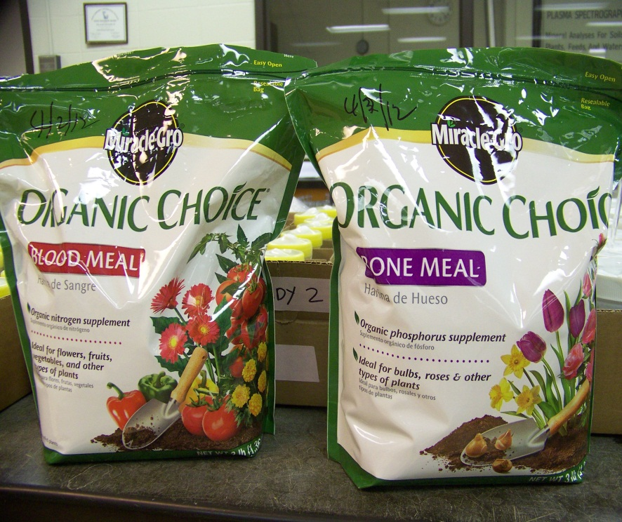
Methods
Three high-N organic fertilizers:
Blood Meal: 15.53% N
Bone Meal: 9.29% N
Feather Meal: 13.95% N

Slide 5
Table 1. Initial concentrations of total carbon (C), total N, C:N, extractable NH₄-N and NO₃-N, and total P and K in organic fertilizers.
Fertilizer | Total C | Total N | C:N | Extr. NH₄-N | Extr. NO₃-N | Total P | Total K
 | % | % |  | mg kg⁻¹ | mg kg⁻¹ | % | %
Feather Meal | 49.43 | 13.95 | 3.11 | 301 | 1.91 | 0.26 | 0.08
Bone Meal | 42.61 | 9.29 | 4.59 | 38 | 3.49 | 4.21 | 0.66
Blood Meal | 49.24 | 15.53 | 3.18 | 256 | 0.94 | 0.15 | 0.41

Slide 6
Rate of application: 200 kg N/ha or 100 mg N/kg soil
Moisture condition during incubation: 70% field capacity
Incubation time (d): 3, 8, 15, 24, 31, 52, 80, 95

Slide 7
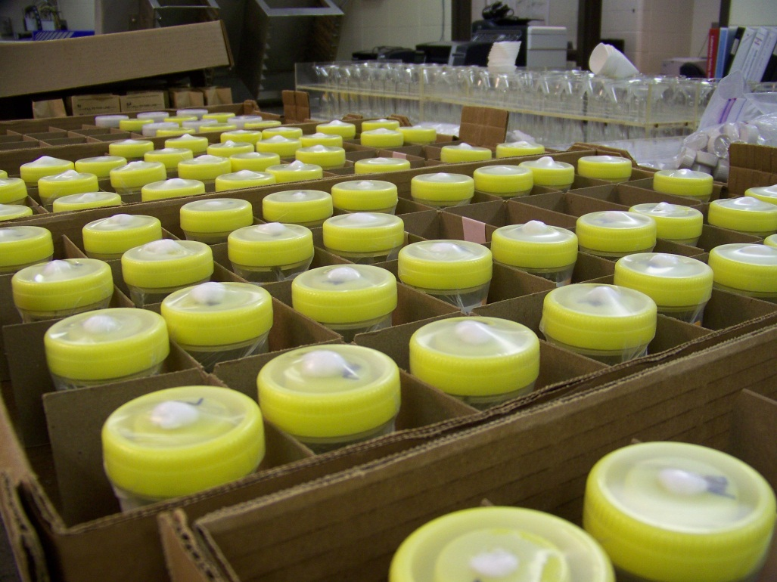
Incubation Experiment
Containers were covered with lids with 0.4 cm hole cut in the center. The hole was plugged with cotton ball and a parafilm was stretched over the lid to minimize water loss but allow gas exchange during incubation. Moisture content of incubated soil/organic fertilizer was maintained at 70% field capacity throughout the incubation by adding water after weighing the jars.

Slide 8
Measurements done every sampling:
NH₄-N
NO₃-N
Total N
Total C
Soil pH

Slide 9
Nitrogen Mineralization
Net N mineralized calculated by subtracting the total mineralized N (NH₄⁺+NO₃⁻) in soil (control) from the total mineralized N (NH₄⁺+NO₃⁻) in soil/organic fertilizer mixtures at the time of sampling divided by the original amount of total N in organic fertilizer:
% N_{min} = [(N_{t}-C_{t})/N_{o}] x 100
N_{min} = N mineralization in organic fertilizer; N_{t} = mineral N (NH₄⁺-N + NO₃⁻-N) from organic fertilizer and soil mixture at sampling time, t; C_{t} = mineral N (NH₄⁺-N + NO₃⁻-N) from soil alone (control) at sampling; N_{o} = initial concentration of total N in organic fertilizer.
The resulting N mineralization indicates the percentage of organic N mineralized from organic fertilizer alone after incubation of soil-organic fertilizer mixture at 23ºC.

Slide 10
Results

Slide 11
NH₄-N in soils applied with organic N fertilizers
Feather meal and blood meal followed similar ammonification pattern, NH₄ peaked at 31 d after incubation.
Bone meal treatment showed higher NH4 in the early stages of incubation.

Slide 12
NO₃-N in soils applied with organic N fertilizers
Nitrification was evident on day 52, and peaked on the day 95.

Slide 13
Mineralized N (NH₄+NO₃) at various incubation times.
Total N availability (NH4-N and NO3-N) was relatively high (48%) on day 31 for feather meal and blood meal, but decreased on days 52 and 80 likely due to immobilization.
Nmin was highest on day 95, ~63% for feather meal and ~67% for blood meal.
N min from bone meal started earlier (day 15) at about 36% and gradually increased to about 48% on day 95.

Slide 14
Ammonium and nitrate in treated soils
Nitrogen loss can be substantial if optimum crop uptake does not coincide with the peak release of N, and nitrate leaching is an important avenue of loss if excessive rain or irrigation is applied.

Slide 15
Mineralized N (NH₄+NO₃) at various incubation times.
Synchronizing N mineralization from organic fertilizers to provide or maintain adequate N availability for crop production.

Slide 16
Changes in nitrogen forms in control soils at various times of incubation.

Slide 17
Soil pH after each incubation time
Soil pH generally decreased with incubation. Sharp decrease in pH was noted on day 52 perhaps due to nitrification.

Slide 18
Summary
Nitrogen mineralization from bone meal was slightly faster than from feather meal and blood meal (within 3 days). The practical significance of this observation can be used on appropriate timing of organic fertilizer application to coincide N needs of growing plants.
Nitrification was highest after 80 days of incubation. Without nitrate sink, leaching loss may become an issue when there’s excessive rain or irrigation. Under anaerobic condition, nitrates could denitrify.

Slide 19
Given the low pH and sandy loam texture of soil used in this study and within the 95-d incubation period, mineralization was approximately 48% for bone meal, and about 68% for feather meal and blood meal.
What’s next?

