Slide 1
Median
Median Absolute Deviation
MAD
% Relative Median Absolute Deviation
%RMAD =
MAD / median x 100

Slide 2
Intralaboratory precision
Within
Interlaboratory precision
Between

Slide 3
ICP vs colorimetry to analyze P
Calculated CEC
Salt pH
Nitrate analysis
Combustion C and CaCO₃
Scooping versus weighing
Hot-water and Mehlich-3 B
Micropipette method for soil texture

Slide 4
ICP vs colorimetry to analyze P

Slide 5
ICP vs colorimetric P
ICP labs = 39
colorimetric labs = 21

Slide 6
ICP vs colorimetric P

Slide 7
ICP vs colorimetric P

Slide 8
Calculated CEC

Slide 9
Calculated CEC
?
1 M NH4OAc
CEC at pH 7 = sum of bases + acidity

Slide 10
Ca
Mg
K

Slide 12
Exchangeable acidity =
12.6 – (1.64 x soil pH) – (0.48 SMP buffer pH)

Slide 13
Exchangeable acidity =
12 x (7 – SMP buffer pH)

Slide 14
Acidity =
8 x (7.5 – SMP buffer pH)

Slide 16
Salt pH

Slide 17
1:1 line

Slide 19
Nitrate analysis

Slide 20
critical value

Slide 21
Combustion C and CaCO₃

Slide 24
Scooping versus weighing

Slide 25
M1 assumes 1.25 g / cm³
M3 assumes 1.18 g / cm³

Slide 26
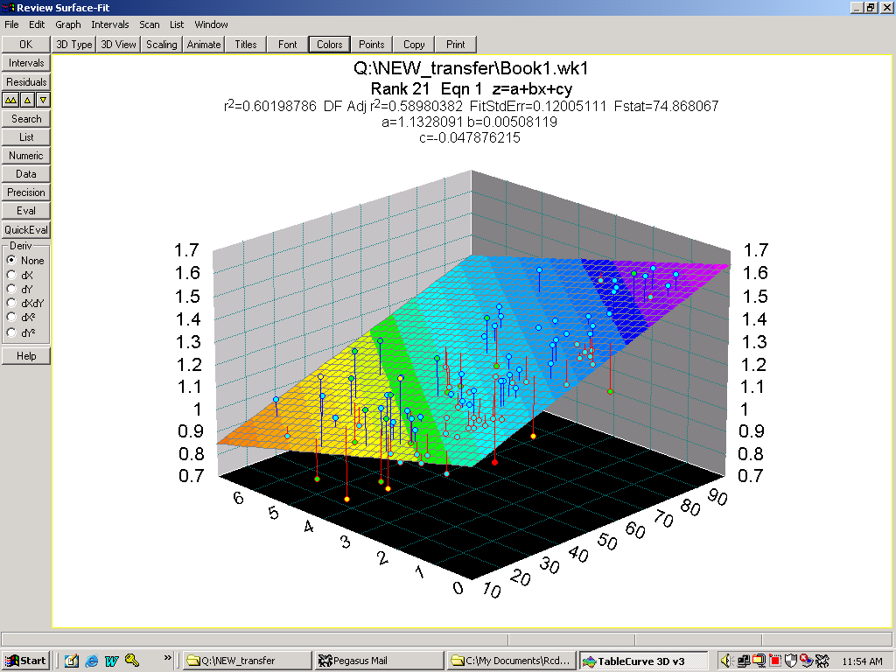
g / cm³
g / cm³
% OM
% sand

Slide 27
+ 40%
M3 assumes 1.18 g / cm³
- 40%

Slide 28
1.7 cm³ scoop &
1.18 g / cm³

Slide 29
Hot-water and Mehlich-3 B

Slide 31
Limit of quantification = 0.05 mg/L
10 g 20 mL
2 g 20 mL

Slide 33
Micropipette method for soil texture

Slide 34
1:1 line

