Slide 1
ICP Detection Limits

Slide 2
Detection Limit (DL) or Limit of Detection (LOD)
The detection limit is the concentration that is obtained when the measured signal differs significantly from the background.
Calculated by this equation for the ARCOS.
C₁ = concentration of the high sample
C₀ = concentration of the blank
I₁ = raw intensity of the high sample (cps)
I₀ = raw intensity of the blank (cps)
3 is a confidence factor
σ (sigma) = standard deviation from a number of measurements of the blank (cps)

Slide 3
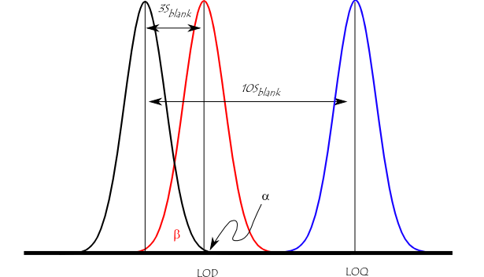
Confidence Factor - Example
Black curve – probability density function for the normal distribution of blank measurements.
LOD (Limit of detection) – defined here as 3 times the standard deviation of the blank.
α – alpha error (probability of a false positive) is only 1%.
β – beta error (probability of a false negative) - there is a 50% chance that the sample could contain the element, but record it as less than the LOD.
LOQ (Limit of quantification) – defined here as 10 times the standard deviation - a minimal chance of a false negative or a false positive. Gives greater confidence that the reported values are actually quantifiable.

Slide 4
Example for P177.495 - using 2 measurements
Sample | Type | P 177.495
 |  | cps
Blank | 1 | 331.526
 | 2 | 308.626
 | <x> | 320.076
 | sd | 16.192
 | rsd | 5.059
20 ppm | 1 | 171326
 | 2 | 172227
 | <x> | 171777
 | sd | 637.103
 | rsd | 0.371
C₁ = 20 ppm
C₂ = 0 ppm
I₁ = 171777 cps
I₀ = 320 cps
OR
or ~0.019 ppm

Slide 5
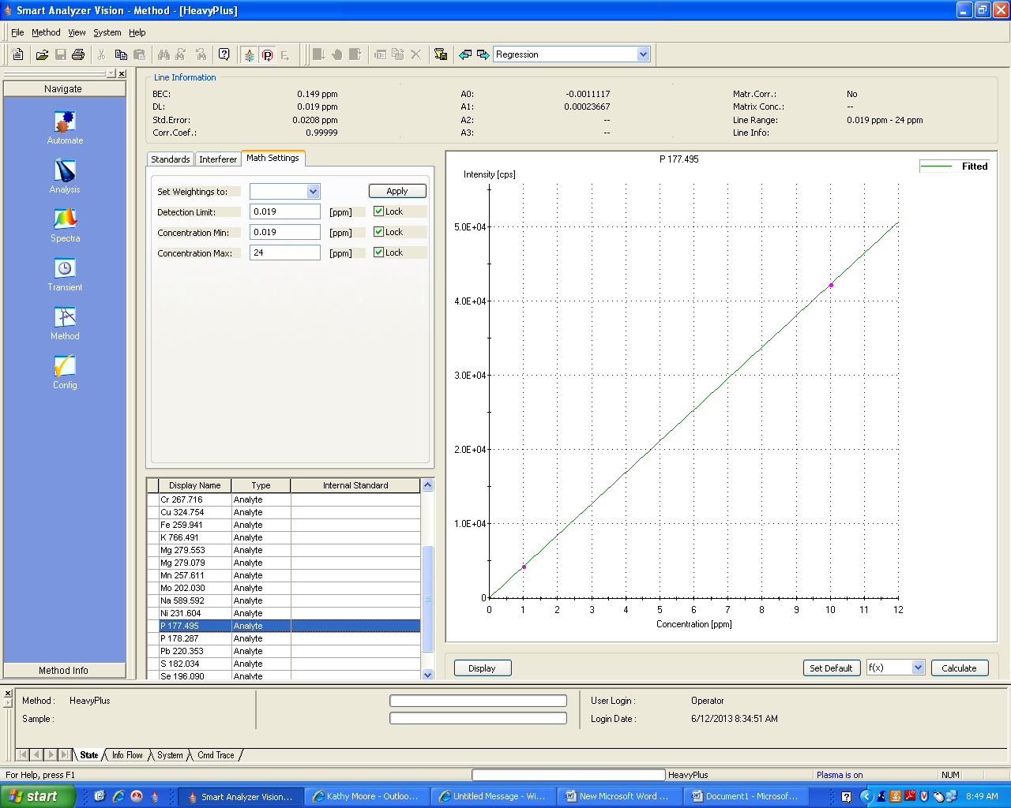

Slide 7
ARCOS - Summary
If the method only does one measurement - the DLs are not automatically calculated.
Input your confidence factor in the system settings.
Calibrate method with 7 - 10 measurements.
Lock the instrument calculated DLs into the math settings for each element.
Once the values are locked in, the method can be set back to 1 measurement.
If the method is set to more than 1 measurement per sample - ARCOS will automatically calculate a new DL for each element whenever it goes through the calibration if values not locked in.
Lock in the instrument calculated DLs from the 7 – 10 calibration measurements.
Set the desired number of measurements.

Slide 8
Results
Result is flagged with a < when below the detection limit
Sample | P
 | ppm
BLK | < 0.019
8773 | < 0.019
8774 | 0.037

Slide 9
Method Detection Limit (MDL) or Method Quantification Limit (MQL)
MDL and MQL describe the LOD and LOQ, respectively, when considering the method blank which goes through all steps of the analysis.
Estimate MDL and MQL by multiplying the LOD and LOQ by the method dilution factor.
ARCOS will take into account the given dilution factor when determining the detection limit for a sample.
For example, if your standard is 1 ppm and you set the instrument to read it at 100 for a 1:100 dilution, the instrument’s DL will be multiplied by 100.

Slide 10
TJA 61E
From command line – type xc”limits”.
Aspirate the blank.
Instrument will take 10 measurements and calculate the detection limits for each element in the method.
Calculate the quantifiable limits for each element as 10 times the given detection limits.
Set up limits tables for each method.
The result will be flagged with an “L” if below the quantifiable limit.

Slide 11
State | ICP | How are limits determined? | How are limits used? | How are limits reported?
Kentucky | Varian Vista Pro axial | LOQ = (x–b+10σ)/m x = average b = intercept σ = std. dev. m = slope | Research solutions | <LOQ
South Carolina | ARCOS radial | LOQ = 10σ /m | Research solutions | < With “<“ defined as indicating below quantification level of detection
Arkansas | ARCOS radial | 3σ of 7 replicates using 3 for the student t value | Research soil and plant Heavy metals on soil | Flagged as “dl” with detection limit at bottom of report
Alabama | Radial and axial |  | Do not use
Florida | Spectro CIROS radial Spectro ARCOS axial PerkinElmer 5300DV radial and/or axial | Variation of USEPA 40CFR136 | Research and NELAC certified Do not use for Extension samples. | < MDL reported with “T” > MDL and < PQL reported with “I” Required by Fl dept of Environmental Protection
Oklahoma | Spectro ARCOS axial Spectro CIROS radial |  | Do not use
Mississippi | Perkin Elmer Optima 4300 DV radial and/or axial |  | Do not use
Virginia | Spectro CIROS Vision and ARCOS – radial | Use instrument DL or MDL = σ x 3.143 (student’s t-value for 7 reps) | Research solutions | Flagged as <
Tennessee | PE 5300 and 7300 Dual view |  | Do not use
Georgia | TJA 61E radial Spectro ARCOS axial | MDL = 3 x σ for 8 reps | Use on all samples. | Reporting limit (RL) RL = 3 x MDL Reported as < or negligible
North Carolina – soils lab | TJA 61E, Spectro ARCOS – radial |  | Do not use

