Slide 1
Assessing Laboratory Quality – Systematic Bias
Robert O. Miller
Colorado State University
Fort Collins, CO

Slide 2
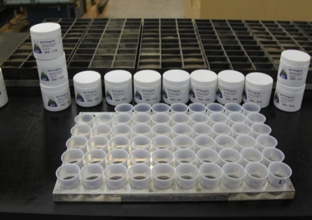
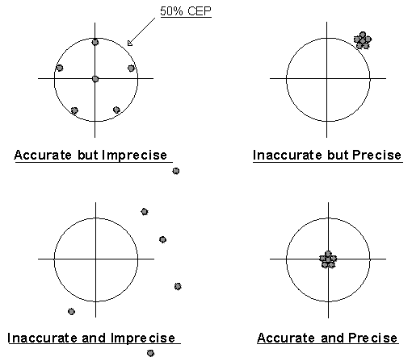
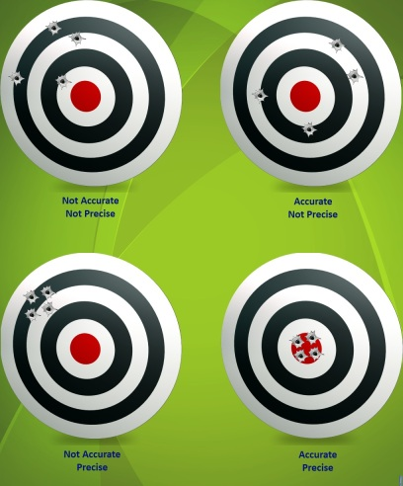
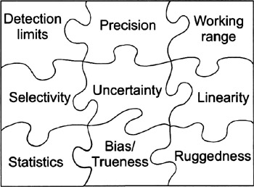
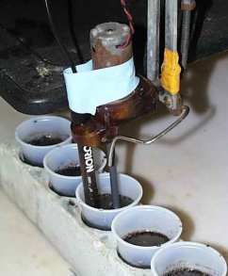
Method Performance
Soil Analysis Bias and Precision
Bias (accuracy) and precision is best depicted by the target bulls eye.
http://www.paduiblog.com/uploads/image/Harrisburg%20DUI%20Lawyer%20accurate%20and%20precise.gif
Bias evaluates soil test consistency between labs, important to the industry, whereas precision defines the uncertainty of the soil test within a laboratory.
http://www.amrl.net/AmrlSitefinity/Newsletter/images/Spring2012/5_image%201.jpg
Miller, 2013

Slide 3
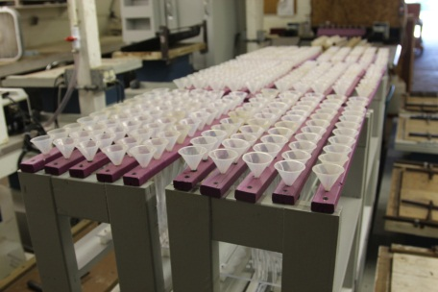
Assessing Bias
Soil Analysis Bias and Precision
Assessment of lab method bias is can be achieved through certified reference samples and/or lab proficiency samples.
Bias can be random, indicating no pattern across multiple reference samples, or systematic in one direction. Bias can be concentration dependent.
Laboratory corrective actions is dependent on the type of bias encountered.
Miller, 2013

Slide 4
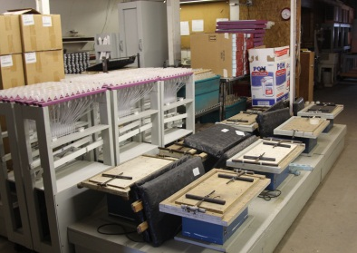
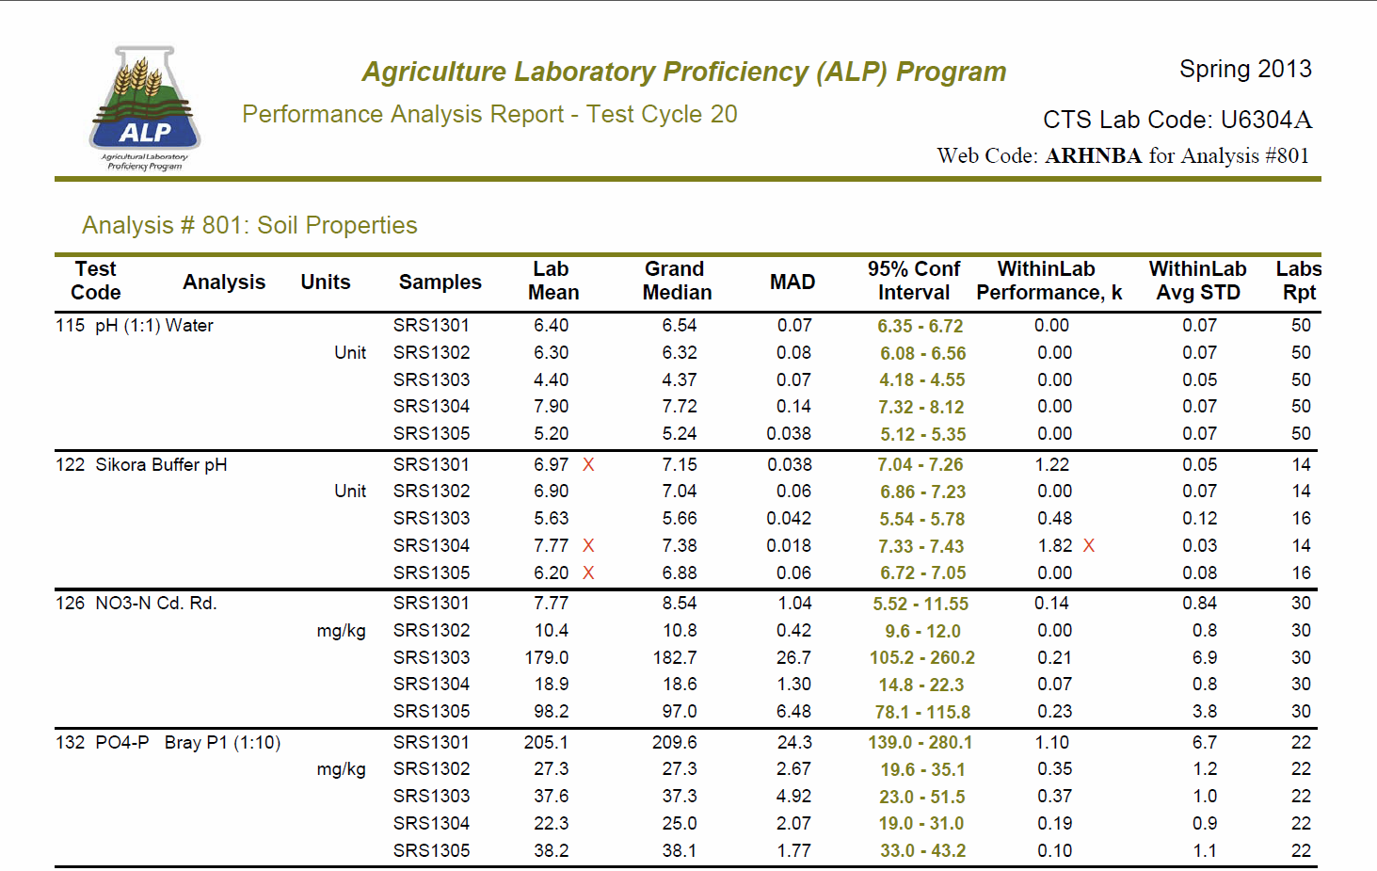
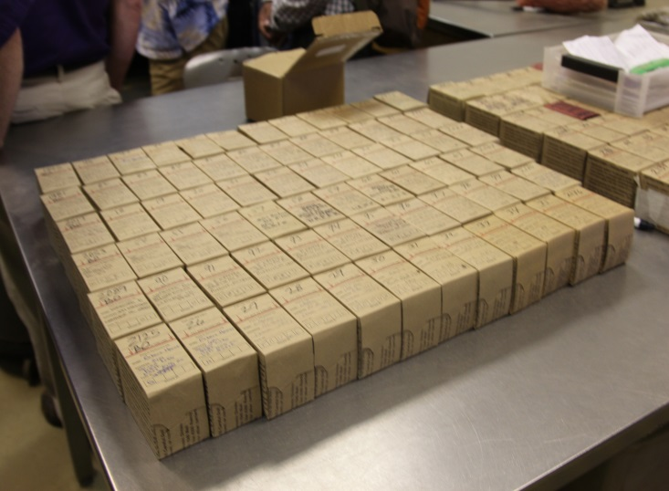
Proficiency Reports
With the completion of each ALP cycle a report is prepared for each lab participant. Soil test results with values exceeding a 95% confidence limit are flagged and precision flagged for samples exceeding 3 x R_{d}.
Miller, 2013

Slide 5
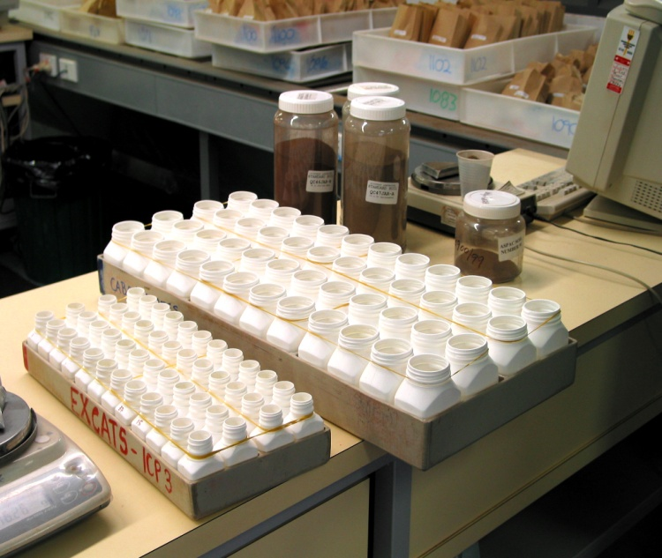
Consensus Value: pH (1:1) H₂O
Lab #1 Systematic Bias
¹ Results ranked from low to high based on soil SRS-1111.
Miller, 2013

Slide 6
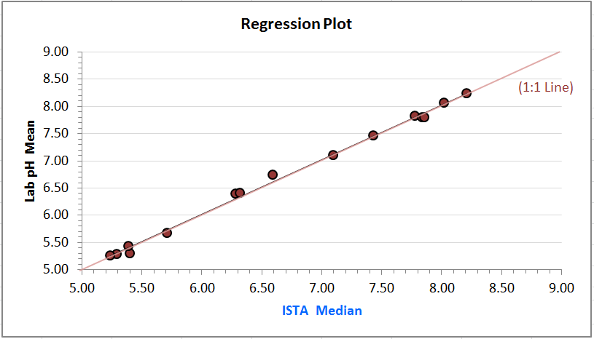
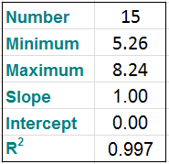
Soil Proficiency Observations - pH
2012 data was compiled for sixteen Illinois labs across 15 soils. Individual lab reports were provided to participants.
Deviation and regression plots provide information systematic bias across 15 soils ranging from pH 5.29 to 7.86.
Deviation plots indicate absolute differences for individual samples, whereas regression plots show an overall comparison for the year.
Miller, 2013

Slide 7
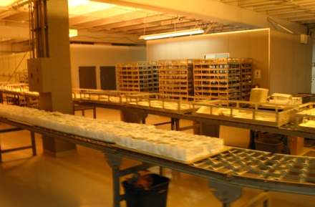
Laboratory Performance
Regression Analysis pH, 2011 ¹
Regression analysis provides insight on lab method bias.
An evaluation of soils with pH 4.98 - 8.10 slope shows 1 of 8 labs deviate by > 5% from the median for the 2011 ALP soils.
Regression intercepts deviated > 0.35 units for 2 of 8 labs shown.
Lab ID | pH (1:1)
 | Slope | Intercept | R²
U6304A | 0.97 | 0.05 | 0.998
U6322A | 0.98 | 0.12 | 0.980
U6333A | 0.95 | 0.31 | 0.997
U6336A | 0.97 | 0.24 | 0.994
U6353A | 1.11 | -0.73 | 0.991
U6718A | 0.95 | 0.34 | 0.994
U6835A | 0.94 | 0.47 | 0.985
U6874A | 1.01 | -0.08 | 0.999
Source: ALP 2011 database. Eight of 48 labs shown.
Miller, 2013

Slide 8
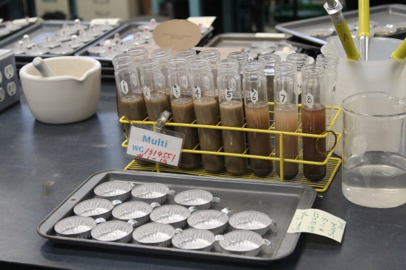
Laboratory Performance
Deviation Plot Mehlich 1-P, ¹
A year summary provides insight on lab method bias.
Results for lab U7255A show random deviations at top left.
Lab U6388A, lower left, consistent low bias across all PT cycles.
255 ppm
¹ Source: ALP 2012 database. Soil M1-P values range 2 - 255 ppm.

Slide 9
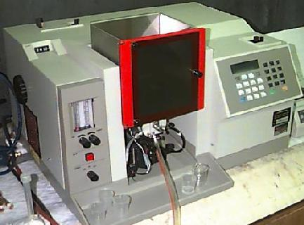
Laboratory Performance
Deviation Mehlich 3-P ICP
Soil ID | X-K (ppm) | M3-K (ppm)
SRS-1114 | 125 ± 25 | 121 ± 30
SRS-1015 | 200 ± 46 | 205 ± 27
Lab U6289A indicates deviations in 2012 cycle 17, none in cycle 18 and bias high deviations in cycle 19.
Lab U7135A indicates significant high bias deviations on two of fifteen samples – these had M3-P concentrations > 150 ppm.
Soil ID | Bray P | M3-P ICP
SRS-1110 | 24.7 ± 5.5 | 35.4 ± 13.6
SRS-1015 | 44.1 ± 6.0 | 51.4 ± 7.0
¹ Source: ALP 2012 database. Soil M3-P ICP values range 1 - 166 ppm.
Miller, 2013

Slide 10
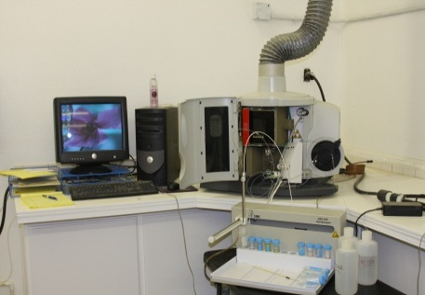
Laboratory Performance
Deviation Plot M3-K
Lab U6289A indicates high bias deviations in 2012 cycle 17, none in cycle 18 and general two of five in cycle 19.
Lab U7135A indicates general low bias deviations across all samples independent of concentration.
¹ Source: ALP 2012 database. Soil M3-K values range 39 - 502 ppm.
Miller, 2013

Slide 11
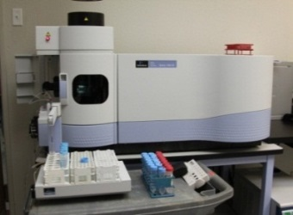
Evaluating Laboratory Bias
* Bias Flag(s)
Single Flag
Multiple Flags ( 2-5 )
- Random Error
- Near Detection Limit - Dilution Error
- Transcription Error
- Problematic Sample
Consistent
Low Bias
Consistent
High Bias
Both Low and
High Bias
Low Bias at all
Concentrations
High Bias at all
Concentrations
Dominant
High Bias
Evaluation based on assessment of five proficiency soils.
Low Bias at low
Concentrations
High Bias at Low
Concentration
Equal High and
Low Bias
Low Bias at high
Concentrations
High Bias at High
Concentration
Miller, 2013

Slide 12
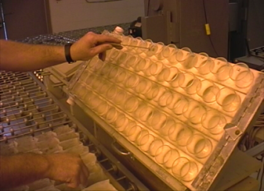
Evaluating Laboratory Bias
Multiple Flags ( 2-5 )
Consistent
Low Bias
Consistent
High Bias
Both Low and
High Bias
Low Bias at all
Concentrations
- Verify calibration Stds
- Verify extractant volume
- Check extractant Conc.
Systematically evaluate each component of the analysis, extraction, analysis and reporting relative to low bias.
Low Bias at low
Concentrations
- Verify low calibration Stds
- Verify extractant volume
- Check extractant Conc.
Low Bias at high
Concentrations
- Verify calibration Stds
- Verify extractant volume
- Check Extractant Conc.
Miller, 2013

Slide 13
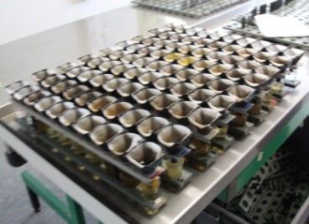
Evaluating Laboratory Bias – Cont.
Multiple Flags ( 2-5 )
Consistent
Low Bias
Consistent
High Bias
Both Low and
High Bias
High Bias at all
Concentrations
- Check for Contamination
- Verify calibration stds
- Check extractant Conc.
- Verify MDL
Systematically evaluate each component of the analysis, extraction, analysis and reporting relative to high bias.
High Bias at Low
Concentration
- Check for Contamination
- Verify low calibration Stds
- Verify extractant volume
- Check extractant Conc.
High Bias at High
Concentration
- Verify calibration Stds
- Verify extractant volume
- Check Extractant Conc.
Miller, 2013

Slide 14
Determining Method Bias Components
Cause-and-effect diagrams are used to systematically list the different component sources which contribute to total of bias in the analysis results. A cause-and-effect diagram can aid in identifying those sources with the greatest contribution.
“Ishikawa Diagram”
Test
Result
Miller, 2013

Slide 15
Fish-Bone Diagram of Soil M3-P Analysis
Use Component Factor
Analysis to Assess Bias
Extraction
Extractant
Shaker
Extract Volume
Time
Filter
Test
Result
Degree of
Mixing
Scoop
Calibration
Technique
Carry Over
Stability
Sample
Homogeneity
Operation
* Major Components
Instrument
Miller, 2013

Slide 16
Fish-Bone Diagram of Soil pH (1:1) H₂O
Bias Components
Extraction
- pH Calibration
- Electrode
- Other?
Stirring
Volume
Test
Result
Degree of
Mixing
Scoop
Calibration
Technique
Carry Over
Stability
Sample
Homogeneity
Electrode
Instrument
Miller, 2013

Slide 17
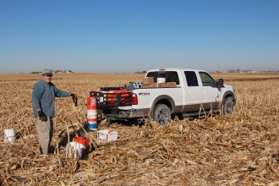
Example Bias Assessment
Plot M3-Ca
Lab U6816A
Fifteen soils ranging from 609-5100 ppm Ca, show significant systematic bias, trending low on soils with low M3-Ca and high on high testing soils. Best shown with regression with slope of 1.20, intercept is -344.
Low bias on low soils, high bias on high soils.
Source of Bias?
(1:1 line)
Number | 15
Minimum | 480
Maximum | 5700
Slope | 1.20
Intercept | -344
R² | 0.980
Miller, 2013

Slide 18
Diagram of Mehlich 3 Ca – Lab U6816A
Extraction
Bias Components
Volume
- Calibration Standards
- Reagent pH, Concentration
- Instrument Carryover
- Other?
Reagent
Shaker
Contamination
Temperature
Filter Paper
Filter Time
Bias of Result
Scoop
Stability
Carry Over
Degree of
Mixing
Technique
Calibration
ICP
For Ca, values in red may contribute to bias.
Number
Wavelength
Homogeneity
Analysis
Miller, 2013

Slide 19
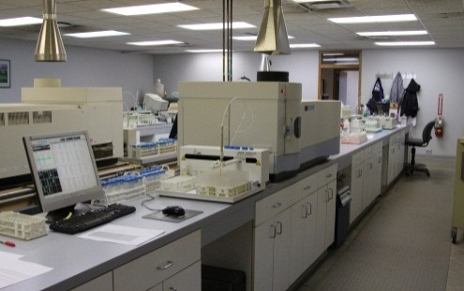
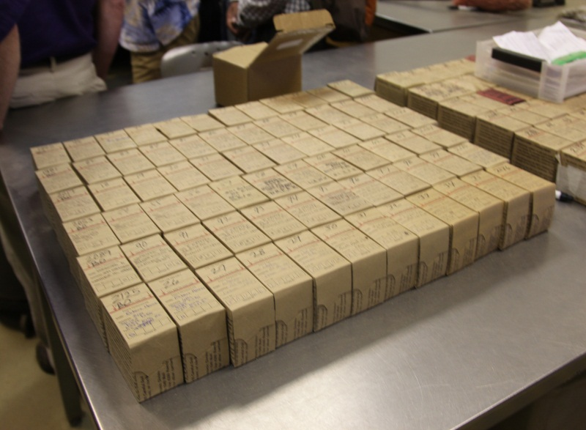
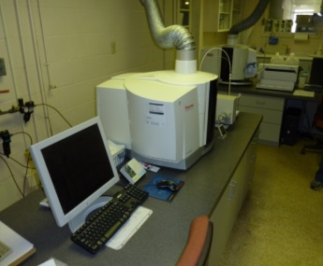
Example Bias Assessment
Check off List
Review bias results and develop a check off list as to extraction and analysis components which contribute to bias as it relates to concentration.
From this list develop a systematic to assess source of bias analytical results.
Parameter | Method Component
Extraction
 | Extractant Conc.
 | Extractant Volume
 | Contamination
 | Shaker
 | Filter Paper
 | Filtration Time
Analysis
Miller, 2013

Slide 20
Quality Flossing
Like dental hygiene, one should periodically assess your lab’s QC program effectiveness.
Through a review of PT program results, use of external standards, and double blind evaluations it’s good lab practice to evaluate lab bias and precision and make modifications to the QC program.
Miller, 2013

Slide 21
Thank you for your time and Attention

