Slide 1



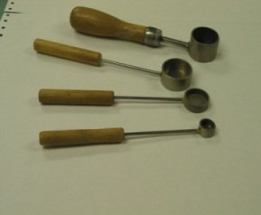
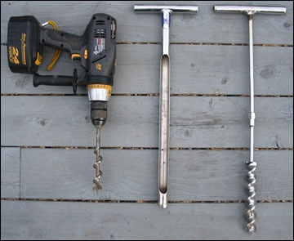
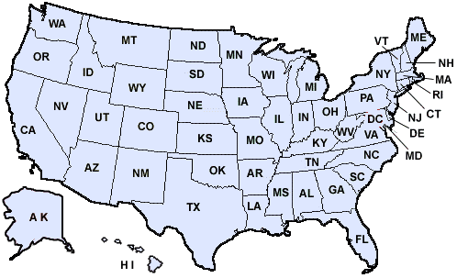

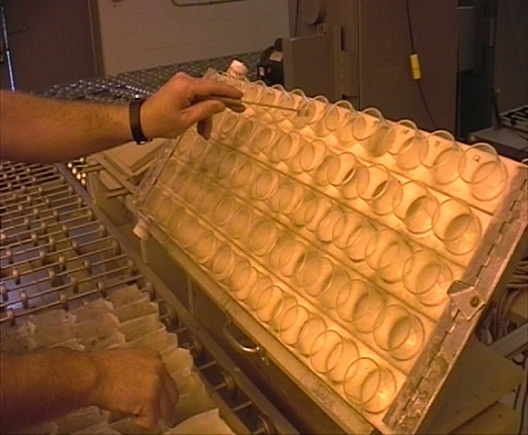

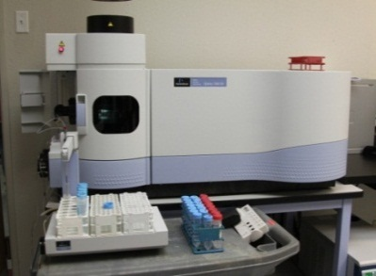
.
Agricultural Laboratory Proficiency Program
“Serving the Laboratory
Testing Industry, Improving
Laboratory Quality”
Soil
Plant
Water
Environmental Soil
.
https://encrypted-tbn0.google.com/images?q=tbn:ANd9GcQUEaNPo6Ro9YgrJeJMUFRcMD5EUNJmgTtHq9CPw5XlAeCKqBZY

Slide 2



Soil Testing: A Chain
The Measurement
Soil Sample
Test
Method
Calibration
Database
Soil Testing is based on three components, each linked to make an accurate recommendation.
Measurement Quality influence the outcome of the Interpretation and the management.
Miller, 2012

Slide 3
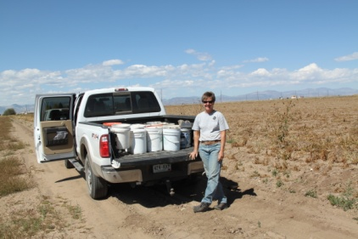
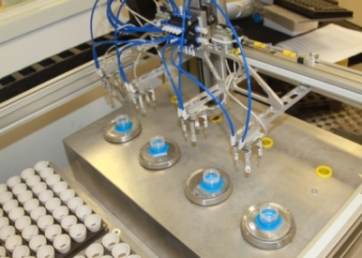



ALP Program Results
Overview: Program structure, components and operation.
Method Performance: Method intra-lab proficiency and precision.
Laboratory Proficiency: Assessment of testing industry performance.

Slide 4

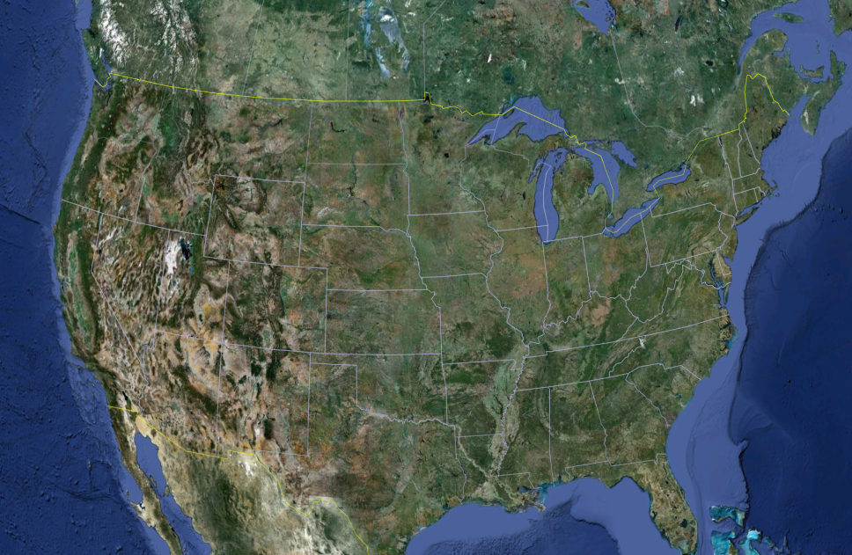
ALP Program
Structure
Collaborative Testing
- Christopher Czyryca, Director
- Ryan Cox, Data Analyst
- Robert Miller, Technical Director
- Larry May, Technician
Soils collected from 52 states and provinces:
Collections Pending
- Hawaii, Vermont, Alberta, Ontario
British Col., Quebec, Nova Scotia, Newfoundland, and Northwest Territories
Miller, 2012
Notes:
4

Slide 5
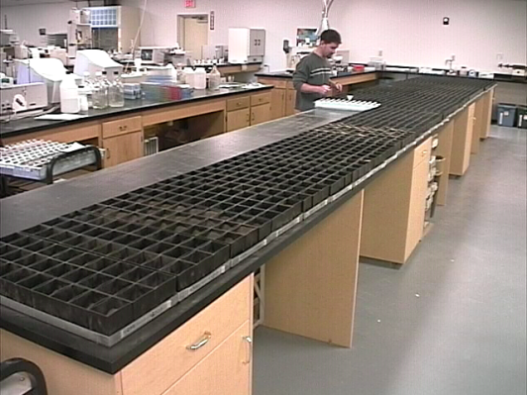
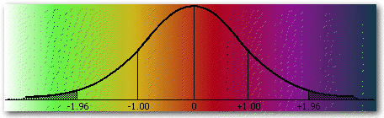
Program Operations
Three proficiency cycles conducted annually on: soils, botanicals, water and environmental soils based on regionally recognized test methods.
Soils utilized represent four regions, as represented by (SERA-6, WERA-103, NCERA-13, NECC-103), 48 states sampled. Botanical samples represent a diverse range of agronomic crops.
Lab method bias is evaluated based on the population median and 95% confidence limit of the method median. Samples are analyzed, in triplicate for calculating precision, based on the intra-lab standard deviation (stdev).
http://www.med.umkc.edu/tlwbiostats/stnderrmean.html
Miller, 2012

Slide 6
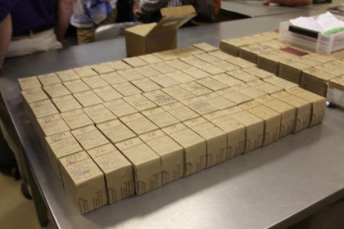
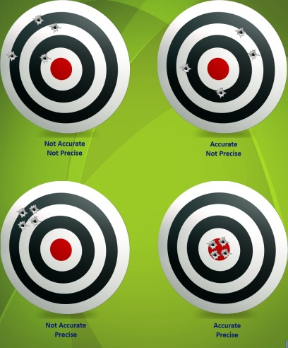
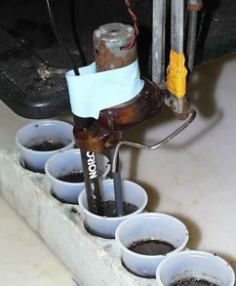
Method Performance
Soil Analysis Bias and Precision
Bias (accuracy) and precision is best depicted by the target bulls eye.
Bias evaluates soil test consistency between labs, important to the industry, whereas precision defines the uncertainty of the soil test within a laboratory.
http://www.amrl.net/AmrlSitefinity/Newsletter/images/Spring2012/5_image%201.jpg
Miller, 2012

Slide 7
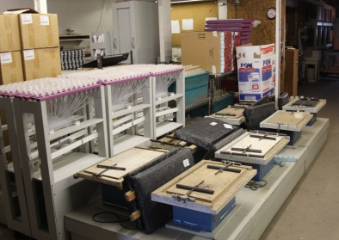

Method Performance
M3-K Intra-Lab stdev
Intra-lab precision (i.e. stdev) distribution across labs is skewed. Example: results for M3-K, show 71% of the stdev are between 0 and 2 ppm for a soil with 52 ppm K, 28 labs.
Increased soil test levels result in higher stdev, but consistent skewed population. The method median intra-lab stdev is 1.2 and 2.5 ppm for the two soils shown.
Method uncertainty is calculated using the stdev based on α -0.05 .
SRS-1202
M3-K: 52 ppm
SRS-1204
M3-K: 126 ppm
Miller, 2012

Slide 8
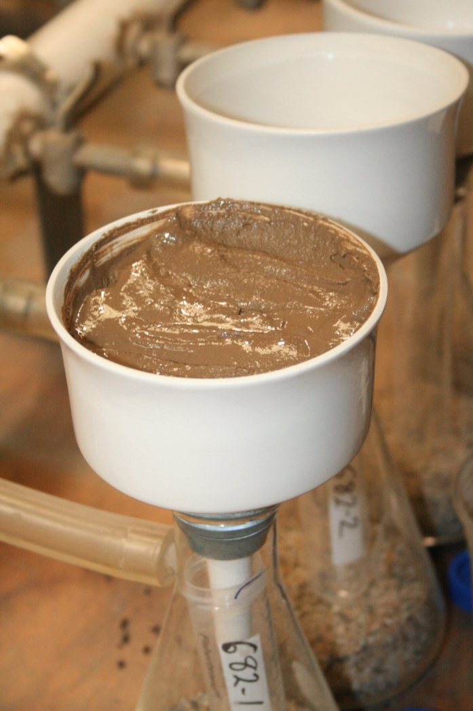
Method Performance
M3-K Median and Intra-Lab stdev
¹ 75 soils, 2007-2012, three replications.
Miller, 2012

Slide 9
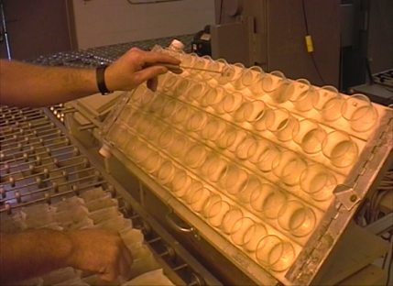
Method Performance
Inta-Lab Precision K
Soil Analysis / Sample
Mean ¹
Stdev
Uncertainty ²
Mehlich 1 K (ppm)
SRS-1107
SRS-1111
SRS-1112
SRS-1113
Mehlich 3 K (ppm)
SRS-1107
SRS-1111
SRS-1112
SRS-1113
39
69
134
275
54
88
155
466
1.5
0.9
3.1
5.1
3.4
4.1
7.7
11.4
± 3.7
± 2.2
± 7.7
± 12.6
± 8.4
± 10.1
± 19.1
± 28.3
¹ Summary statistics based on ALP 2011 data base.
² Uncertainty based on α 0.05 and 3 replications.
Miller, 2012

Slide 10
Method Performance
Intra-Lab Precision P
Soil Analysis / Sample
Mean ¹
Stdev
Uncertainty ²
Mehlich 1 P (ppm)
SRS-1107
SRS-1111
SRS-1113
Mehlich 3 P ICP (ppm)
SRS-1107
SRS-1111
SRS-1113
10.5
22.5
35.0
31.4
72.1
16.0
0.3
0.9
1.3
2.0
2.6
0.9
± 0.8
± 2.2
± 3.2
± 4.9
± 6.5
± 2.3
¹ Summary statistics based on ALP 2011 data base.
² Uncertainty based on α 0.05 and 3 replications.
Miller, 2012

Slide 11
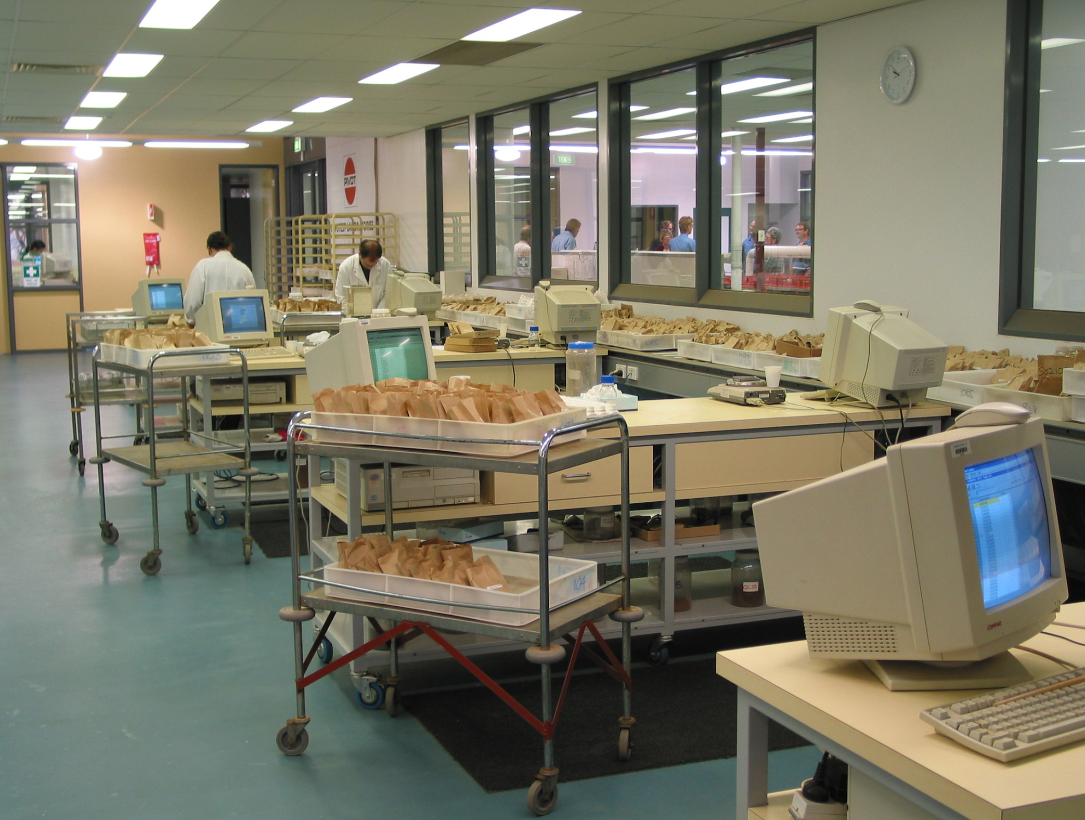
Method Performance
Intra-Laboratory Summary - Soils
Method relative uncertainty was calculated (uncertainty/median x 100) and indicates similar extraction methods are not equivalent.
Mehlich 1 (M1) had the lowest relative uncertainty for P and K.
Micronutrient (B, Zn, Mn, Cu) uncertainty was generally > 20% for DTPA and M3 methods and 8-12% for the M1 method.
Analysis | Relative Uncertainty
pH (1:1) H₂O | ± 2.4 %
Bray P (ppm) | ± 14 %
M1-P (ppm) | ± 9 %
M3-P (ppm) | ± 15 %
X-K (ppm) | ± 11 %
M1-K (ppm) | ± 6 %
M3-K (ppm) | ± 10 %
SOM-LOI (%) | ± 12 %
¹ Based on 45 ALP samples 2009-2012, soil P values < 100 ppm, pH < 7.5, removed.
Miller, 2012

Slide 12
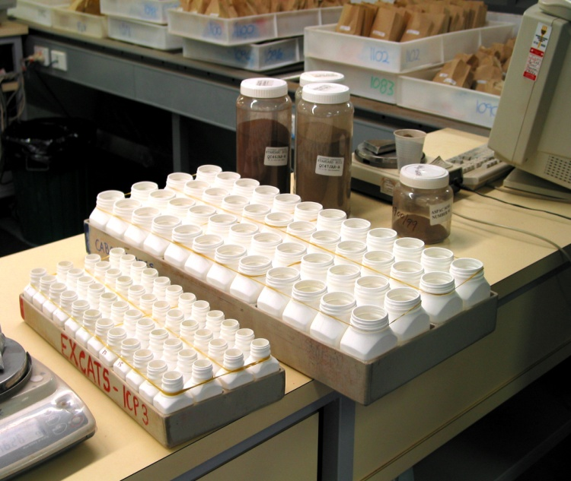
Method Performance
Intra-Laboratory Summary - Soils
Relative Uncertainty | Soil Analysis Method (Ranked low to high)
1 – 5 % | pH, Buffer pH, Saturated Paste %, Bray-K, M1-Mg
5 – 10 % | M1-Ca, M1-K, NO₃N-CTA, M1-Mn, M1-Zn, M3-Al, TOC, M1-P, M3-Ca, M3-Mn
10 – 15% | M3-K, X-Ca, M3-Mg, X-K, NO₃N-Cd, SOM-LOI, X-Mg, M3-Cu, M3-P ICP, Bray-P
15 – 25 % | CEC, TKN, M3-Zn, Clay %, EC, Bicarb-P, DTPA-Zn, M3-S, DTPA-Cu
25 – 35 % | M3-Na, Hot W-B, Cl, Extr. SO₄-S, M3-B, SAR, NH₄-N
¹ Based on 50 ALP samples 2009-2012, soil P values < 100 ppm, pH < 7.5, removed.
Miller, 2012

Slide 13
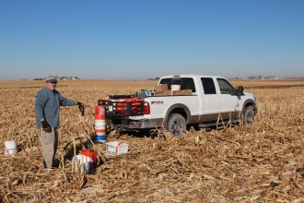
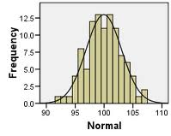
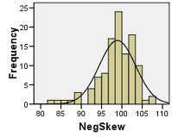
Laboratory Performance
Overview
Laboratory method bias evaluates soil test consistency between labs, important to the industry. It is evaluated using a 95% confidence limit of the population median.
Miller, 2012

Slide 14
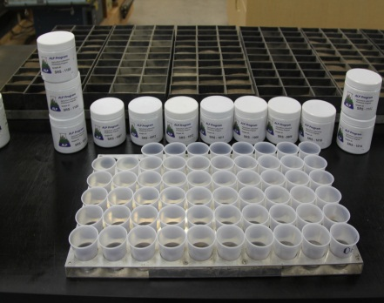
Laboratory Performance
Inter-Lab M3-K Distribution, 2011 ¹
SRS-1111
SRS-1112
50th Percentile
Median and 95%
Confidence Limits
}
154 ± 35 mg/kg
}
88 ± 23 mg/kg
Lab Number
¹ ALP Data base 2011 Cycle 16, lab result plotted low to high
Miller, 2012

Slide 15
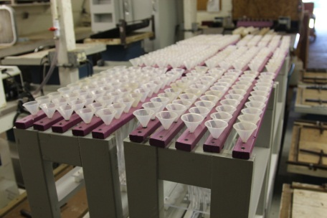
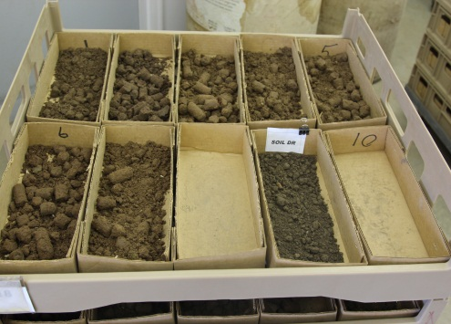
Laboratory Performance
Lab Proficiency Soil SRS-1109 ¹
For Cycle 14, 16% of 46 labs provided pH results exceeding the 95% confidence limits of 7.40 ± 0.21 units.
For M3-K 10% of 26 labs provided results exceeding 95% CL of 162 ± 38 ppm
Soil Test | Soil SRS-1109
 | Median | 95% CL | Labs > CL¹
pH (1:1) H₂O | 7.40 | ± 0.21 | 16 %
Bray P (ppm) | 35.7 | ± 14.5 | 11 %
M1-P (ppm) | 30.0 | ± 5.2 | 11 %
M3-P ICP (ppm) | 42.8 | ± 16.0 | 10 %
X-K (ppm) | 160 | ± 30 | 21 %
M3-K (ppm) | 162 | ± 38 | 10 %
DTPA-Zn (ppm) | 0.40 | ± 0.19 | 8.5 %
SOM-LOI (%) | 4.1 | ± 1.4 | 8.3 %
¹ Lab bias based on 95% Confidence Limits.
Soil SRS-1109 was a fine sandy loam collected from Cassia, Cty ID.
Miller, 2012

Slide 16
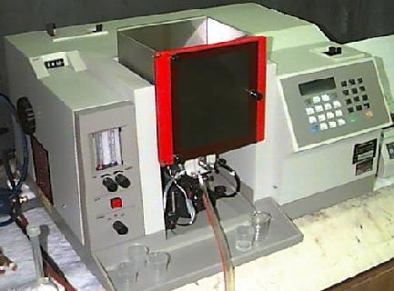
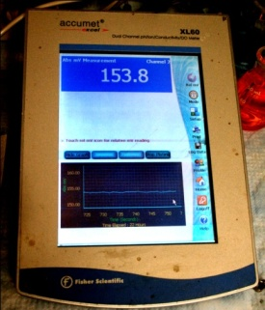
Laboratory Performance
Box Whisker Plot X-K ¹
http://www.cartage.org.
SRS-1205
SRS-1106
SRS-1203
Soil ID
SRS-1204
Box 25th and 75th %
Whisker 5th & 95th %
SRS-1111
SRS-1202
95% CL are 20% -40% of the median for soils with < 150 ppm K
SRS-1013
¹ Seven ALP soils sorted low to high K, 2010-2012.
Miller, 2012

Slide 17
Laboratory Performance
Box Whisker Plot M3-P ¹
SRS-0911
SRS-1101
SRS-1204
Soil ID
SRS-1114
SRS-1202
SRS-1013
Box and 95% CL widen with increased M3-P concentrations
¹ Six ALP Soils sorted low to high K, 2009-2012.
Miller, 2012

Slide 18
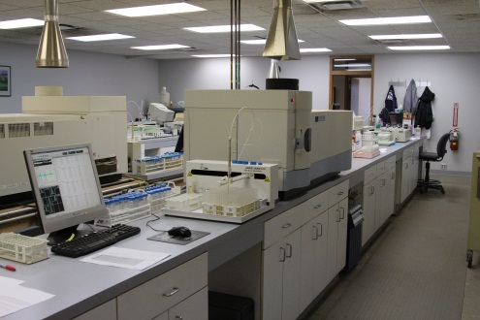
Laboratory Performance
Lab Proficiency Soil SRS-1111 ¹
For Cycle 16, 19% of 46 labs provided pH results exceeding the 95% confidence limits of 5.58 ± 0.23 units.
For M3-K 16% of 25 labs provided results exceeding the 95% CL of 88 ± 23 ppm
Soil Test | Soil SRS-1111
 | Median | 95% CL | Labs > CL ¹
pH (1:1) H₂O | 5.58 | ± 0.23 | 19 %
Bray P (ppm) | 67.3 | ± 14 | 17 %
M1-P (ppm) | 22.1 | ± 13 | 0 %
M3-P ICP (ppm) | 72 | ± 22 | 19 %
X-K (ppm) | 83 | ± 40 | 4 %
M3-K (ppm) | 88 | ± 23 | 16 %
SOM-LOI (%) | 0.81 | ± 0.35 | 11 %
¹ Percent of laboratories exceeding 95% confidence limits.
Soil SRS-1111 was a sandy loam collected from Lee Cty, AL.
Miller, 2012

Slide 19
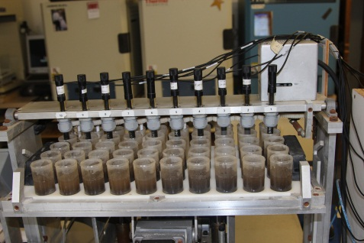
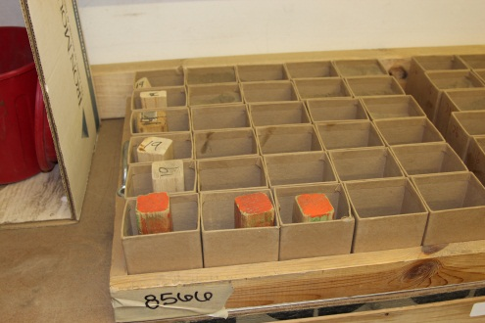
Laboratory Performance
Secondary Methods - Confidence Limits ¹
Confidence limits for salt pH were superior to water pH. Sikora Buffer pH CL vary by soil.
NO₃-N CL increase near the MDL. Generally CL for micronutrients range from 25 to 50% of median, increase to 100% near MDL.
Soil Test | SRS-1106 | SRS-1204
pH (1:1) CaCl2 | 6.24 ± 0.11 | 4.46 ± 0.15
Sikora Buf. | 7.37 ± 0.12 | 6.36 ± 0.40
NO₃-N (ppm) | 36.5 ± 4.6 | 0.9 ± 0.9
Al-KCl (ppm) | 4.2 ± 5.5 | 108 ± 10
M1-Zn (ppm) | 2.6 ± 1.5 | 0.38 ± 0.24
M3-Zn (ppm) | 3.2 ± 0.7 | 0.52 ± 0.49
M3-B (ppm) | 0.62 ± 0.40 | 0.22 ± 0.20
HTW-B (ppm) | 0.52 ± 0.26 | 0.26 ± 0.14
¹ Percent of laboratories exceeding 95% CL, 2011-2012.
MDL – Method Detection Limit.
Miller, 2012

Slide 20
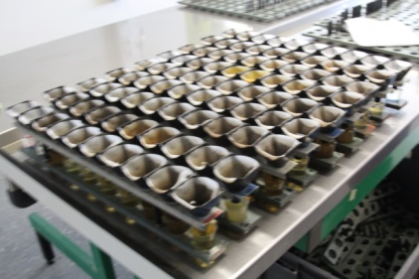
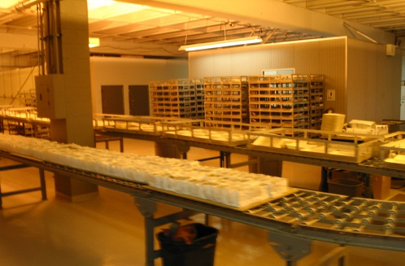
Laboratory Performance
Method Summary
Percent of labs flagged for bias is a function of:
Soil Test | Percent of Labs Flagged for Bias ¹
pH | 12% - 14%, pH < 6.0 15% - 20%
Bray P | 15% - 18%, P > 80 ppm > 20%
M1-P | 15% - 20%
M3-P (ICP) | 15% - 20%, P > 100 ppm > 20%
X-K | 8% - 12%, K < 125 ppm 20%
M1-K | 10% - 15%
M3-K | 10% - 15%, K < 125 ppm 20%
SOM-LOI | 8% - 10%
Analysis Method
Population Distribution
Analyte Concentration
¹ Percent of laboratories exceeding 95% CL, 2010-2012.
Miller, 2012

Slide 21
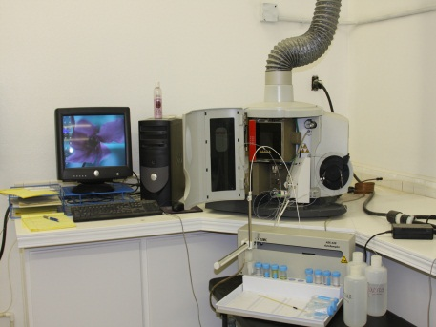
Laboratory Performance
Lab Bias
Individual laboratory bias can be attributed to method deviation(s).
Although it may occasionally be a single specific soil, often it can be attributed to a chronic method deviation.
Method bias (deviation) often is associated with instrument calibration.
Example: M3-K ICP
Miller, 2012

Slide 22
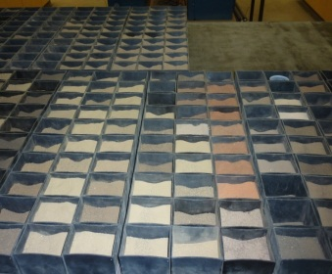
Mehlich 3 K Solution Evaluation
ICP Labs, 16, sorted by mid range standard
Cycle 13 of 2010, five M3 solutions were submitted to 16 laboratories enrolled in the ALP Program.
K concentrations ranged from 0 to 451 ppm on a soil basis. Laboratories performed analysis in triplicate.
ID¹ | K (ppm)
Bottle #1 | 154
Bottle #2 | 86.5
Bottle #3 | 55.2
Bottle #4 | 451
Bottle #5 | 0
* Concentrations soil basis
Labs #1, #15 and #16 have bias calibration issues.
¹ An evaluation of M3 solutions conducted cycle 12, 16 labs.
Miller, 2011

Slide 23


Laboratory Performance
Laboratory instrument calibration accounts for 18% of the labs that are flagged for method bias for M3-K, and 14% for M3-P.
What is the consequence for consistent performance issues?
Miller, 2012
http://vadlo.com/cartoons.php?id=9

Slide 24

Thank you for your time and Attention

