Slide 1

Current Status of Soil Test Calibration in Mississippi
Bobby R. Golden
Delta Research and Extension Center
479-409-6191
bgolden@drec.msstate.edu
Mississippi-crops.com

Slide 2
Updating Soil Test Correlations in MS
Why are we interested in doing this ?
Changing crop rotational mix
Improved production practices since last major update
Lancaster unpublished data (19?)

Slide 3

Interpretation of Soil Test Results
A soil-test value is an INDEX, is not “the” total amount available (snapshot in time)
Field calibrations with crop response give a meaning to soil-test values by different testing methods.
  critical/optimum value or range
  interpretation classes
  application rate for responsive ranges

Slide 4
How do we get there ?
Program Development for Correlation/Calibration
Currently working on Corn, Soybeans, and Cotton.
P, K, Zn
Major Goal:
  Field correlate soil test index to yield response and tissue concentrations

Slide 5
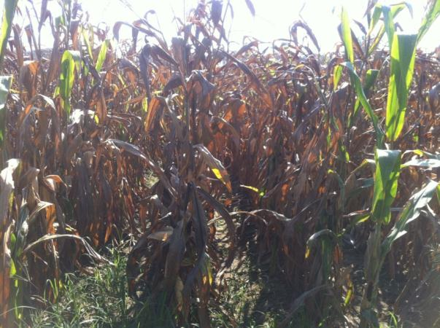
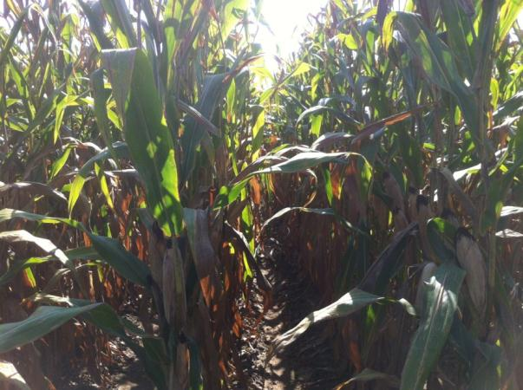
Potassium and Corn
0 lb K₂O/acre
Soil test K in the top 6” of soil is an indicator of corn yield responsiveness in the Midwest.
Does this hold true for the Midsouth?
However corn is new to the Midsouth and little research has been conducted to establish critical values
160 lb K₂O/acre

Slide 6
Corn Response to K Fertilization
73 bu/ac yield response
27 bu/ac yield response
Golden unpublished data (2012)

Slide 7
Corn Response to K Fertilization
Golden unpublished data (2012)

Slide 8
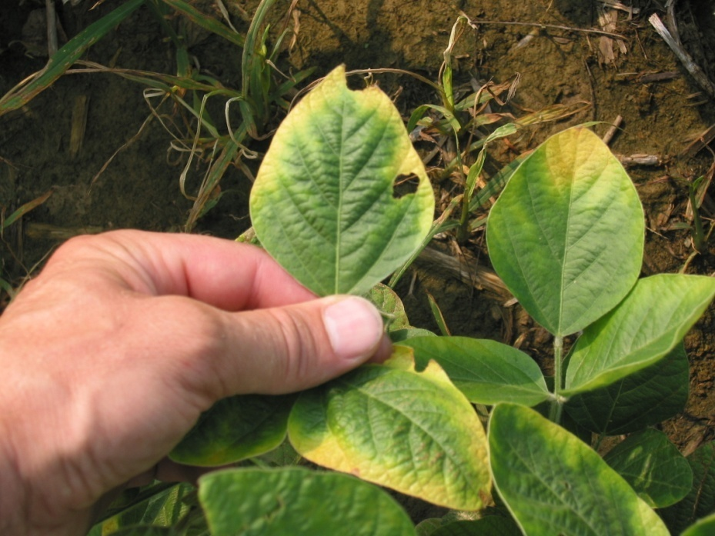
Potassium and Soybean
Soil-test K in the top 4 or 6 inches of soil is an excellent predictor of soybean responsiveness to K fertilization.
  Slaton et al. 2010
  Mallarino et al., 2005
  Clover and Mallarino, 2009
Notes:
I think that those slide set to table to underscore why soil testing is important. I heard a lot yesterday about people saying fertility is voodoo magic

Slide 9
Soybean Actual Yield at Responsive sites
8 bu/ac response
10 bu/ac response
Golden unpublished data (2012)

Slide 10
Soybean Yield Response to K Fertilization
Golden unpublished data (2012)

Slide 11
Soybean Tissue Response to K Fertilization
Golden unpublished data (2012)

Slide 12
Mehlich 3 - Lancaster Correlation
Golden unpublished data (2012)

Slide 13
Mehlich 3 – Lancaster Correlation
Golden unpublished data (2012)

Slide 14
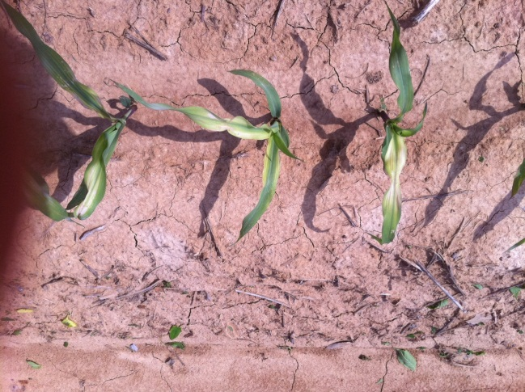
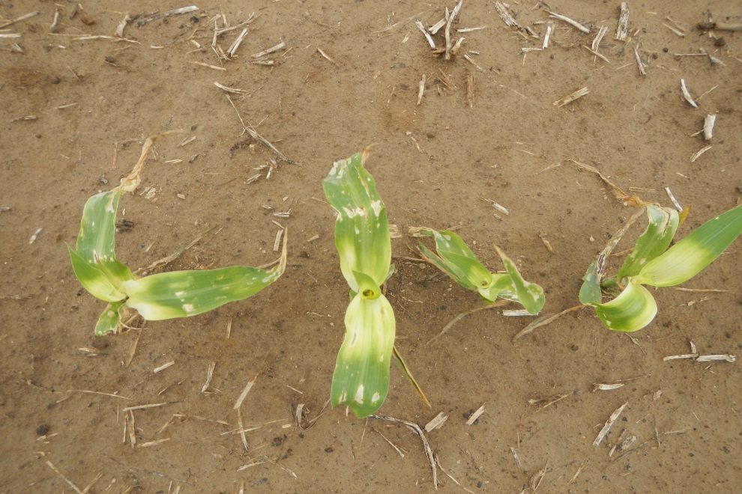
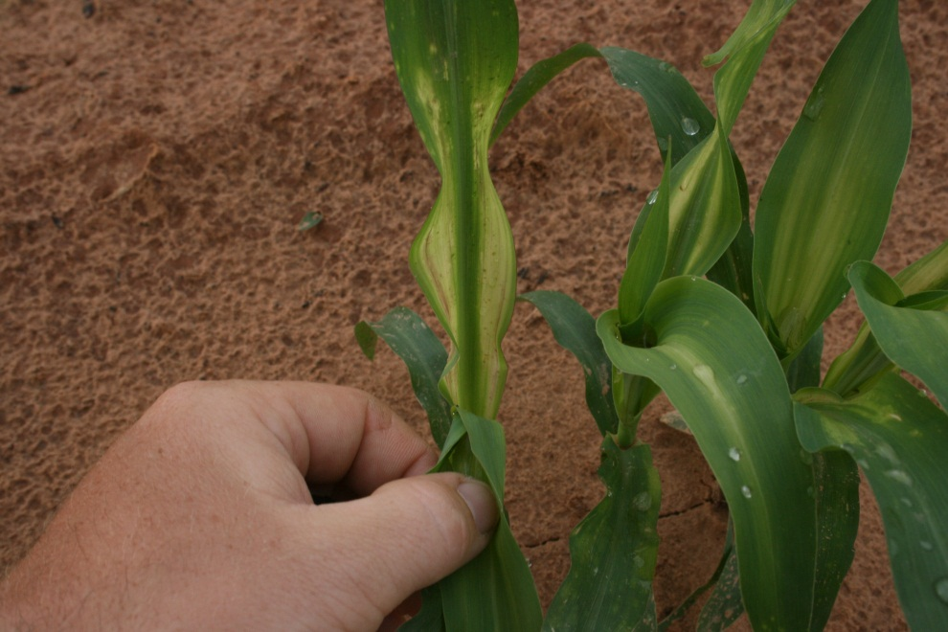
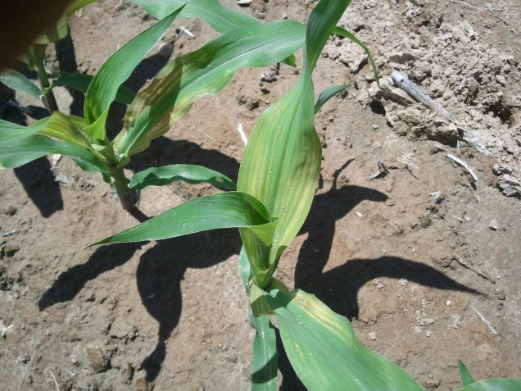
Zinc Deficiency Symptomology
Notes:
Corn plants that did not receive Zn are shown here

Slide 15
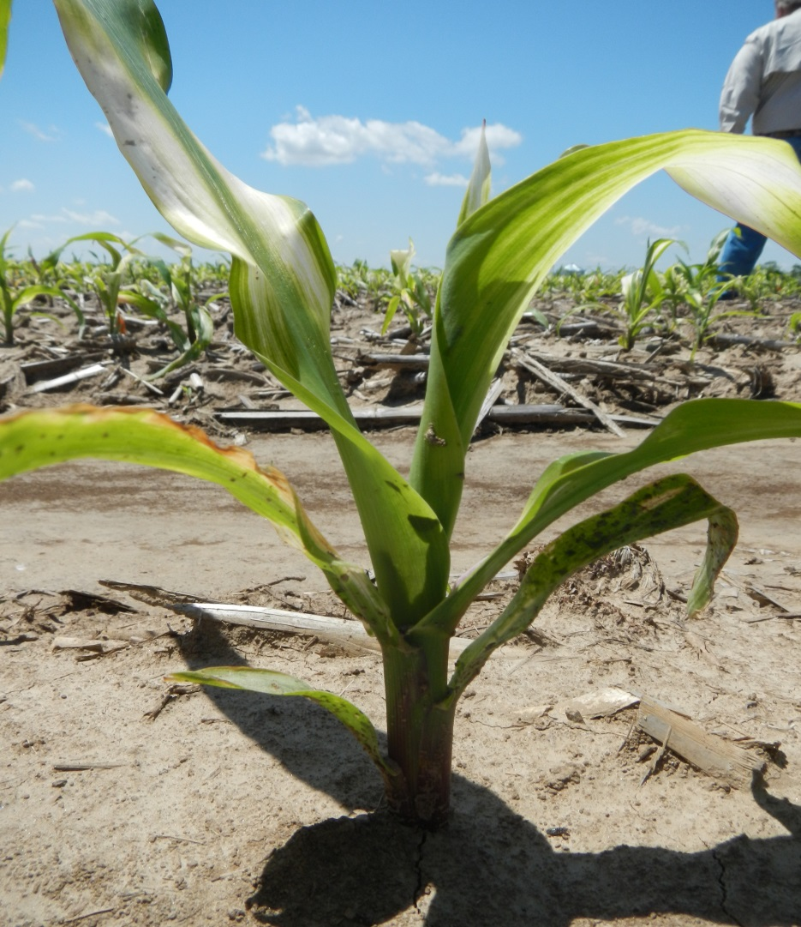
Methods of Zn Fertilization
Soil Applied
  10 lb Zn/acre as a granular fertilizer
  Adjust rates based on water solubility of Zn sources
Foliar Applied
  Apply 1-2 lb Zn/acre after emergence
  Chelated for soil application (Little foliage for interception)
  Sulfate for foliar application (larger plants)
Notes:
NOT HIGHLY MOBILE IN THE SOIL

Slide 16

Corn Response to Zn Rate

Slide 17
Corn Yield Response to Zn Fertilization

Slide 18
Mehlich 3 - Lancaster Correlation

Slide 19
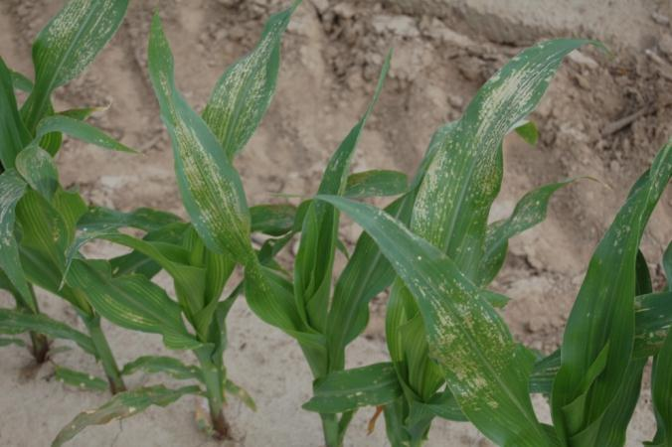
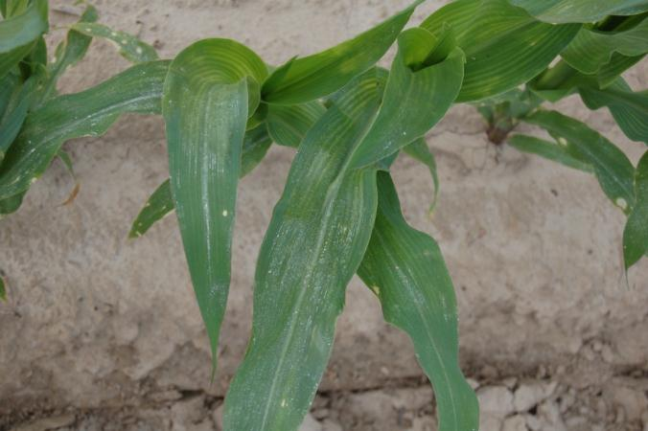
Zn Product Foliar Burn
Citric Acid Chelate @ 2lb Zn
EDTA Chelate @ 2lb Zn

Slide 20
Zinc Product Foliar Burn @ 6d after application

Slide 21
Zinc Foliar Burn - Tissue Concentration @ 2 WAA
Golden unpublished data (2012)

Slide 22
Zinc Foliar Burn Tissue Concentration @ 2 WAA
Golden unpublished data (2012)

Slide 23
Zn Foliar Burn Grain Yield
Golden unpublished data (2012)

Slide 24
Zinc Basics
Soil test Zn coupled with pH is a good indicator of need
Use the Right rate for the Zn source and soil
Remember not all Zn fertilizers are created equal
  Must take into account water solubility
  Supply Zn early

Slide 25
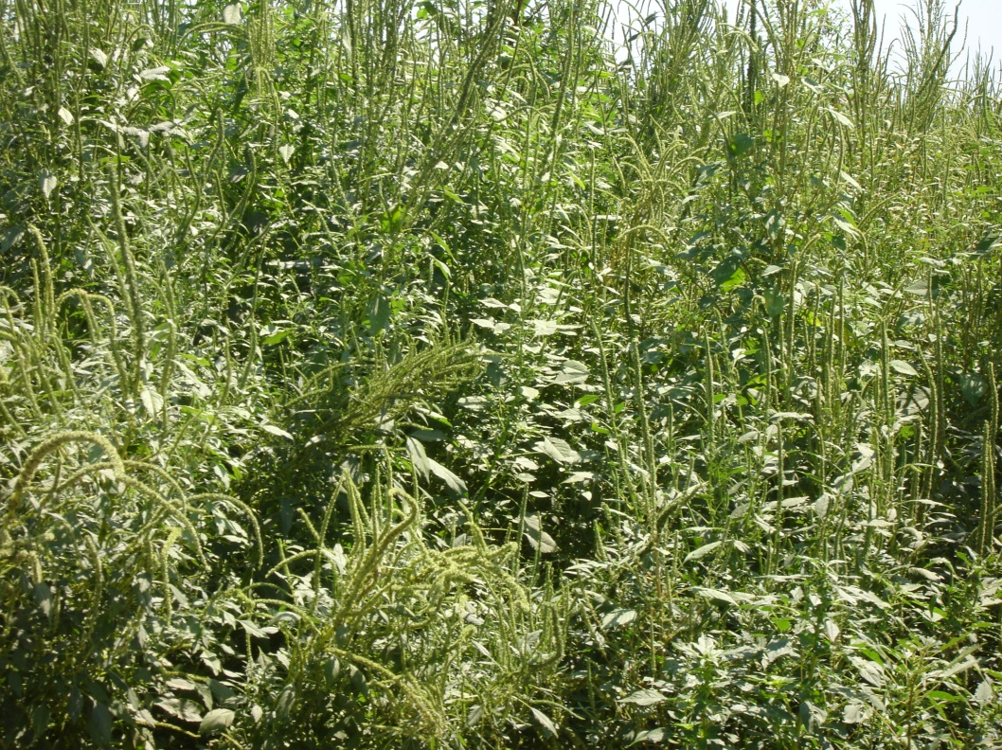
At the End of the Day
Fertilizer costs money, but yield pays the bills: High fixed production costs for land, good seed, equipment
  relative costs, and business management approach

