Slide 1
Soil Health Tradeoffs may be Minimal in P-Enriched Coastal Plain Soils
MASTPAWG Annual Meeting
22-23 February 2023
Lauren R. Mosesso and Amy L. Shober

Slide 2
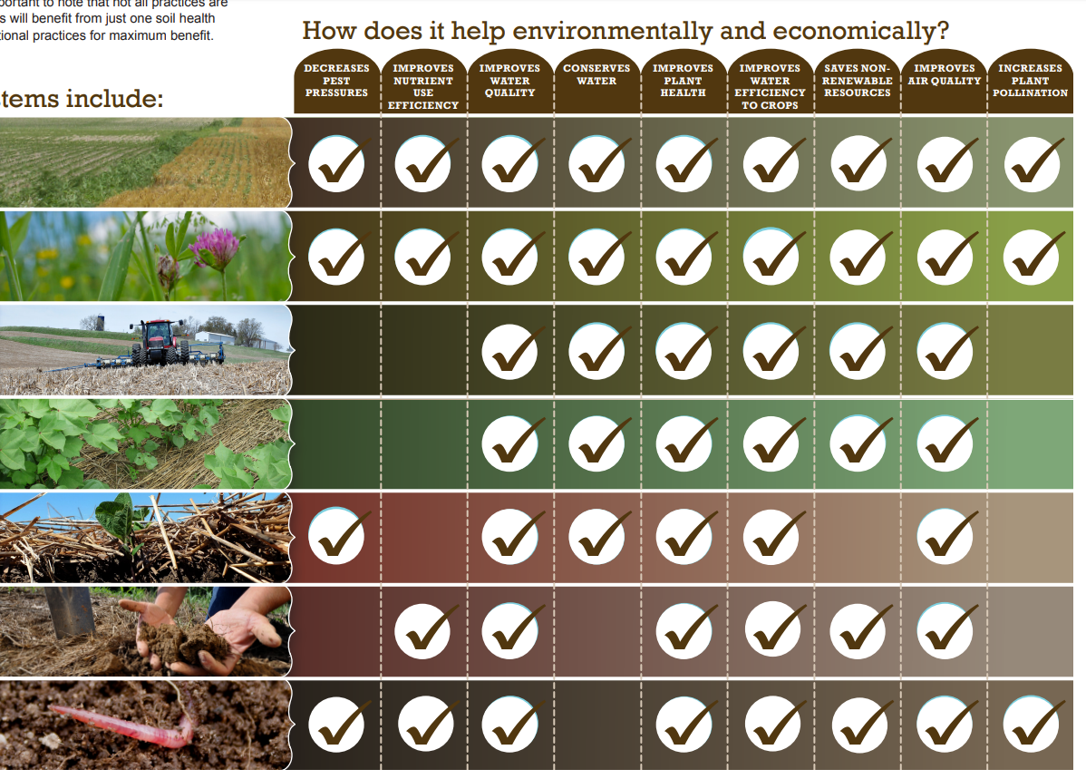
Recommended Soil Health Practices
Conserv Rotation
Cover Crop
Mulch Tillage
No-Till
Mulching
Nutrient Mgmt
Pest Mgmt
Notes:
Farmers are increasingly implementing soil health practices to achieve various ecosystem services. And if we look at the NRCS recommended suite of Soil Health Practices, we can see that many are touted to produce multiple ecosystem benefits. Interestingly, “improving water quality” is listed as a benefit across all soil health practices.

Slide 3
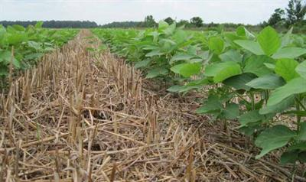
Soil Health Practices Benefit Water Quality
Reduced erosion and particulate P losses (Kasper et al., 2001; Uribe et al. 2018)
Delayed and reduced runoff (Blanco-Canqui et al., 2013)
Harvested cover crops can help drawdown soil test P (Schoumans et al., 2014)
Notes:
And researchers have actually documented some of these water quality related benefits in the scientific literature.

Slide 4
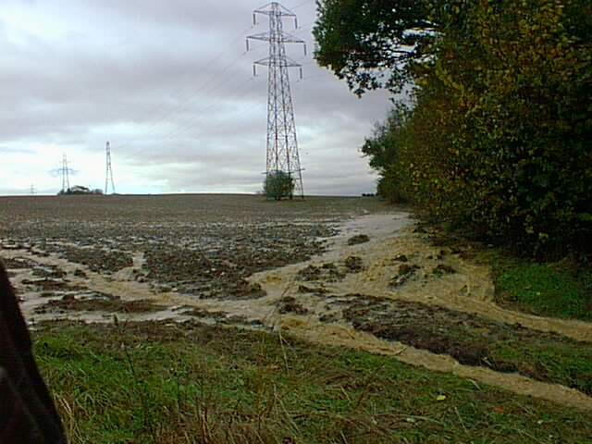
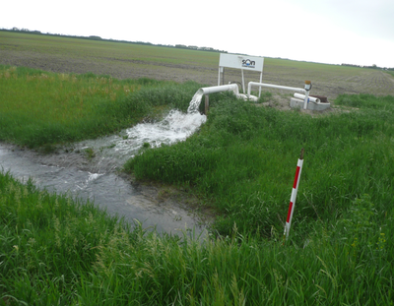
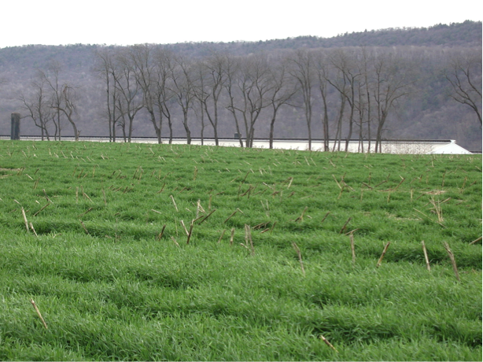
Acknowledging Potential Tradeoffs
Nitrogen vs. Phosphorus
Surface vs. Subsurface
Particulate P vs. Dissolved P
This Photo by Unknown Author is licensed under CC BY-SA-NC
Notes:
While we implement soil health and other CPs to reap their benefits, we must also acknowledge that every land management decision is not without potential consequences. It’s important to understand and acknowledge these potential tradeoffs when planning and implementing CPs. Potential tradeoffs include, a reduction in loads of one nutrient at the expense of another, a decrease in nutrient load one form but increase the load from another, or a shift in nutrient or sediment loss pathways. Plus, the potential for CP tradeoffs can vary spatially and temporally due to external factors like climate, physiographic and landscape properties, and nutrient legacies.
It is not our intention to discount the value of conservation practices by acknowledging potential tradeoffs related to P. Instead, we hope to provide information that will help land managers minimize or mitigate potential P tradeoffs associated with conservation practices. Let’s take a deeper dive to examine the potential tradeoffs associated with three conservation practices: tillage management and cover crops, which represent our soil health practices and drainage.

Slide 5
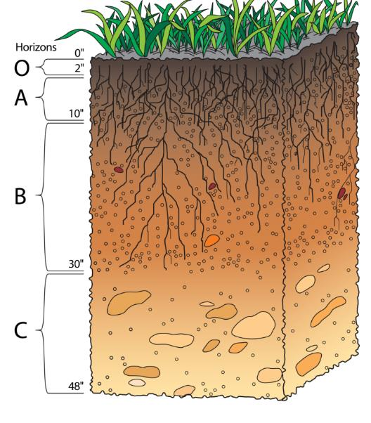
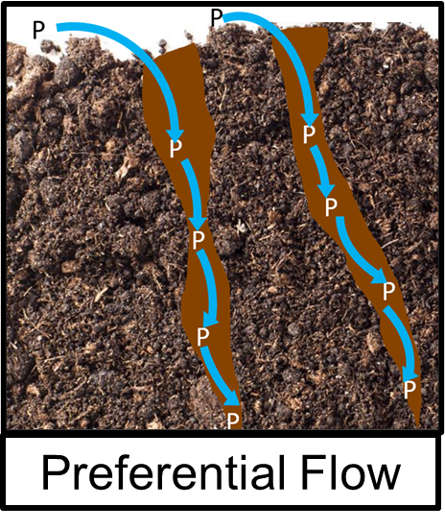
Examples of Potential Trade-Offs
Practices increase DP loss potential
  Soil stratification
  Preferential flow formation
Low
P Concentration
High
Cover Crop
Photo source for soil profile: NRCS
Background
Notes:
However, soil health practices, such as no-tillage and conservation tillage, can have unintended trade-offs. Previous research has found that fields with reduced or no-till practices are more likely to have P stratification in the plow layer and (CLICK) pref flow pathways as there is little to no tillage dilutes the band of P and break up pref flow pathways.

Slide 6
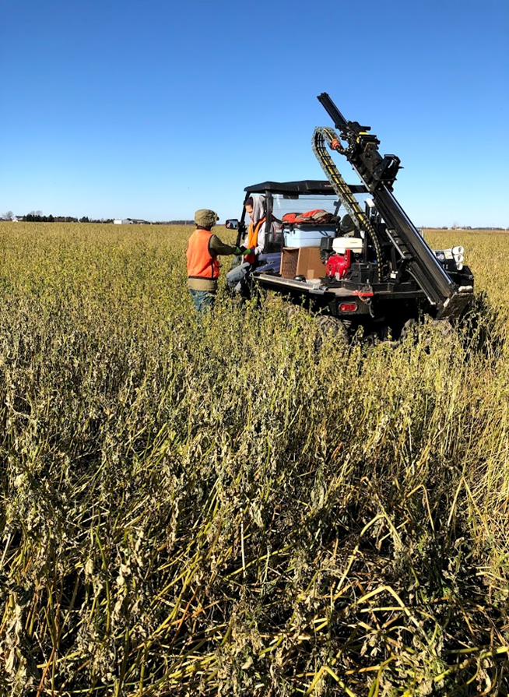
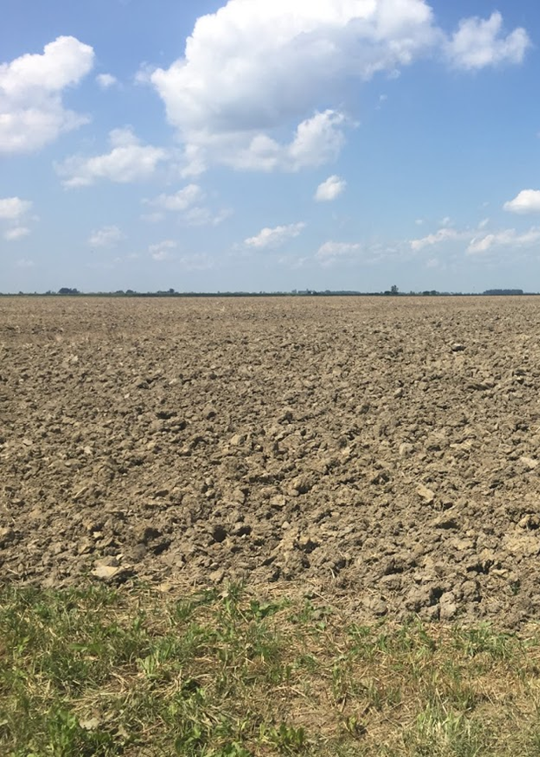
P Tradeoffs and Soil Health/Conservation
Duncan et al. (2020) doi:10.2134/ael2019.04.0014 (open access)
Osmond et al. (1999) doi:10.2134/jeq2019.03.0114 (open access)
Background
Notes:
If you are interested in reading more about P tradeoffs, I wanted to make you aware of two open access resources that cover the concept in more detail. The first is a commentary on Phosphorus and Soil Health Practices that is a product of the SERA-17 Phosphorus workgroup. I would recommend starting with this paper as it is quite short and gives perspective on potential tradeoffs between soil health and phosphorus management. The second article looks beyond soil health practices to discuss the potential tradeoffs between conservation practices in general and phosphorus management.

Slide 7
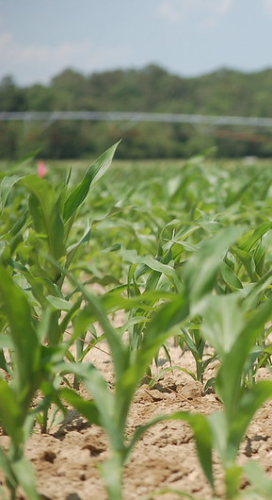
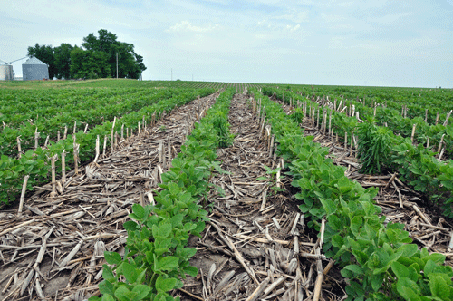
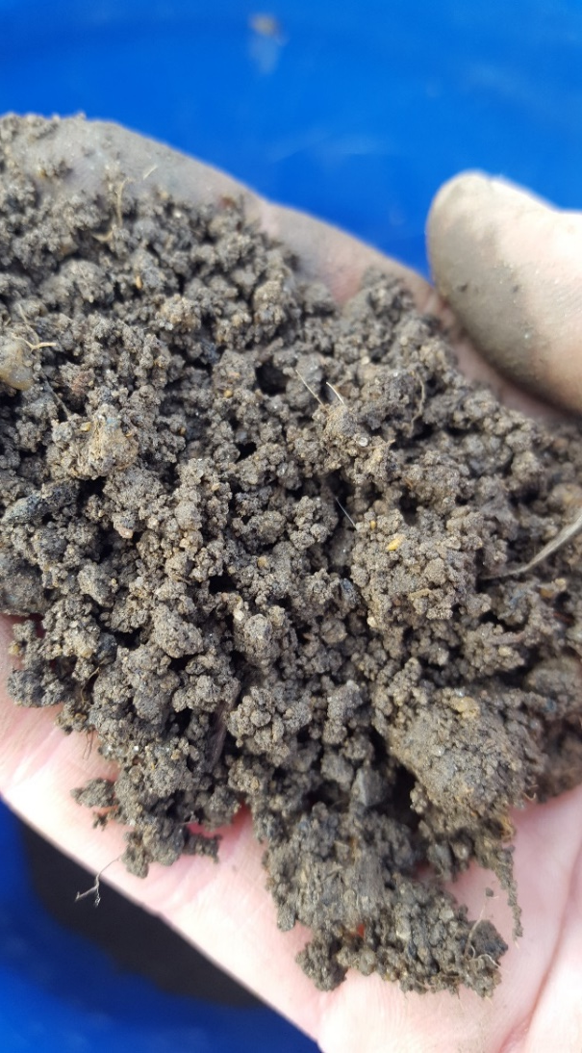
How Likely are P Tradeoffs in High P Soils?
Will adding soil health practices make P problems worse?
  P Stratification
  Preferential flow
Conventional Tillage
Soil aggregates
Conservation Till
Photo Credits: Michele Walfred
Background
Notes:
To our knowledge, no studies have investigated the potential for P stratification and formation of preferential flow pathways from implementing soil health practices like conservation tillage and cover crops on soils with elevated soil test P concentrations. In this study, we evaluated soil P stratification and dry aggregate stability in fields with a history of PL application and with a range of soil health practice implementation.
We expected that fields with long-term soil health practices would have P stratified in topsoil (b/c no or minimal tillage mixing applied P into soil) and start to see the formation of preferential flows (tillage breaks these up and cover crop roots can promote these too).
Lastly, we estimated annual particulate, runoff, and leachate P loads from each site using the NC P Loss Assessment Tool (NC-PLAT) under two scenarios assuming no P additions: 1) no-till corn and full season soybean with winter cereal cover crop and 2) conventional tillage corn and soybean with winter fallow.

Slide 8
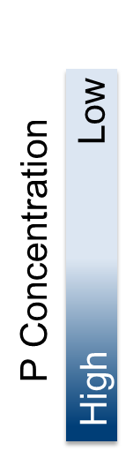
How Bad are P Tradeoffs in High P Soils?
Low P Soils with Tillage
P-enriched soils
Stratification?
Background

Slide 9
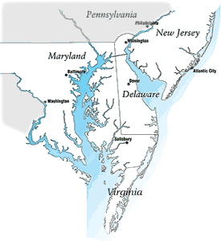
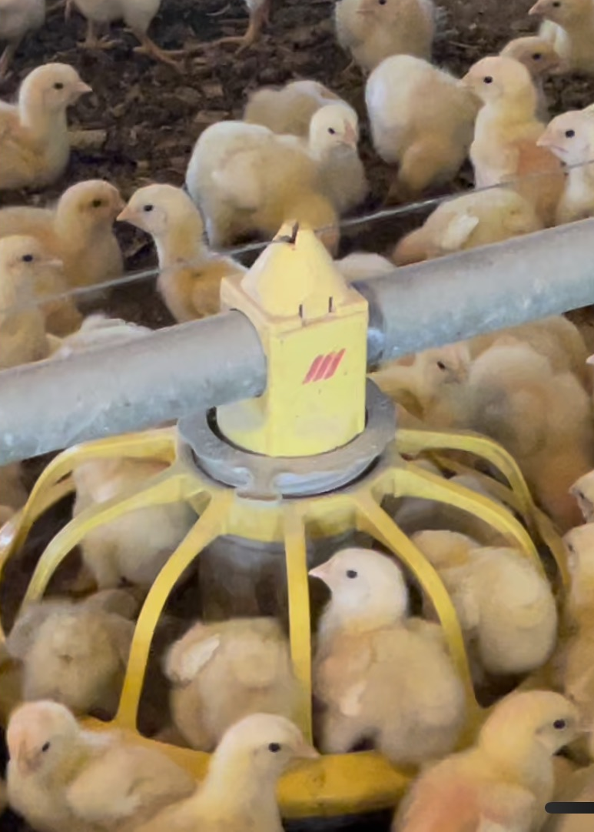
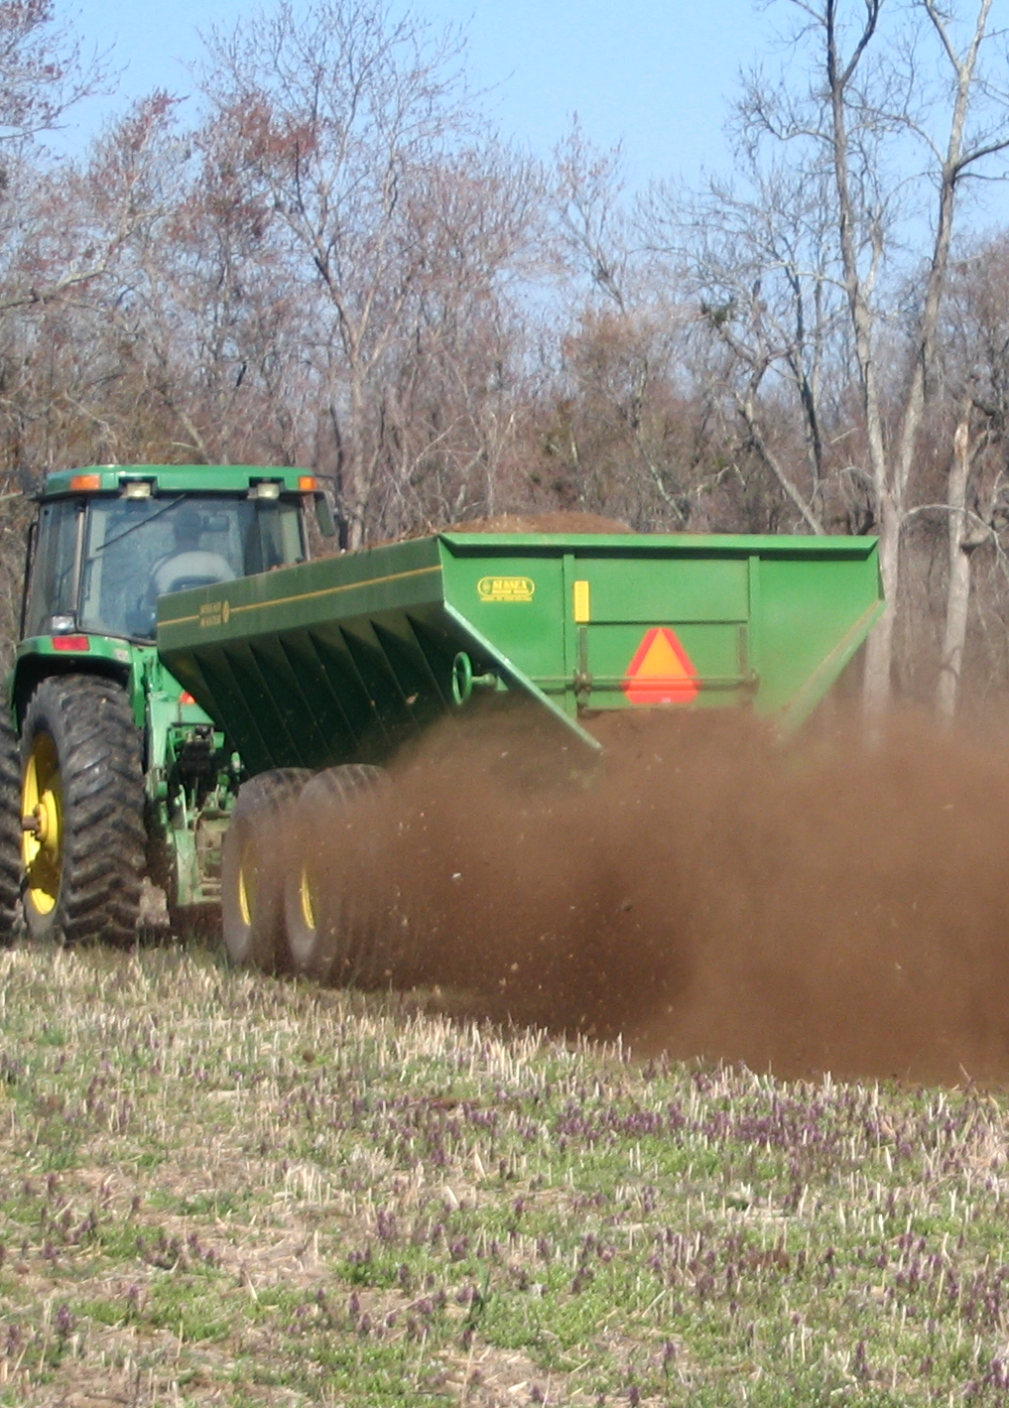
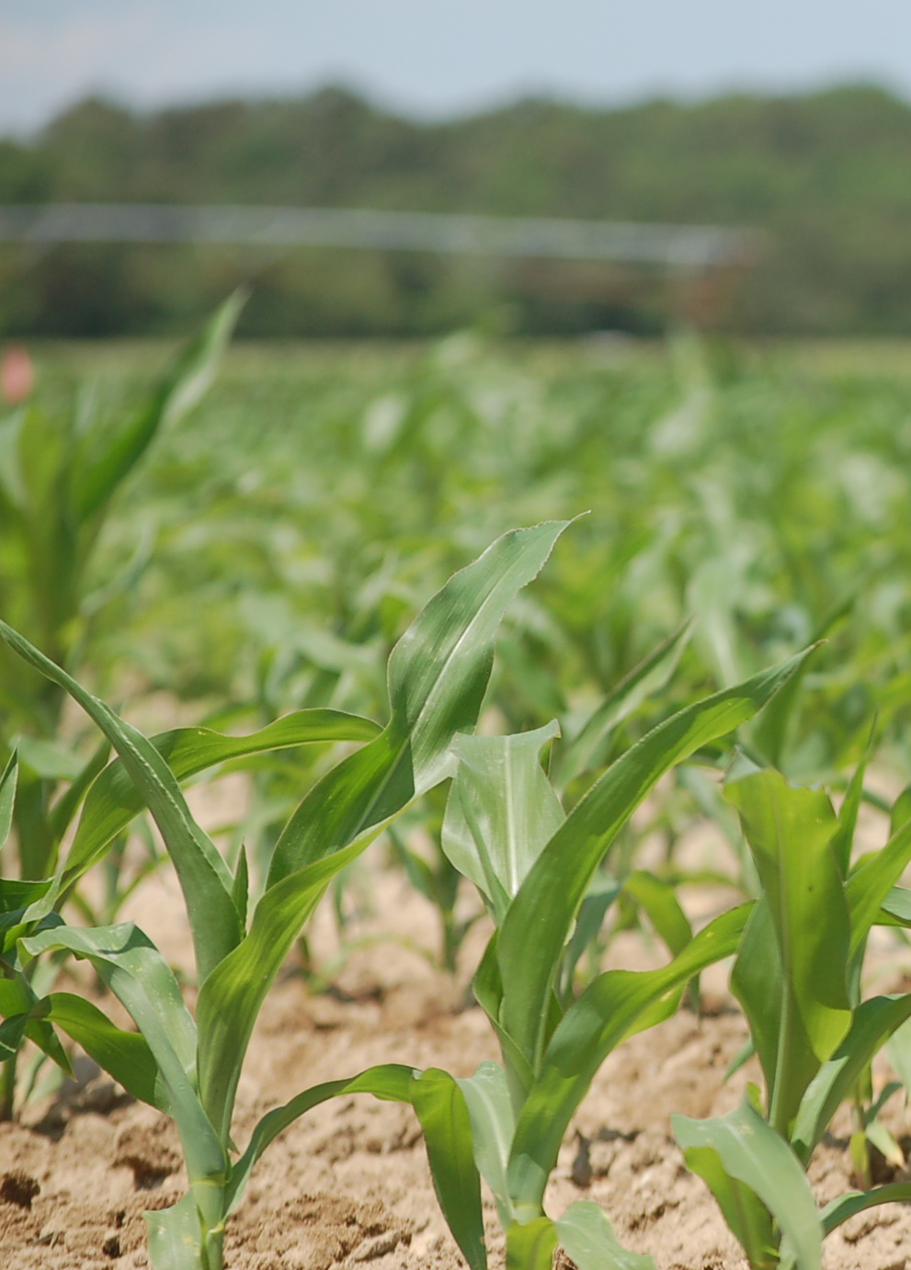
Delmarva is an Ideal Location!
550+ Million Birds
Poultry Litter
Sandy, High P Soil
Background
Notes:
Our research is focused on the Delmarva Peninsula which includes all of DE, and the Eastern Shore of MD and VA. The Delmarva Peninsula is home to a large broilers industry, or chickens produced for meat. In 2017, 605 million broilers were produced. Historically, manure from these birds was applied at N-based rates which resulted in high P soils from this “legacy P” app and can be lost from the field and end up in water ways.
Photo Sources:
https://www.hotraco-agri.com/en/project/813217934/two-new-modern-broiler-houses
http://webapps.delmarva.com/dp/your_business/territory.cfm
http://homeslandcountrypropertyforsale.com/farms/properties/4-broiler-houses-for-sale-mount-olive-covington-county-ms/
Updated broiler numbers here: https://www.dcachicken.com/facts/facts-figures.cfm

Slide 10
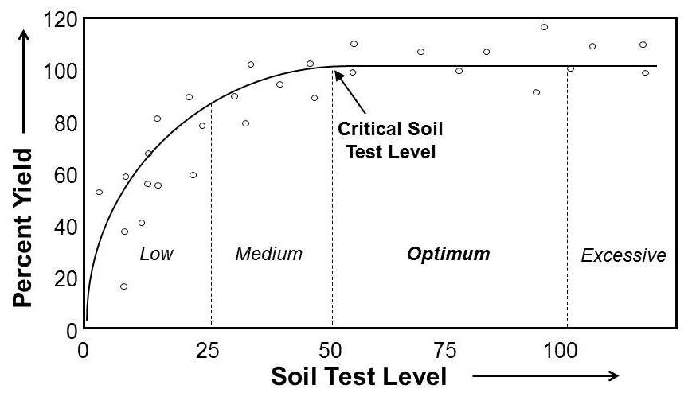
What Do We Mean by “High P” Soil?
Mehlich 3 P >150 ppm
Notes:
Here in Delaware, we use the Mehlich 3 soil test method for routine fertility testing. This figure here relates the soil test level (Mehlich 3 in FIV which for P is equivalent to mg/kg or ppm for P) to yield response. We consider the critical soil test level at 50 FIV, above which nutrient applications are statistically unlikely to result in a yield response. When nutrients are in excessive range (above 100 FIV), the nutrient is available at a level beyond crop needs and additional applications result in wasted resources, and in the case of P, can increase the risk of negative environmental impacts.

Slide 11
P-Enriched Soils from Poultry Litter
FY 2011-2015
19% above 150
29% above 150
54% above 150
(n = 2,253)

Slide 12
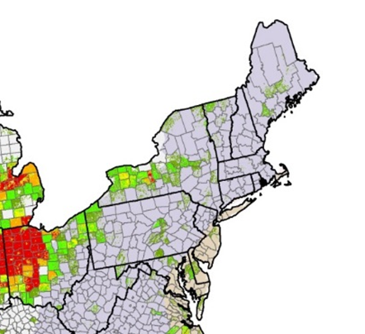
Some Areas on Delmarva are Drained
Ditch Drainage
Percent of agricultural land with drainage
Tile Drainage
0
1
4
15
25
50
100
Notes:
I am also going to discuss drainage management, as this is a conservation practices that is meant to control movement of water. My discussion of drainage management is strategic as it will describe some of the challenges, we face in the Delmarva region as drainage is a conservation practice that is widely on the Delmarva to lower the water tables and facilitate farming activities. Drainage will also be important when we look an example of conservation practice tradeoffs in the western Lake Erie basin. Plus, it appears that there is some drainage happening in Maine.

Slide 13
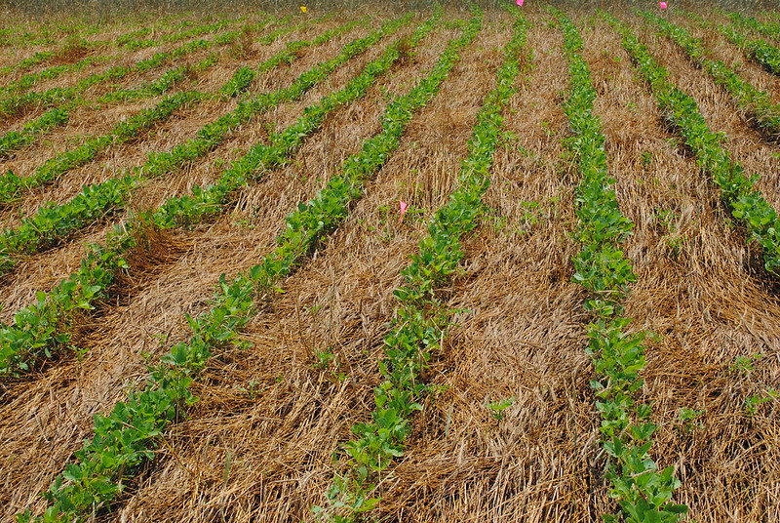
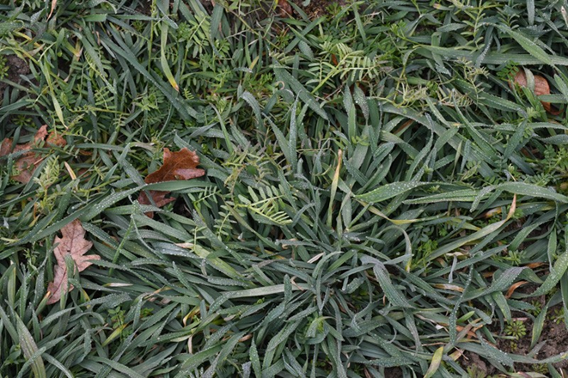
Soil Health Practices on Delmarva
Practices that are relatively inexpensive and easy to verify are prioritized
No-till
Conservation Till
Cover Crops
Photo Credits: Michele Walfred
Background
12
Notes:
Cover crops, conservation tillage and no-tillage implementation are increasing in popularity on the DP. In Delaware in 2012, 393 acres of cropland had cover crops and in 2017 490 acres of cropland had covercrops. Conservation tillage is increasing as 292 acres of cropland had reduced tillage (not including no-till) in 2012 and increased to 373 acres in 2017. CLICK: These practices provide many benefits:
Increase soil organic matter
Control erosion
Reduce nitrogen (N) losses
Reduce particulate P losses in runoff
Mitigate P losses from newly applied manure
https://www.nass.usda.gov/Publications/AgCensus/2017/Full_Report/Volume_1,_Chapter_2_US_State_Level/st99_2_0041_0041.pdf

Slide 14
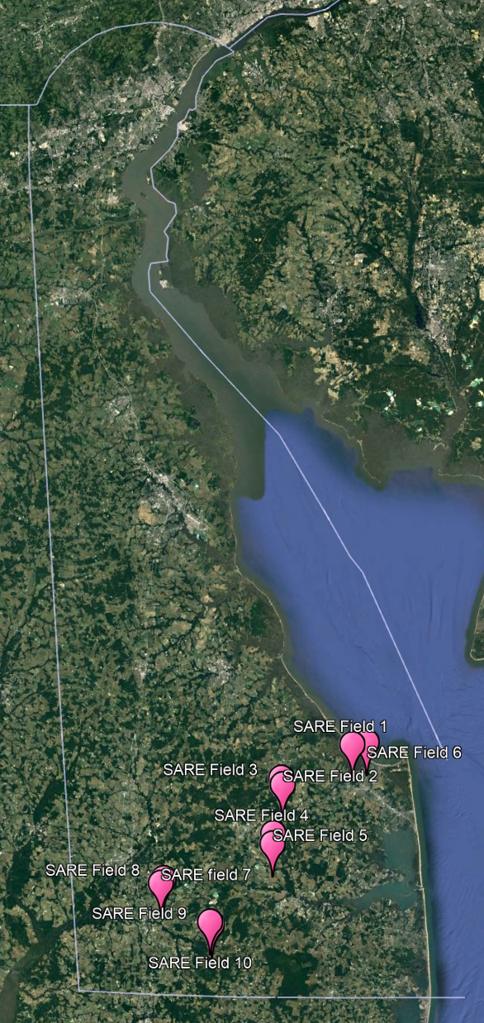
Site Selection
Five with conventional till and winter fallow
Five with up to 15 years of conservation/no-till and cover crops
Materials and Methods

Slide 15
Site Name | Tillage Management | Winter Cover | Years in Mgt | Previous Crop | Manure History
Downer | Conservation | Winter wheat | >5 | Corn (Grain) | No
Evesboro* | Conventional | Winter wheat* | >15 | Corn (Grain) | No
Henlopen | Conservation | Winter wheat | >5 | Corn (Grain) | Yes
Pepperbox-1 | Conventional | None | >15 | Corn (Grain) | No
Pepperbox-2 | Conservation | Winter wheat | >5 | Soybean | Yes
Pepperbox-3 | No-till | Winter wheat | >5 | Corn (Grain) | Yes
Pepperbox-4 | No-till | Winter wheat | >15 | Soybean | Yes
Rockawalkin | Conventional | None | >15 | Corn (Grain) | Yes
Rosedale | Conventional | None | >15 | Corn (Swt) | Yes
Woodstown | Conventional | None | >15 | Corn (Grain) | Yes
Materials and Methods

Slide 16
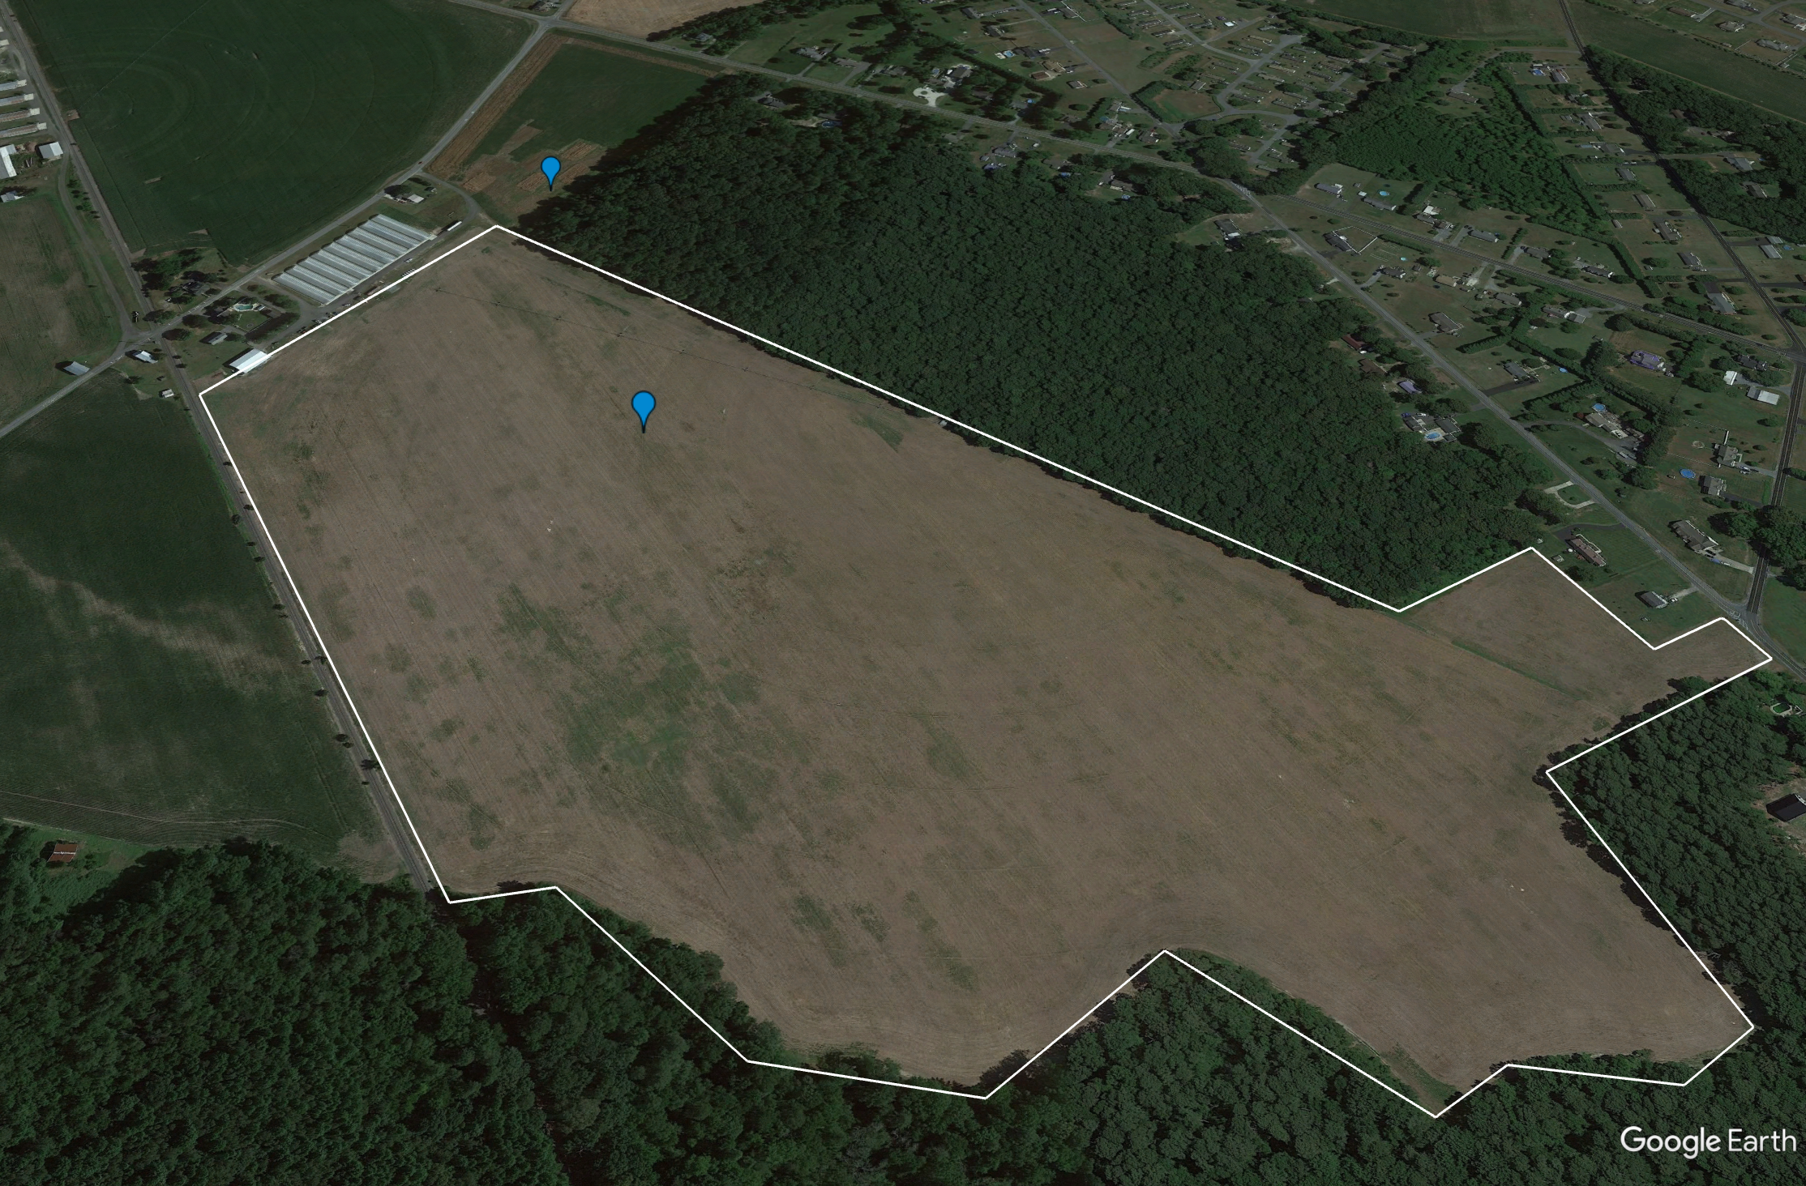
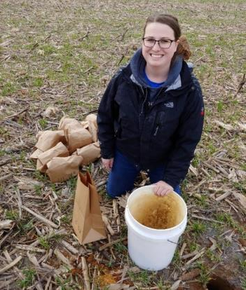
Soil Collection
Uncultivated Control
7 cores to 1-m depth at various depth increments
1 core from uncultivated area adjacent to field to 30-cm depth
Study Field
Materials and Methods

Slide 17
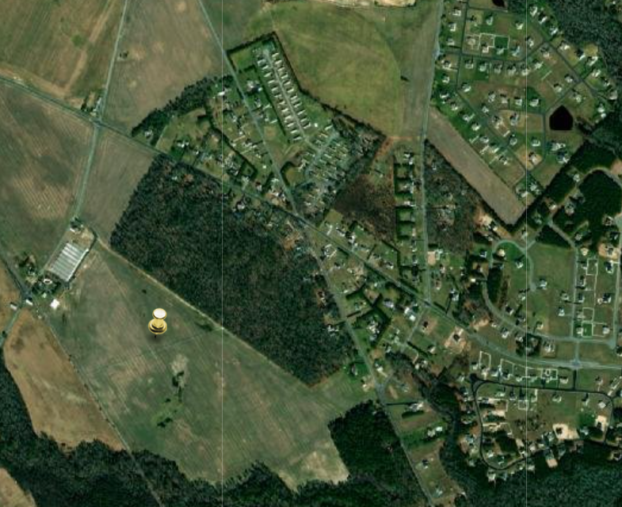
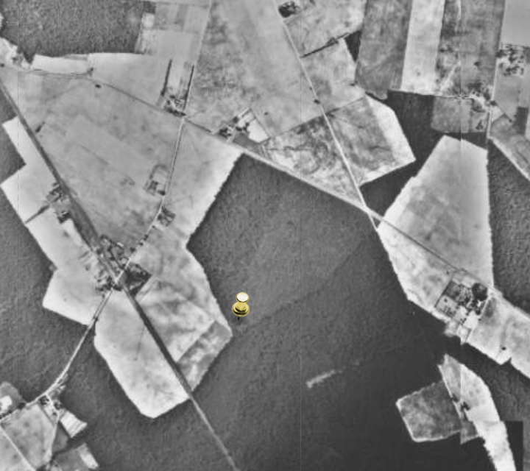
Identifying Uncultivated Controls
Now
1937

Slide 18
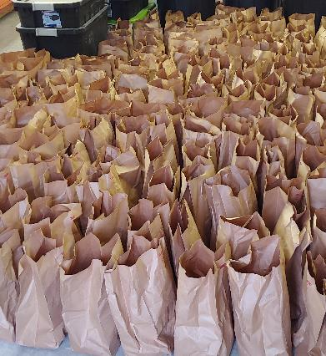
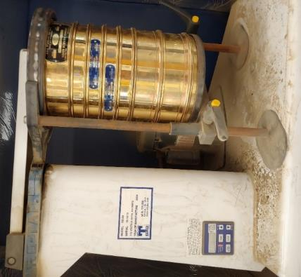
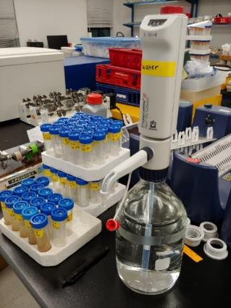
Soil Analysis
Air Dried
Mehlich 3 P
Dry Aggregate Distribution
Materials and Methods
Notes:
All soils were air dried and then analyzed for Mehlich 3 P at all depth increments. We determined the dry aggregate stability on soils at four depth increments to 25 cm. We have all the data, but we selected the Pepperbox-Rosedale soils so that we could make more valid comparisons.
Descriptive statistics with qualitative evaluation due to the small sample size.

Slide 19
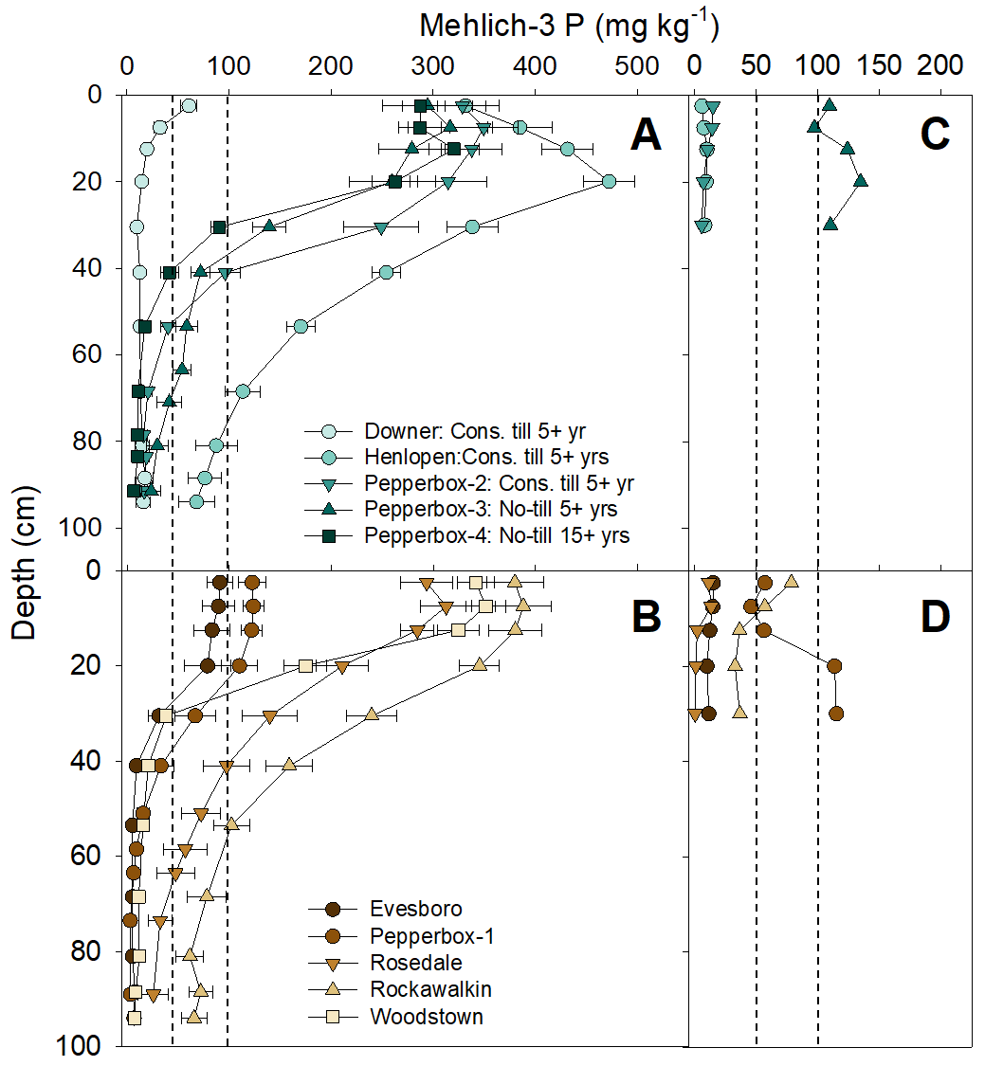
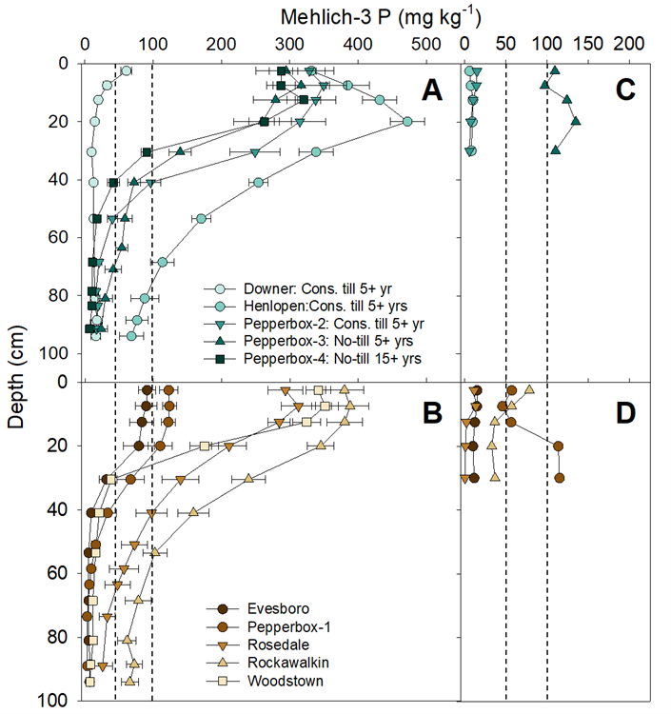
Mehlich-3 P Soil Concentrations
Mehlich-3 P (mg/kg)
Depth (cm)
No evidence for stratification in soils with high P concentrations
Results
Notes:
Mehlich-3 P concentrations in cultivated surface soils (0–15 cm) ranged from 19.7 to 431 mg kg⁻¹ (Figure 1A and B). Eight sites had surface Mehlich-3 P concentrations that were above the agronomic “optimum” (>100 mg kg⁻¹ P; Sims et al., 2002), indicating a low probability of plant response to P. Moreover, seven fields had surface Mehlich-3 P concentrations above the environmental threshold (>150 mg kg⁻¹), indicating increased risk of P losses that may impact water quality (Sims et al., 2002). Soil test P concentrations above the environmental threshold are common in the Delmarva region (Maryland Department of Agriculture, 2019). In contrast, six of seven control areas had surface (0–15 cm) Mehlich-3 P concentrations below the agronomic “optimum”, with Mehlich 3-P ranging from 0.5–78.5 mg kg⁻¹ (Figure 1C and D). “Excessive” surface Mehlich-3 P concentrations (97–134 mg kg⁻¹) in the Pepperbox-1 and -3 control areas were likely natural, as the sites remained uncultivated since 1937.
Only the no-till Downer soil, which had surface Mehlich-3 P concentrations that were below the agronomic optimum (≤50 mg kg⁻¹), showed evidence of surface P stratification (top 25-cm; Figure 1A). Surface Mehlich-3 P concentrations in the remaining fields were homogenous, regardless of management (Figure 1A and B), with little evidence to suggest that adding soil health practices increased stratification of soil P at study sites. Overall, our results contradicted published reports of surface soil P stratification in fields managed under conservation or no-till receiving surface applications of manure or fertilizers (Baker et al., 2017; Cade-Menun et al., 2015; Daryanto et al., 2017, Duiker & Beegle, 2006). Surface P stratification was also absent in the top 25-cm of the control soils, except for Pepperbox-4, which was historically disturbed (i.e., gravel mining, Figure 1C and D). We hypothesize that farmer adoption of soil health practices at our sites occurred long after initial soil P enrichment resulting in no surface soil P stratification. Delaware farms typically received N-based manure applications prior to 1999, when the Delaware Nutrient Management Act required P-based manure management when Mehlich-3 P >150 mg kg⁻¹ (Sims et al., 2002).
Five study fields (three soil health, two conventional) had elevated Mehlich-3 P concentrations (>50 mg kg⁻¹ agronomic critical level) at depths exceeding 36 cm depth; three fields had elevated Mehlich-3 P concentrations at the depth to seasonal high-water table (up to 97-cm depth based on SSURGO data; Figures 1A and B). Enrichment of soil P at depth indicates an increased risk for subsurface losses; however, subsurface P enrichment did not appear to be driven by adoption of soil health practices in our fields.

Slide 20
Mehlich-3 P Soil Concentrations
Mehlich-3 P (mg/kg)
Depth (cm)
Subsurface P accumulation in several P-enriched fields (3 soil health, 2 conventional)
Results
Notes:
Five study fields (three soil health, two conventional) had elevated Mehlich-3 P concentrations (>50 mg kg⁻¹ agronomic critical level) at depths exceeding 36 cm depth; three fields had elevated Mehlich-3 P concentrations at the depth to seasonal high-water table (up to 97-cm depth based on SSURGO data; Figures 1A and B). Enrichment of soil P at depth indicates an increased risk for subsurface losses; however, subsurface P enrichment did not appear to be driven by adoption of soil health practices in our fields.

Slide 21
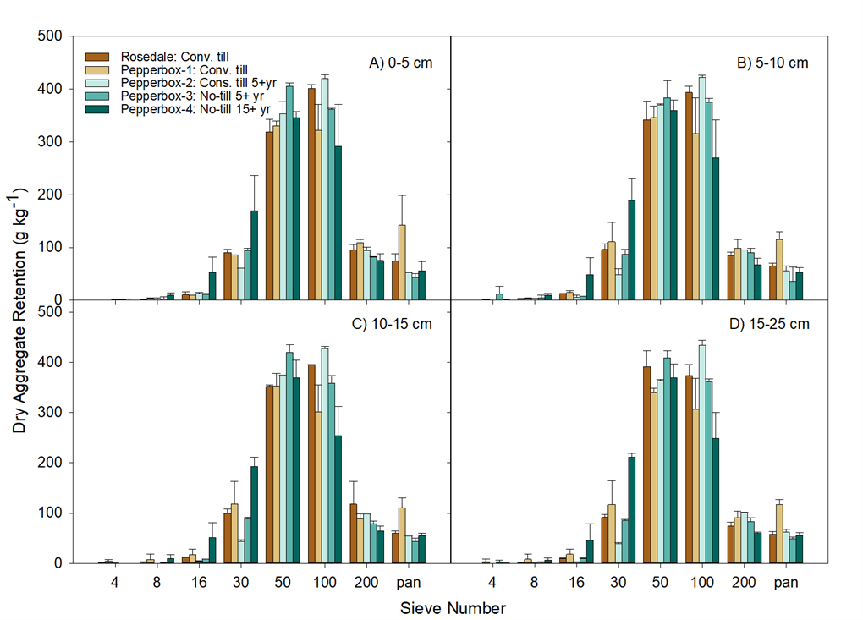
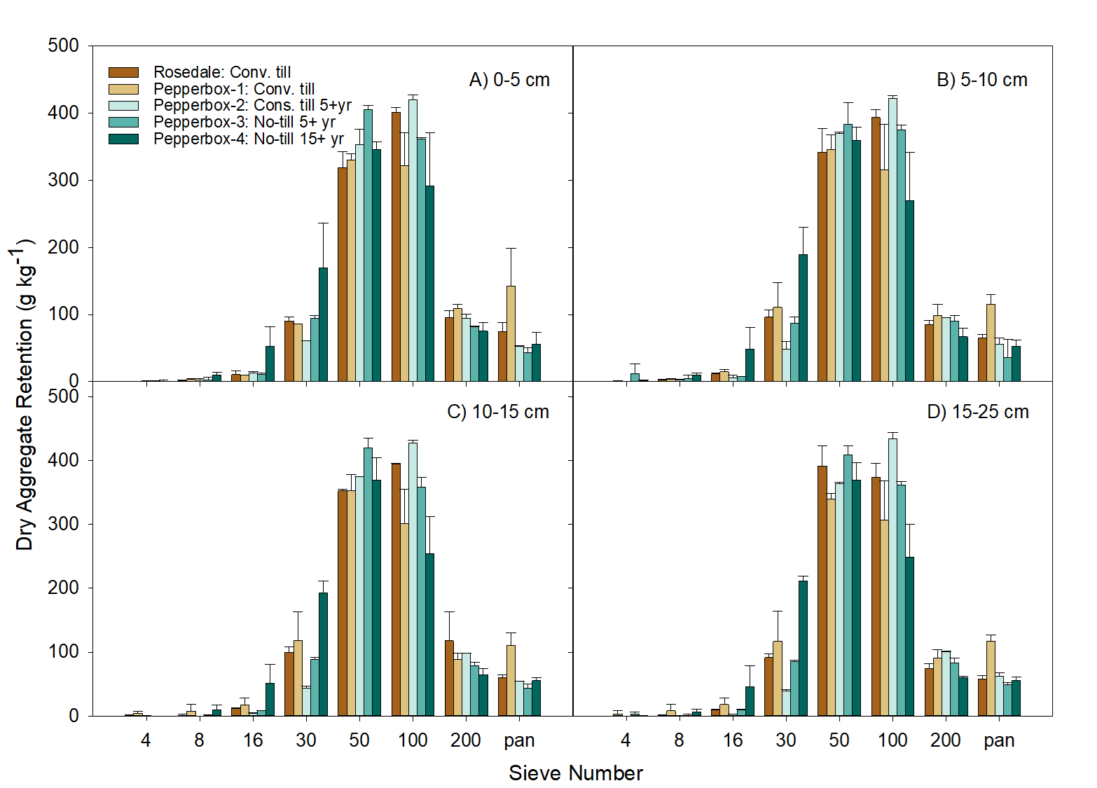
Dry Aggregate Distribution
1.6 to 15 x more soil on 16 and 30 sieves
Dry Aggregate Retention (g/kg)
Results
Notes:
All Pepperbox-Rosedale soils displayed similar dry aggregate distribution at all depths; soil was mostly retained on the 50 and 100 sieves (Figure 2). However, between 1.6 and 15 times more soil from Pepperbox-4 (>15 years no-till with cover crops) was retained on the 16 and 30 sieves than other Pepperbox-Rosedale soils at all depth increments, suggesting larger aggregates formed in the surface layers of this soil. Soils with a wider aggregate size distribution suggest the formation of preferential flow pathways (Shipitalo et al., 2000), which could increase the hydrologic connectivity and increase the risk of subsurface P loss when formed in surface soils (Vadas et al., 2007).

Slide 22
Dry Aggregate Distribution
1.6 to 15 x more soil on 16 and 30 sieves
Dry Aggregate Retention (g/kg)
Results
Notes:
All Pepperbox-Rosedale soils displayed similar dry aggregate distribution at all depths; soil was mostly retained on the 50 and 100 sieves (Figure 2). However, between 1.6 and 15 times more soil from Pepperbox-4 (>15 years no-till with cover crops) was retained on the 16 and 30 sieves than other Pepperbox-Rosedale soils at all depth increments, suggesting larger aggregates formed in the surface layers of this soil. Soils with a wider aggregate size distribution suggest the formation of preferential flow pathways (Shipitalo et al., 2000), which could increase the hydrologic connectivity and increase the risk of subsurface P loss when formed in surface soils (Vadas et al., 2007).

Slide 23
Phosphorus Risk Assessment
Considered several tools
NC P Loss Assessment Tool (PLAT)
Two scenarios
Surface/Subsurface Dissolved P
Particulate P (Erosion)
This Photo by Unknown Author is licensed under CC BY-SA-NC
Materials and Methods
Notes:
While we implement soil health and other CPs to reap their benefits, we must also acknowledge that every land management decision is not without potential consequences. It’s important to understand and acknowledge these potential tradeoffs when planning and implementing CPs. Potential tradeoffs include, a reduction in loads of one nutrient at the expense of another, a decrease in nutrient load one form but increase the load from another, or a shift in nutrient or sediment loss pathways. Plus, the potential for CP tradeoffs can vary spatially and temporally due to external factors like climate, physiographic and landscape properties, and nutrient legacies.
It is not our intention to discount the value of conservation practices by acknowledging potential tradeoffs related to P. Instead, we hope to provide information that will help land managers minimize or mitigate potential P tradeoffs associated with conservation practices. Let’s take a deeper dive to examine the potential tradeoffs associated with three conservation practices: tillage management and cover crops, which represent our soil health practices and drainage.

Slide 24
PLAT Results
0.002 kg ha⁻¹
0.016 kg ha⁻¹
Wilcoxan Sign Rank Test P = 0.002
With no-till and cover crops, predicted:
  Significant decrease in Particulate and Runoff Dissolved P
  Significant increase in Leachate P
0.77 kg ha⁻¹
1.39 kg ha⁻¹
2.93 kg ha⁻¹
2.66 kg ha⁻¹
Results
Notes:
Annual NC-PLAT estimated PP, runoff DP, and leachate DP loads under a soil health scenario (no-till and cover crops) were significantly different (P = 0.002 for all pathways) from the conventional scenario (Table 1). The NC-PLAT estimated annual PP and runoff DP loads decreased by 0.01 and 0.63 kg ha⁻¹ on average, respectively, under the soil health scenario. Conversely, estimated annual leachate DP loads were 0.28 kg ha⁻¹ higher under the soil health scenario (Table 1). However, the estimated leachate DP load increase under the soil health scenario was offset by a larger decrease in estimated runoff DP loads. Based on NC-PLAT P loss estimates, we suggest that implementing soil health practices at our 10 P-enriched field sites may decrease total P loads.

Slide 25
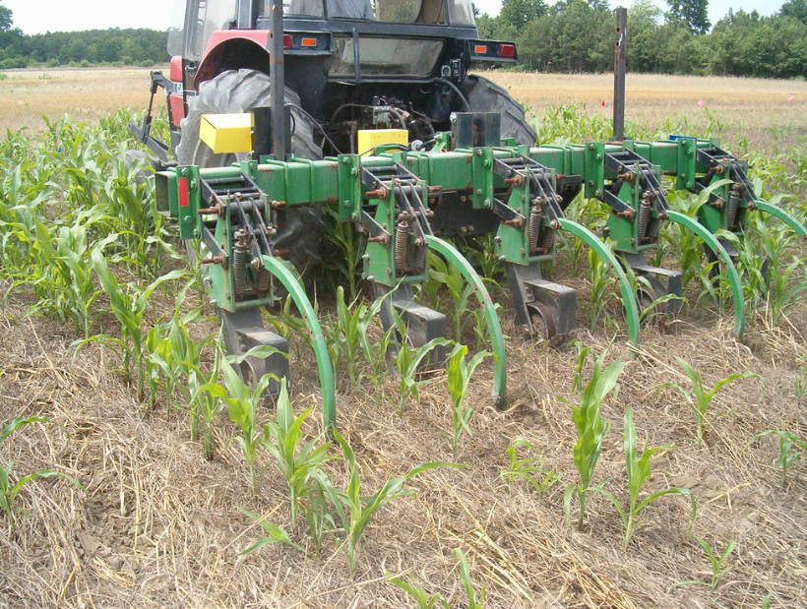
Conclusions and Implications
No evidence that adding soil health practices fields increases risk for DP losses – soils themselves are a significant source of DP
Data reflects primarily coarse-textured soils with high P from flat landscape – more research
Photo Credit: Michele Walfred
Conclusion
Notes:
We saw no evidence that adding soil health practices would significantly increase the risk for dissolved soil P losses (surface and subsurface) from soils with historical P enrichment. If anything, adopting conservation tillage or planting cover crops could reduce runoff DP losses from P-enriched soils when compared to conventional tillage and winter fallow. Yet, evidence of surface P stratification at one site with “optimum” Mehlich-3 P concentrations supports the potential for P tradeoffs when P loss risk from surface soils is “low” at the time of soil health practice adoption). Our results reflect a very small dataset (n = 10) consisting of primarily coarse-textured, high P soils from flat landscapes. Data from additional fields that reflect a wider variety of soil textures, P enrichment status, landscape positions, and cropping systems should be paired with water quality data to quantify the potential for soil health management to impact P loss risk.

Slide 26

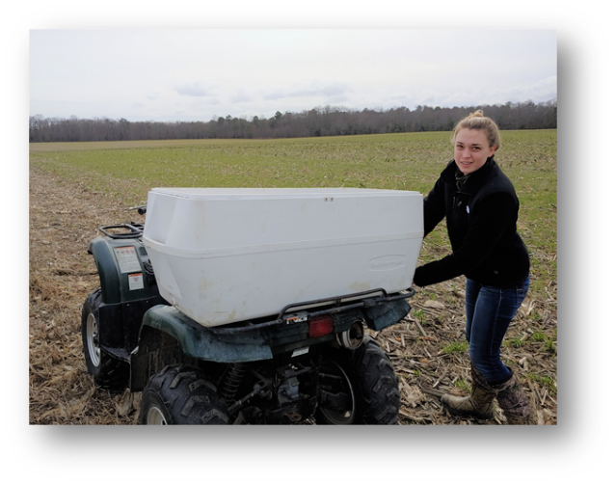
Questions?
Funded by Northeast SARE GNE19-210-33243
Thank you to:
  Shawn Tingle
  Jamie Taraila
  Joe Paller
  Chander Lekha
  Jo Ann Payne
  Riss Hardcastle
  Karen Gartley
  Participating farmers
Conclusion

Slide 27
Phosphorus Risk Assessment
Show the different in the different pathways and a tool that we can use to calculate the load for all
Used field measurements to evaluate two scenarios: No-till with winter CC, Convent till with winter fallow (photos)
PLAT gives us edge of field P load estimates for 3 pathways
Used Wilcoxan sign rank test to determine differences between scenarios

Slide 28
Study Goals and Objectives
Soil health tradeoffs in P enriched soils?
Evaluated soil P stratification and dry aggregate stability in fields
Conventional Tillage
Conservation Till
Photo Credits: Michele Walfred
Background
Notes:
To our knowledge, no studies have investigated the potential for P stratification and formation of preferential flow pathways from implementing soil health practices like conservation tillage and cover crops on soils with elevated soil test P concentrations. In this study, we evaluated soil P stratification and dry aggregate stability in fields with a history of PL application and with a range of soil health practice implementation.
We expected that fields with long-term soil health practices would have P stratified in topsoil (b/c no or minimal tillage mixing applied P into soil) and start to see the formation of preferential flows (tillage breaks these up and cover crop roots can promote these too).
Lastly, we estimated annual particulate, runoff, and leachate P loads from each site using the NC P Loss Assessment Tool (NC-PLAT) under two scenarios assuming no P additions: 1) no-till corn and full season soybean with winter cereal cover crop and 2) conventional tillage corn and soybean with winter fallow.

Slide 29

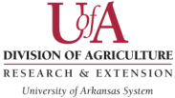
Phosphorus Loss Pathways
Soil erosion & particulate P
Release of
soil P dissolved P
P leaching
is small
Total P
Tile flow
Crop P harvest
Subsurface
flow
Soil P immobilization – Al, Fe, Ca
Notes:
Controlling P losses from the landscape can be challenging because of the way it behaves and potentially moves in the environment. I think it is useful to review the P cycle to describe how P behaves in the environment.
In many environments, concentrations of P in the soil are quite low and when we apply P fertilizers or manure to soil, it is easily fixed by Fe, Al, or Ca minerals that are present in the soil. Fixation occurs very quickly and is enhanced by processes like tillage that increase contact between the P fertilizers and the soil. If a large portion of P is fixed, then it will remain in soils and only a small amount of applied P will be taken up by the crop and removed from the site in the harvested crop. In soils with high P fixation potential, growers may choose to band P fertilizers to reduce that soil to fertilizer contact to keep P more soluble.
The portion of P that remains fixed to the soil has the potential to be lost from the site as particulate P in erosion events. Phosphorus can also be lost as dissolved P in runoff events. The risk of P loss is higher when soils are enriched with P, as Lauren will discuss when she describes soil P status on the Delmarva due to historical application of poultry litter at N-based rates.
In general, P leaching and subsurface transport of P is relatively minor. However, the presence of artificially drainage or preferential flow pathways can lead to P losses in leachate or subsurface lateral flow.

Slide 30
Site Selection and Soil Collection
Seven cores from each field to 1 m
Materials and Methods
Notes:
Identified 10 fields ranging from with 0 to 15 years of soil health practices (no-tillage, conservation till, and/or cover crops). Zero years considered our control and referred to as “conventionally tilled fields.”
All fields had grain crop rotation. In Jan 2020, took seven cores from each field (0 to 0.97 m depth) and divided into depth increments (ranging from 5 to 15 cm). Smaller increments near surface and above and below seasonal high water table. Ground was frozen! BRRRRR

Slide 31
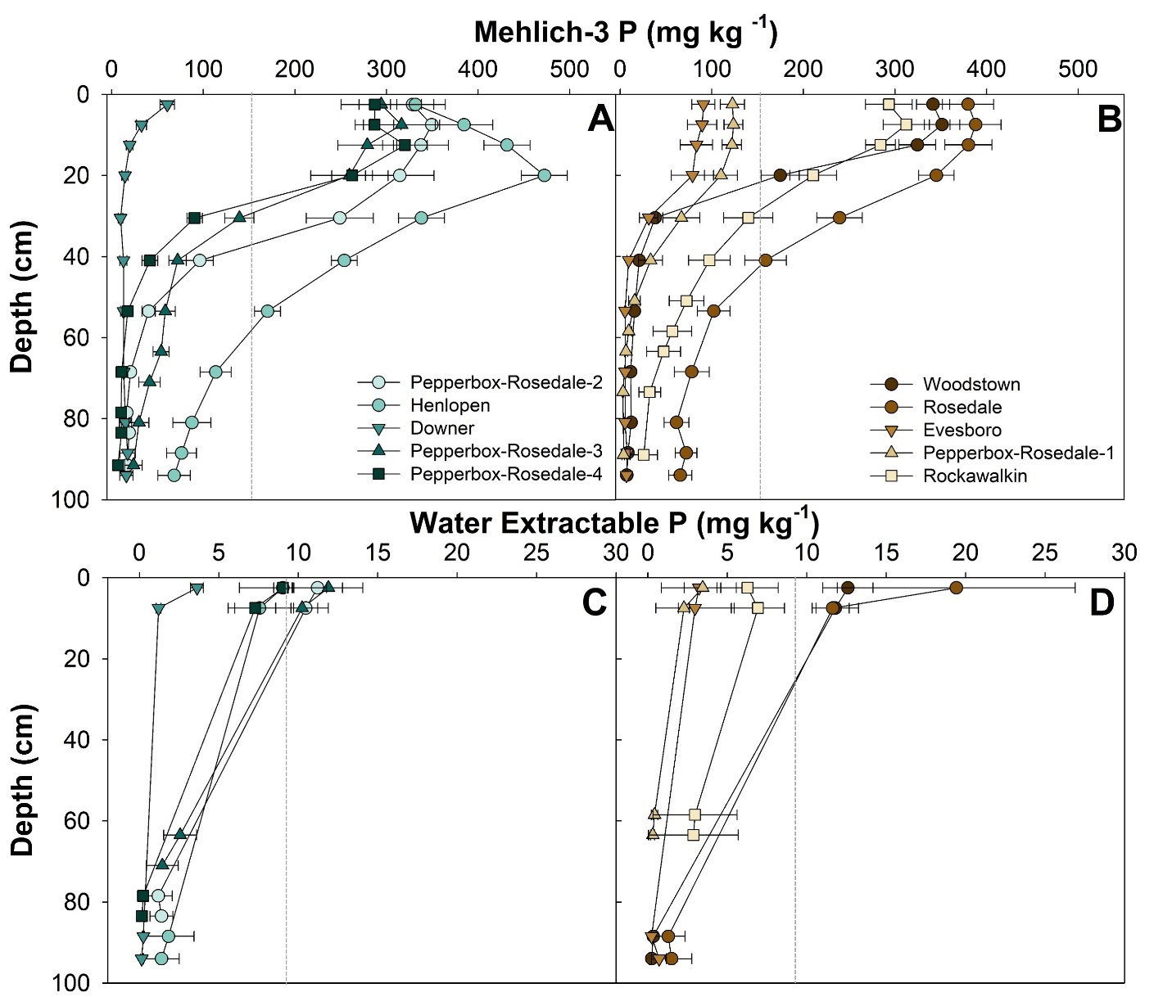

P Characterization: Mehlich-3 P
Soil health practices did not increase stratification in soils with high P concentrations
Soil Health
Conventionally Tilled
Results
Notes:
For the sake of time, I will just show you our M3P data. Seven of our fields (both soil health and conventional) had surface Mehlich-3 P concentrations above the environmental threshold and considered high P soils (>150 mg kg-1 P). We saw no difference and no stratification of P in the topsoil between conventional and soil health fields. However, one field, with M3P below the agronomic optimum (50 mg/kg P) showed evidence of P stratification. We saw a similar pattern with our WEP not shown here.
Mehlich-3 P concentrations in the top 25 cm of the remaining fields were homogenous at all other sites, regardless of soil health practices, showed little evidence to suggest that implementation of soil health practices was increasing stratification of soil P in these fields. Contradicts those of past researchers who did find stratification in surface layers of fields managed under conservation or no-till. The lack of P stratification in our study may be due to the adoption of these soil health practices years after soils were already enriched with P from historical manure applications prior to the requirement for P-based manure management with the 1999 Delaware Nutrient Management Act

Slide 32
P Characterization: Mehlich-3 P
Soil health practices did not increase subsurface P accumulation and leaching potential
Soil Health
Conventionally Tilled
Results
Notes:
Five of the seven fields (three soil health, two conventional) with “excessive” surface Mehlich-3 P concentrations also had Mehlich-3 P concentrations within the agronomic optimum range (50–100 mg kg⁻¹) at the 36–49 cm depth (Figure 1a); three of these seven fields (one soil health) had Mehlich-3 P concentrations >50 mg kg⁻¹ at the depth to seasonal high water table (up to 97 cm depth). Enrichment of soil P at depth indicates an increased risk for subsurface losses; however, subsurface P enrichment did not appear to be driven by adoption of soil health practices in our fields. Three soils (two soil health) had PSR values above the environmental threshold at a depth of 36 cm, providing evidence of P leaching.

Slide 33
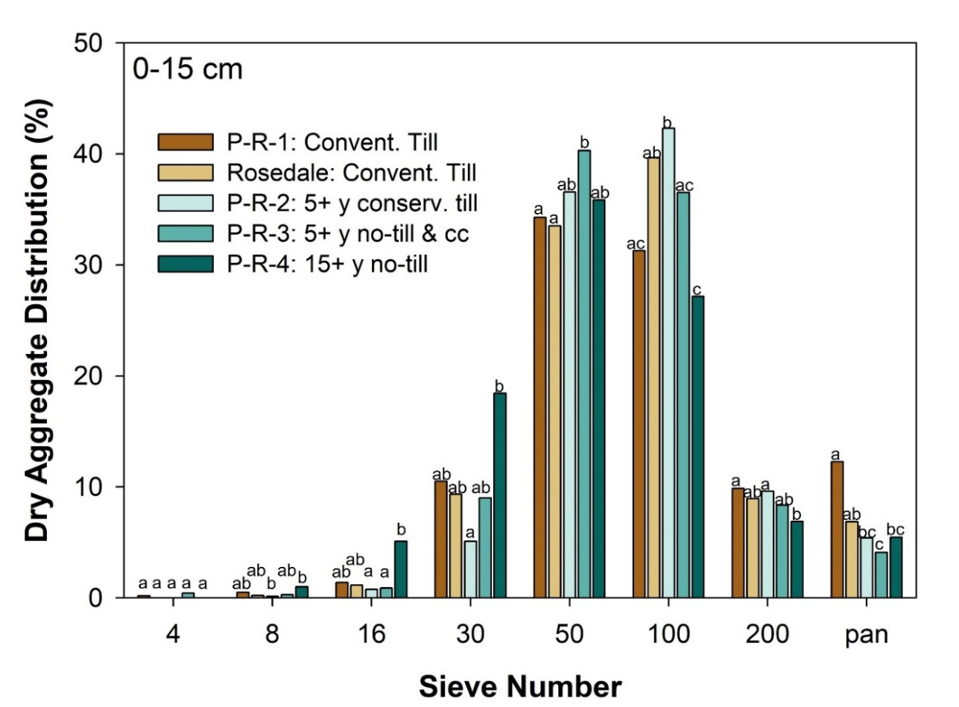
Dry Aggregate Stability
Evidence of larger aggregate formation in field with 15+ years no-tillage
Results
Notes:
We compared fields of varying soil health implementation from only the Pepperbox-Rosedale soil series to minimize changes in aggregate size due to different soil types. All Pepperbox-Rosedale soils displayed a similar dry aggregate distribution within each sieve size. Surface soils from Pepperbox-Rosedale-4 (managed for >15 years in no-till with cover crops) had nearly twice the aggregates retained on the 8, 16, and 30 sieves (9.94, 50.9, and 184 g kg-1) than other Pepperbox-Rosedale soils (mean = 2.87, 10.4, 84.8 g kg-1), suggesting larger aggregates formed in this soil. Soils with a wider aggregate size distribution suggest the formation of preferential flow pathways (Shipitalo et al., 2000), which could increase the hydrologic connectivity and increase the risk of subsurface P loss (Vadas et al., 2007).

Slide 34
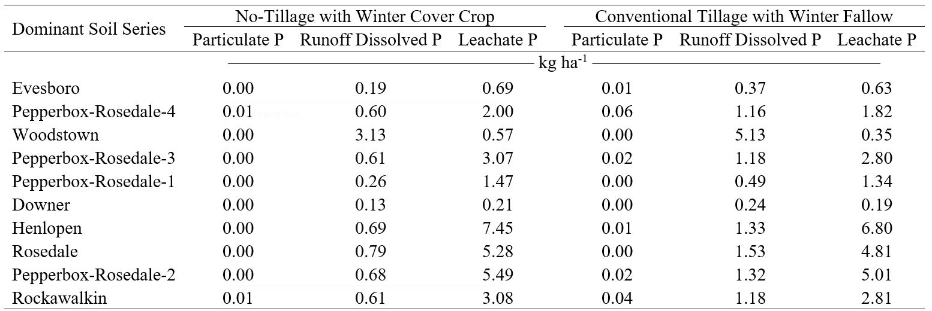
P Risk Assessment with NC-PLAT
Scenario 1
Scenario 2
Mean =
0.002 kg ha⁻¹
Mean =
0.77 kg ha⁻¹
Mean =
2.93 kg ha⁻¹
Mean = 0.016 kg ha⁻¹
Mean =
1.39 kg ha⁻¹
Mean =
2.66 kg ha⁻¹
Results
Notes:
The NC-PLAT estimated annual particulate P and runoff DP loads decreased on an average of 0.02 and 0.63 kg ha⁻¹, respectively, under no-till and cover crops (vs. winter fallow and conventional tillage). Conversely, annual leachate P loads were 0.28 kg ha⁻¹ higher with cover crops and no-tillage than conventional tillage and no cover crop. Although leachate P loads increased under no-tillage and winter cover crops. this tradeoff was minimal as NC-PLAT load estimates showed reduced runoff DP loads with soil health practices. Assuming NC-PLAT accurately estimates P loss potential from our fields, implementing soil health practices at our P-enriched field sites should not increase total P loads; instead, may slightly decrease total P loads. We do need more data from other fields to determine if the potential for increased leachate P loads would offset a decrease in particulate and runoff DP loads from P-enriched fields with soil health practices.

